Slide 1
2023 ROUND ROBIN EXERCISE
Working Group (Commission I) Radiolytic alteration of the organic matter in coal
and rocks enriched in radioactive minerals
Tatiana Larikova, Ivana Sýkorová

Slide 2
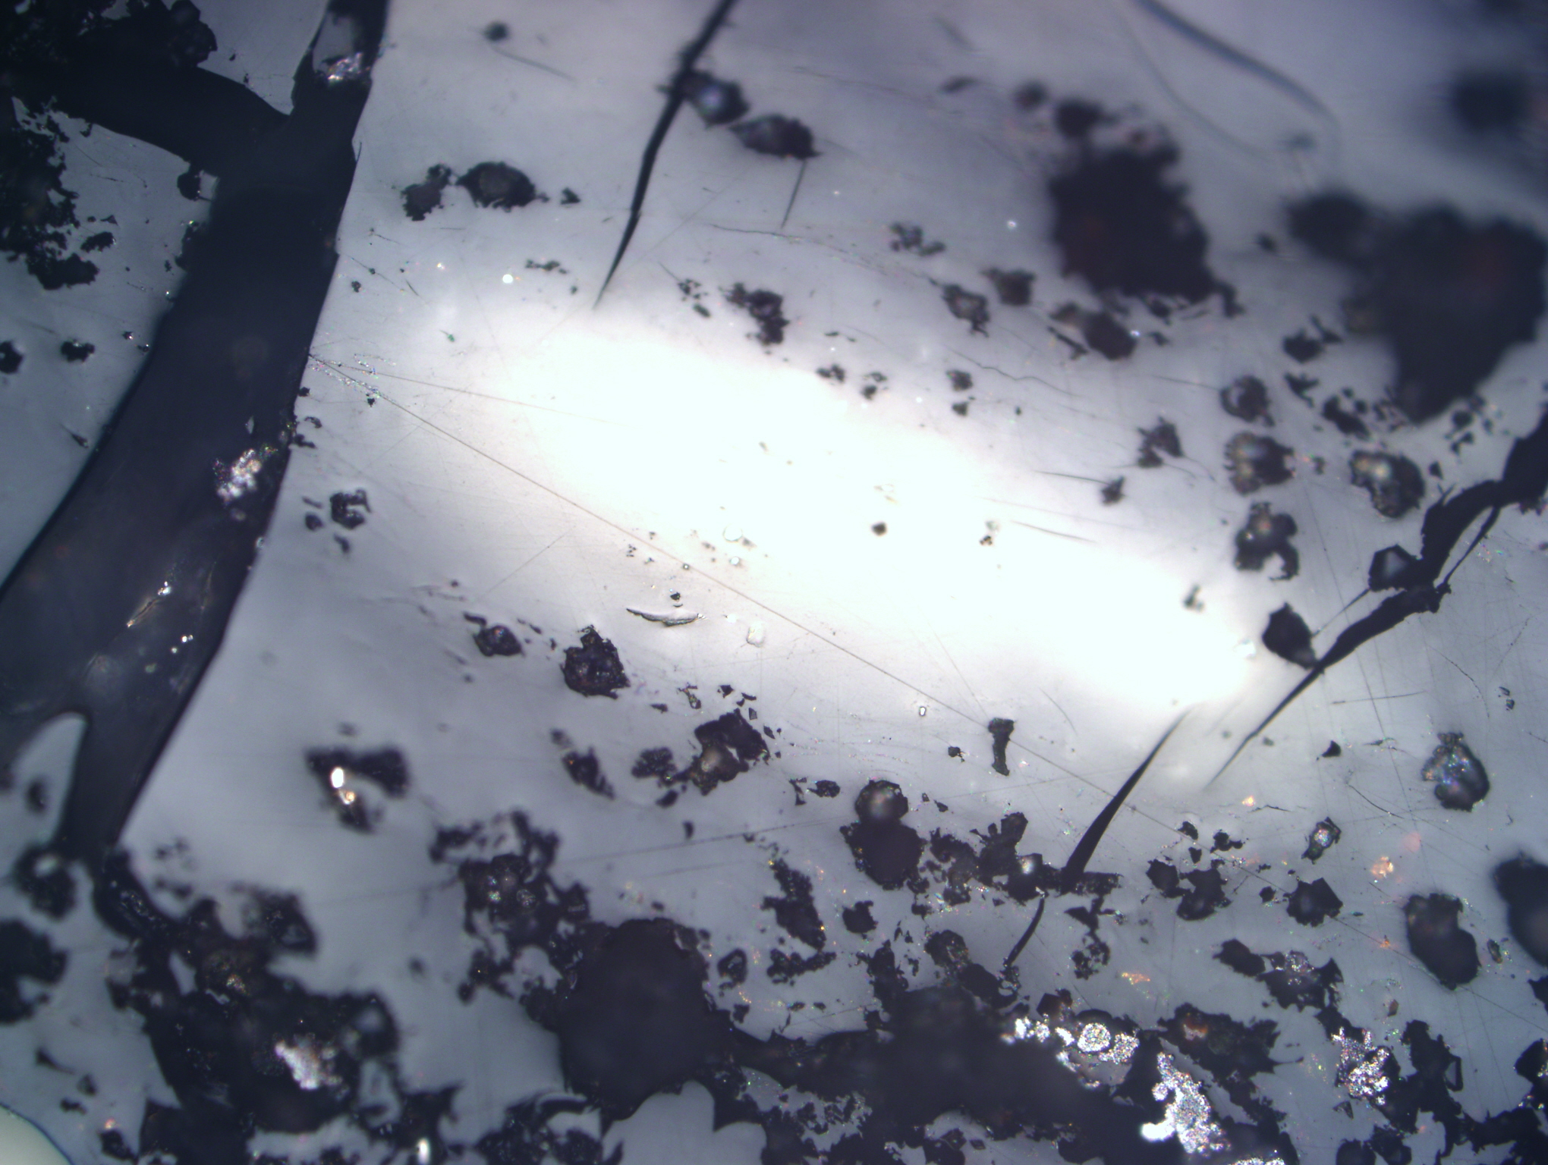
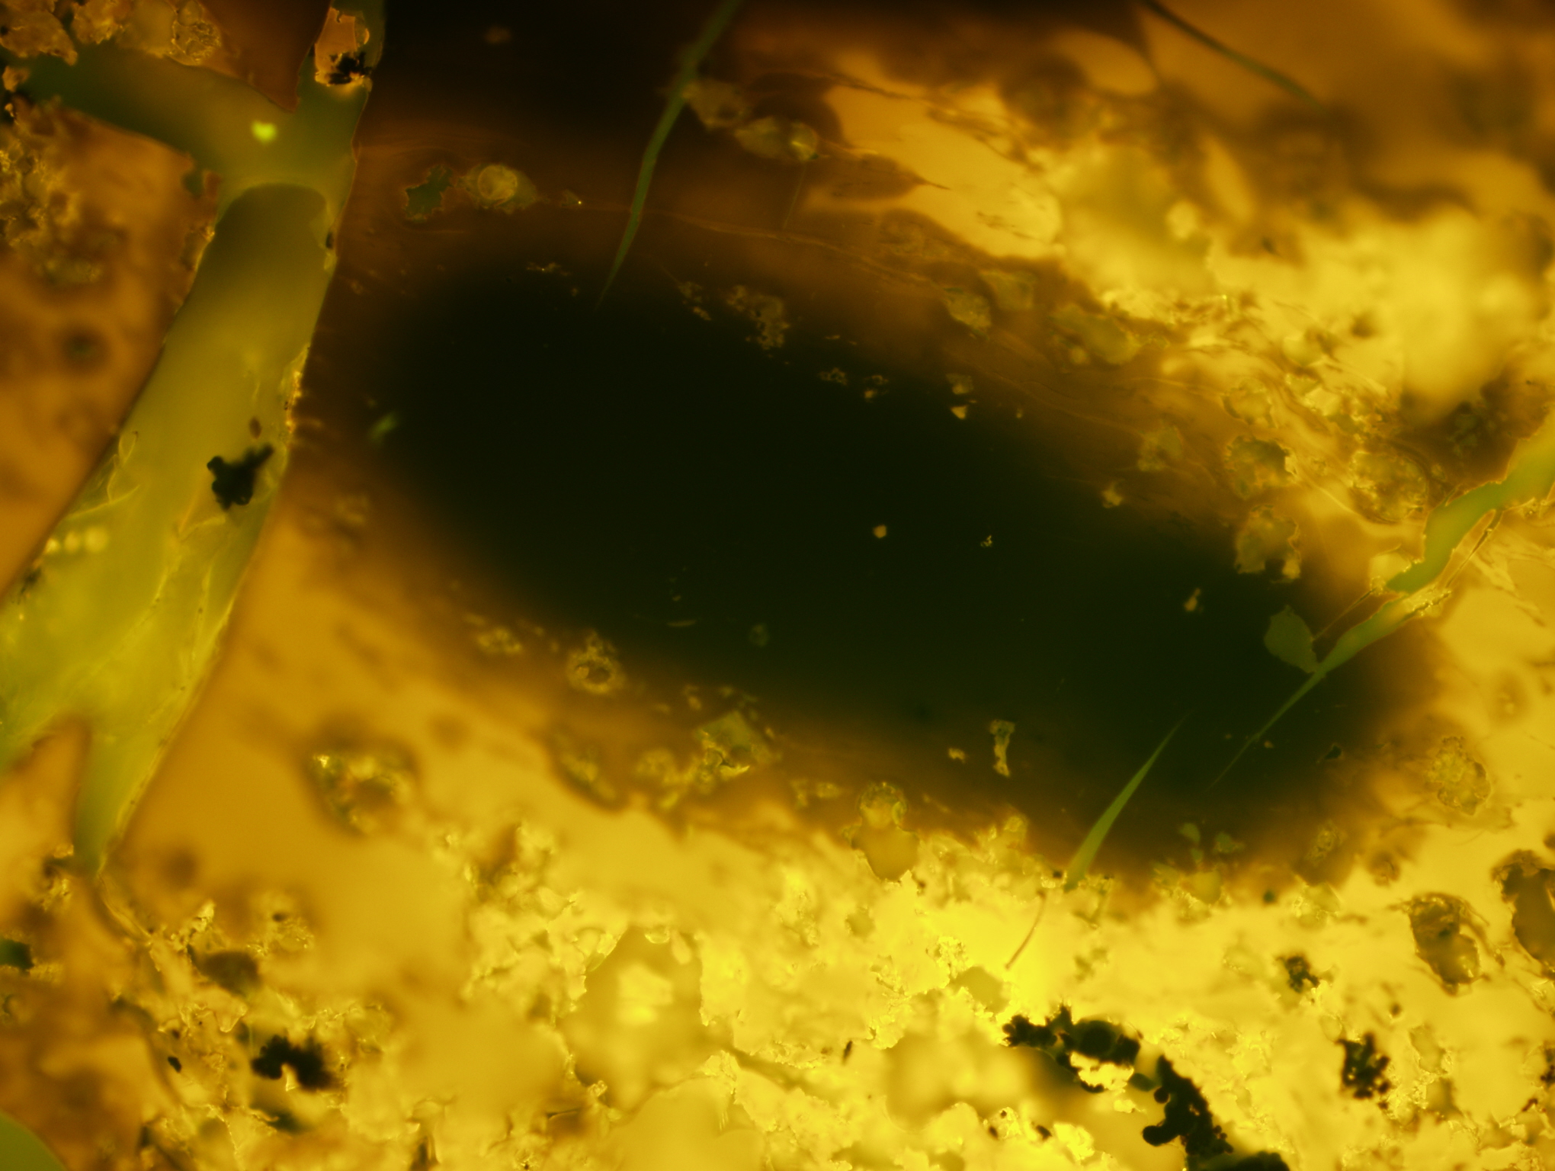
Photo 1: Uranium content 29 364 ppm; Bitumen reflectance Rb = 0.66%; Reflectance of altered bitumen Rab = 3.24%;
A
A
B
B

Slide 3
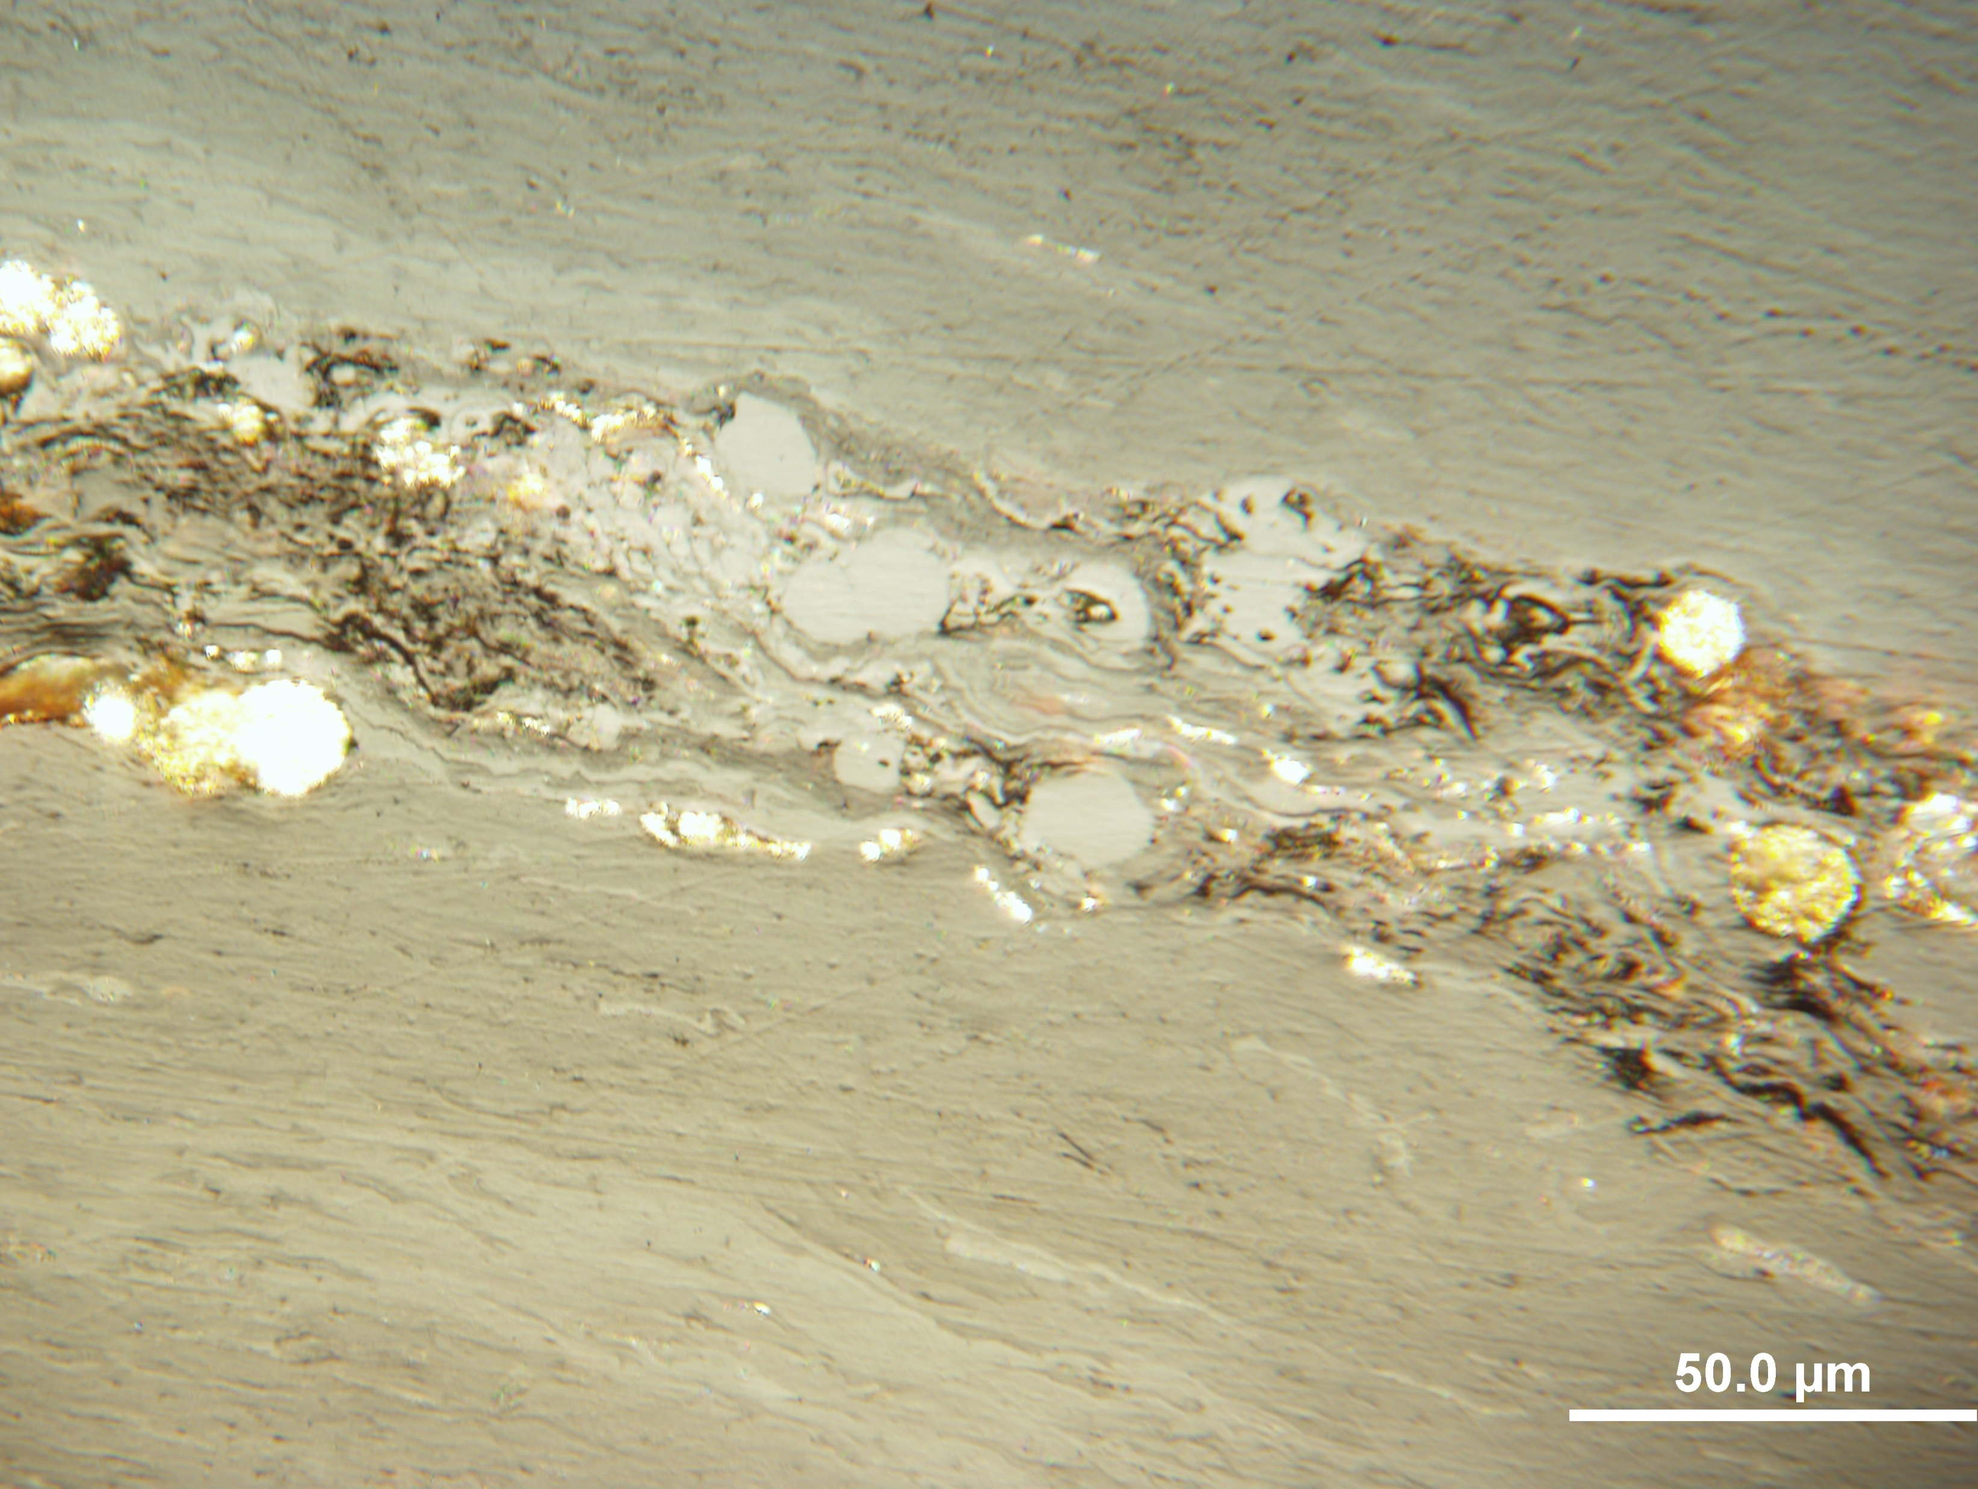
Photo 2:
Uranium content: 534 ppm; Huminite reflectance Rr = 0.30%; Reflectance of altered huminite Rah = 0.44 %;
A
B

Slide 4
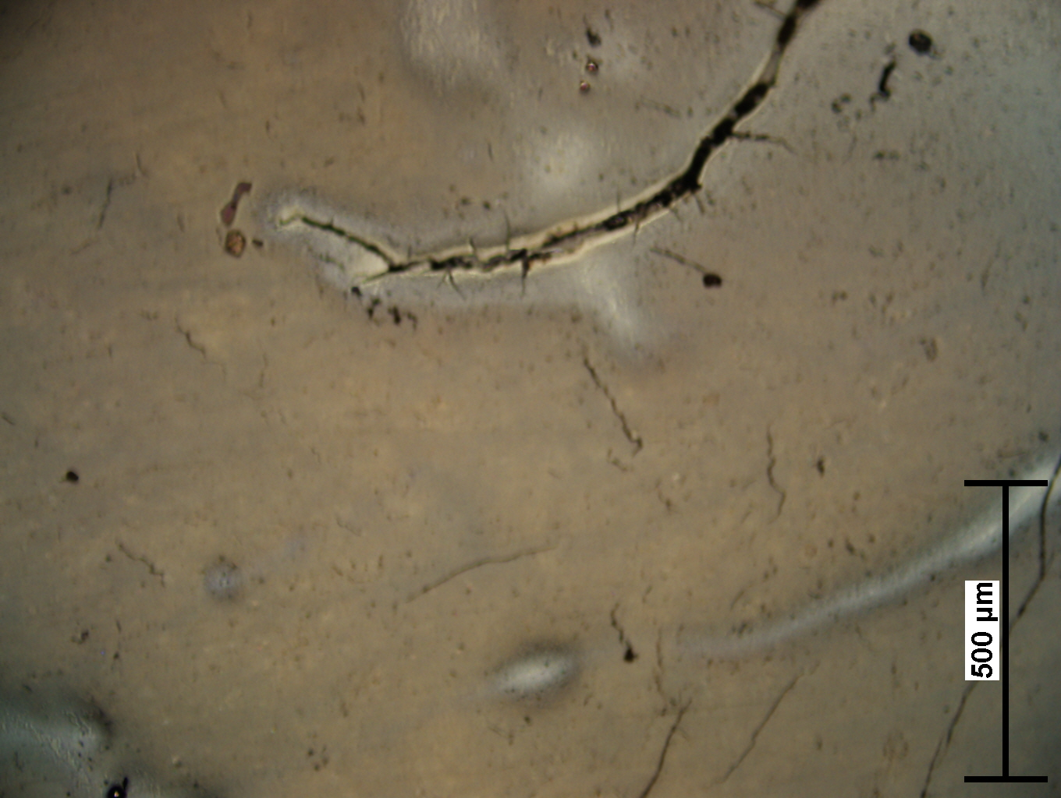
Photo 3: Uranium content 14 725 ppm; Resinite reflectance Rr = 0.17%; Reflectance of altered resinite Rar = 0.33 %
A
B

Slide 5
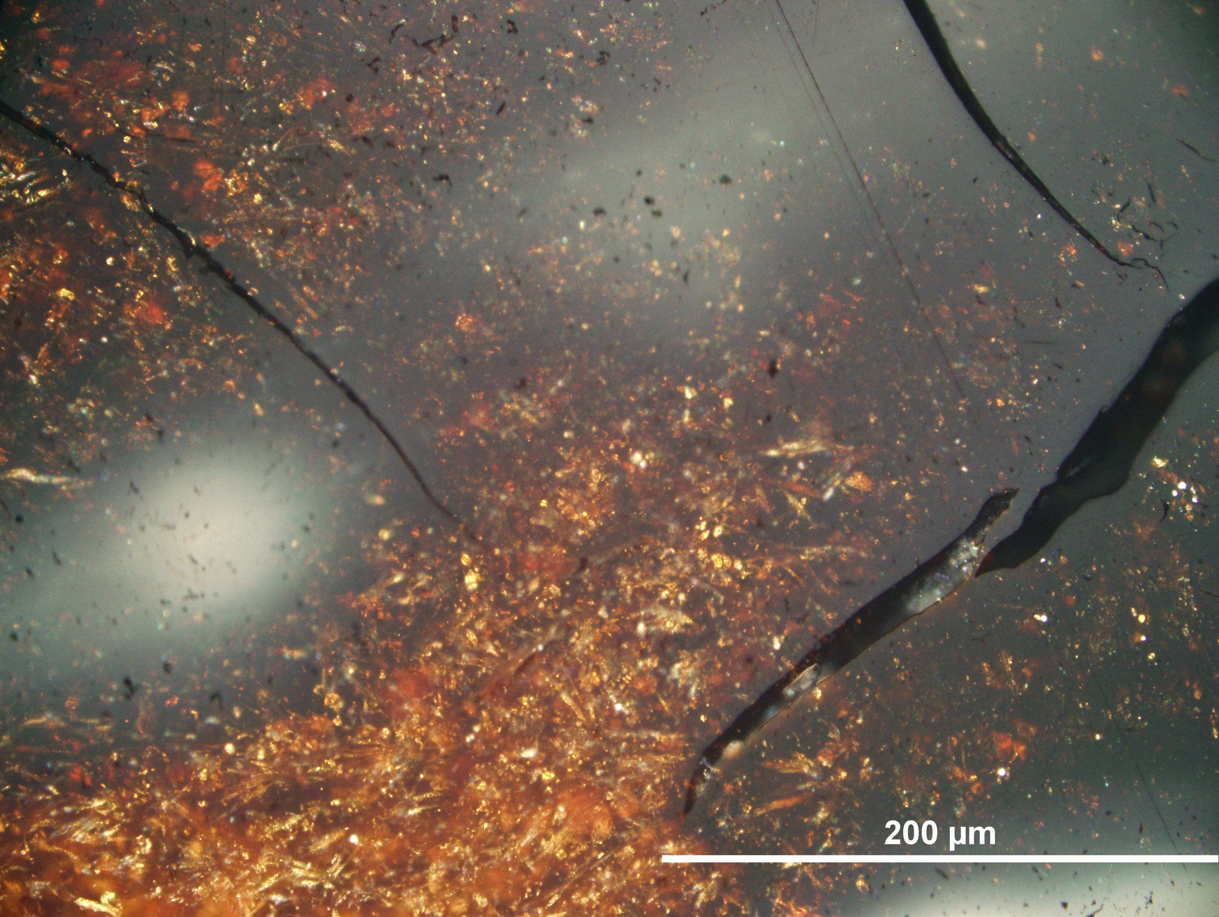
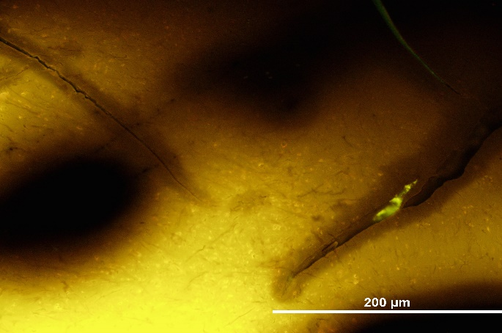
Photo 4: Uranium content 14 725 ppm; Resinite reflectance Rr = 0.10% reflectance of altered resinite Rar = 0.33 %
A
A
B
B
C
C

Slide 6
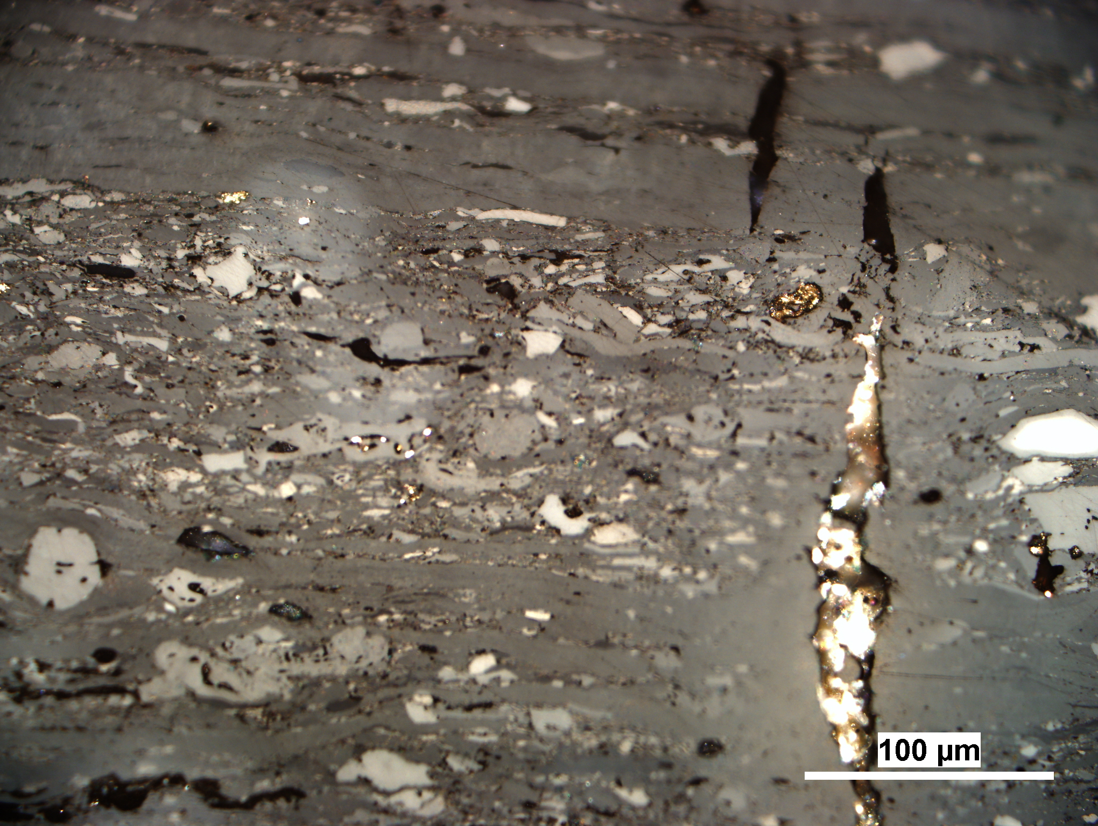
Photo 5: Uranium content 1 278 ppm; Vitrinite reflectance Rr = 0.80%; Reflectance of altered vitrinite Rav = 1.20%
A
B

Slide 7
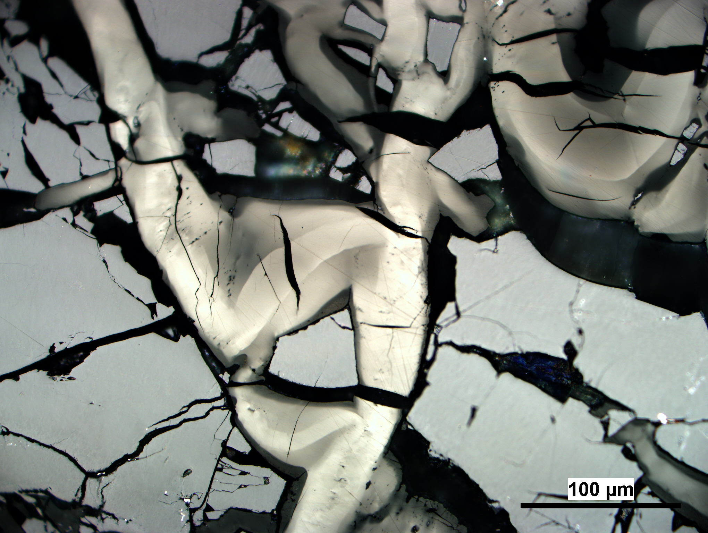
Photo 6 Uranium content 28 527 ppm; Bitumen reflectance Rb = 0.67%; Reflectance of altered bitumen:
ø weak Rwb = 1.22% and ø strong Rsb = 3.05%
A
B
C

Slide 8
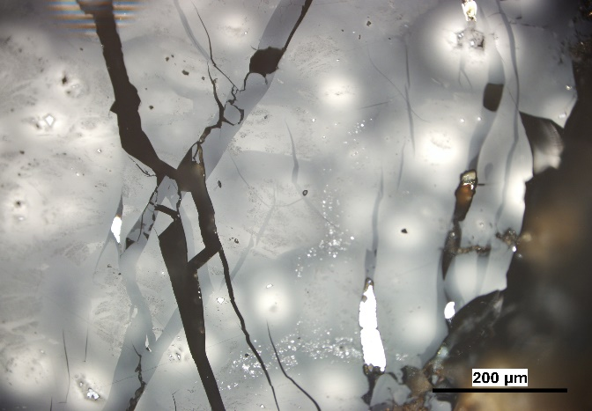
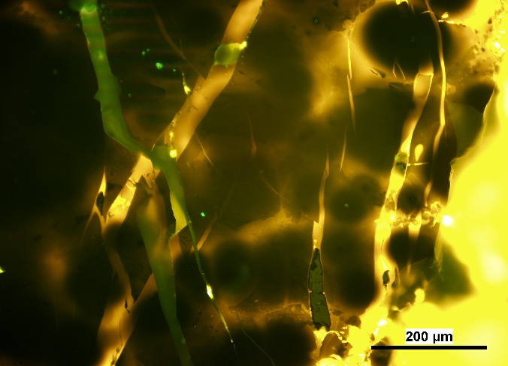
Photo 7 Uranium content 34 515 ppm; Bitumen reflectance Rb = 0.66%; Reflectance of altered bitumen:
ø weak Rwb = 1.24% and ø strong Rsb = 3.65%
B
B
A
A
C
C

Slide 9
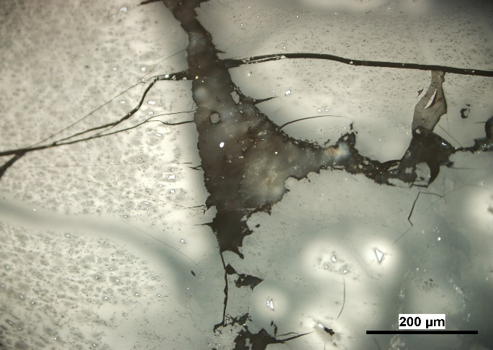
Photo 8 Uranium content 34 515 ppm; Bitumen reflectance Rb = 0.66%; Reflectance of altered bitumen:
weak ø Rwb = 1.24% ; strong ø Rsb = 3.65%
D
A
C
B

Slide 10
Photo 9: Uranium content 1 278 ppm; Vitrinite reflectance Rr = 0.80%; Reflectance of altered vitrinite Rav = 1.20%
A
B

Slide 11
Photo 10: Uranium content 34 515 ppm; Bitumen reflectance Rb = 0.66%; Reflectance of altered bitumen:
weak ø Rwb = 1.24% ; strong ø Rsb = 3.65%
A
B

Slide 12
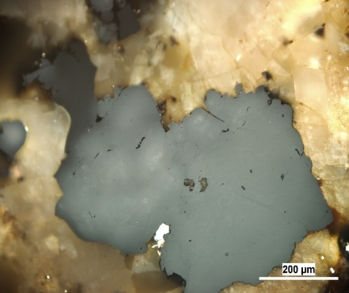
Photo 11 Uranium content 25 455 ppm; Bitumen reflectance Rb = 0.54%; Reflectance of altered bitumen:
weak ø Rwb = 0.92% ; strong ø Rsb = 2.74%
A

Slide 13
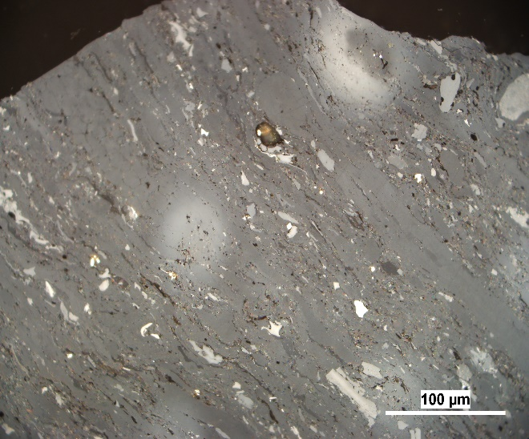
Photo 12: Uranium content 1 176 ppm; Vitrinite reflectance Rr = 0.74%; Reflectance of altered vitrinite Rav = 1.10%
A
B

Slide 14
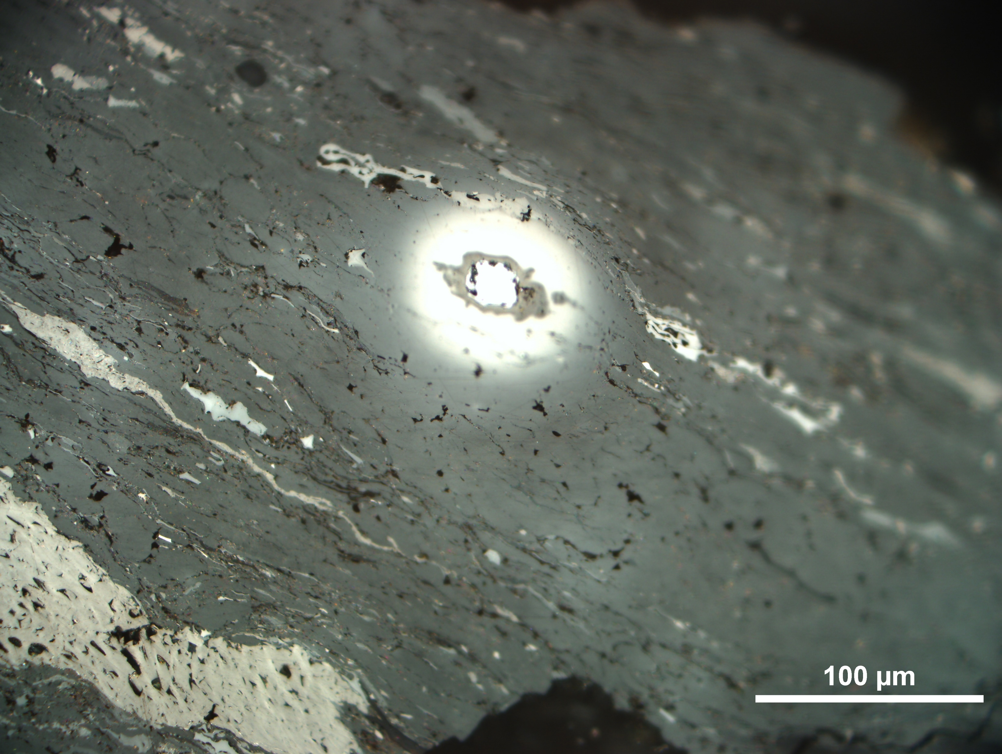
Photo 13: Uranium content 1 176 ppm; Vitrinite reflectance Rr = 0.74%;
Reflectance of altered vitrinite Rav = 2.89%

Slide 15
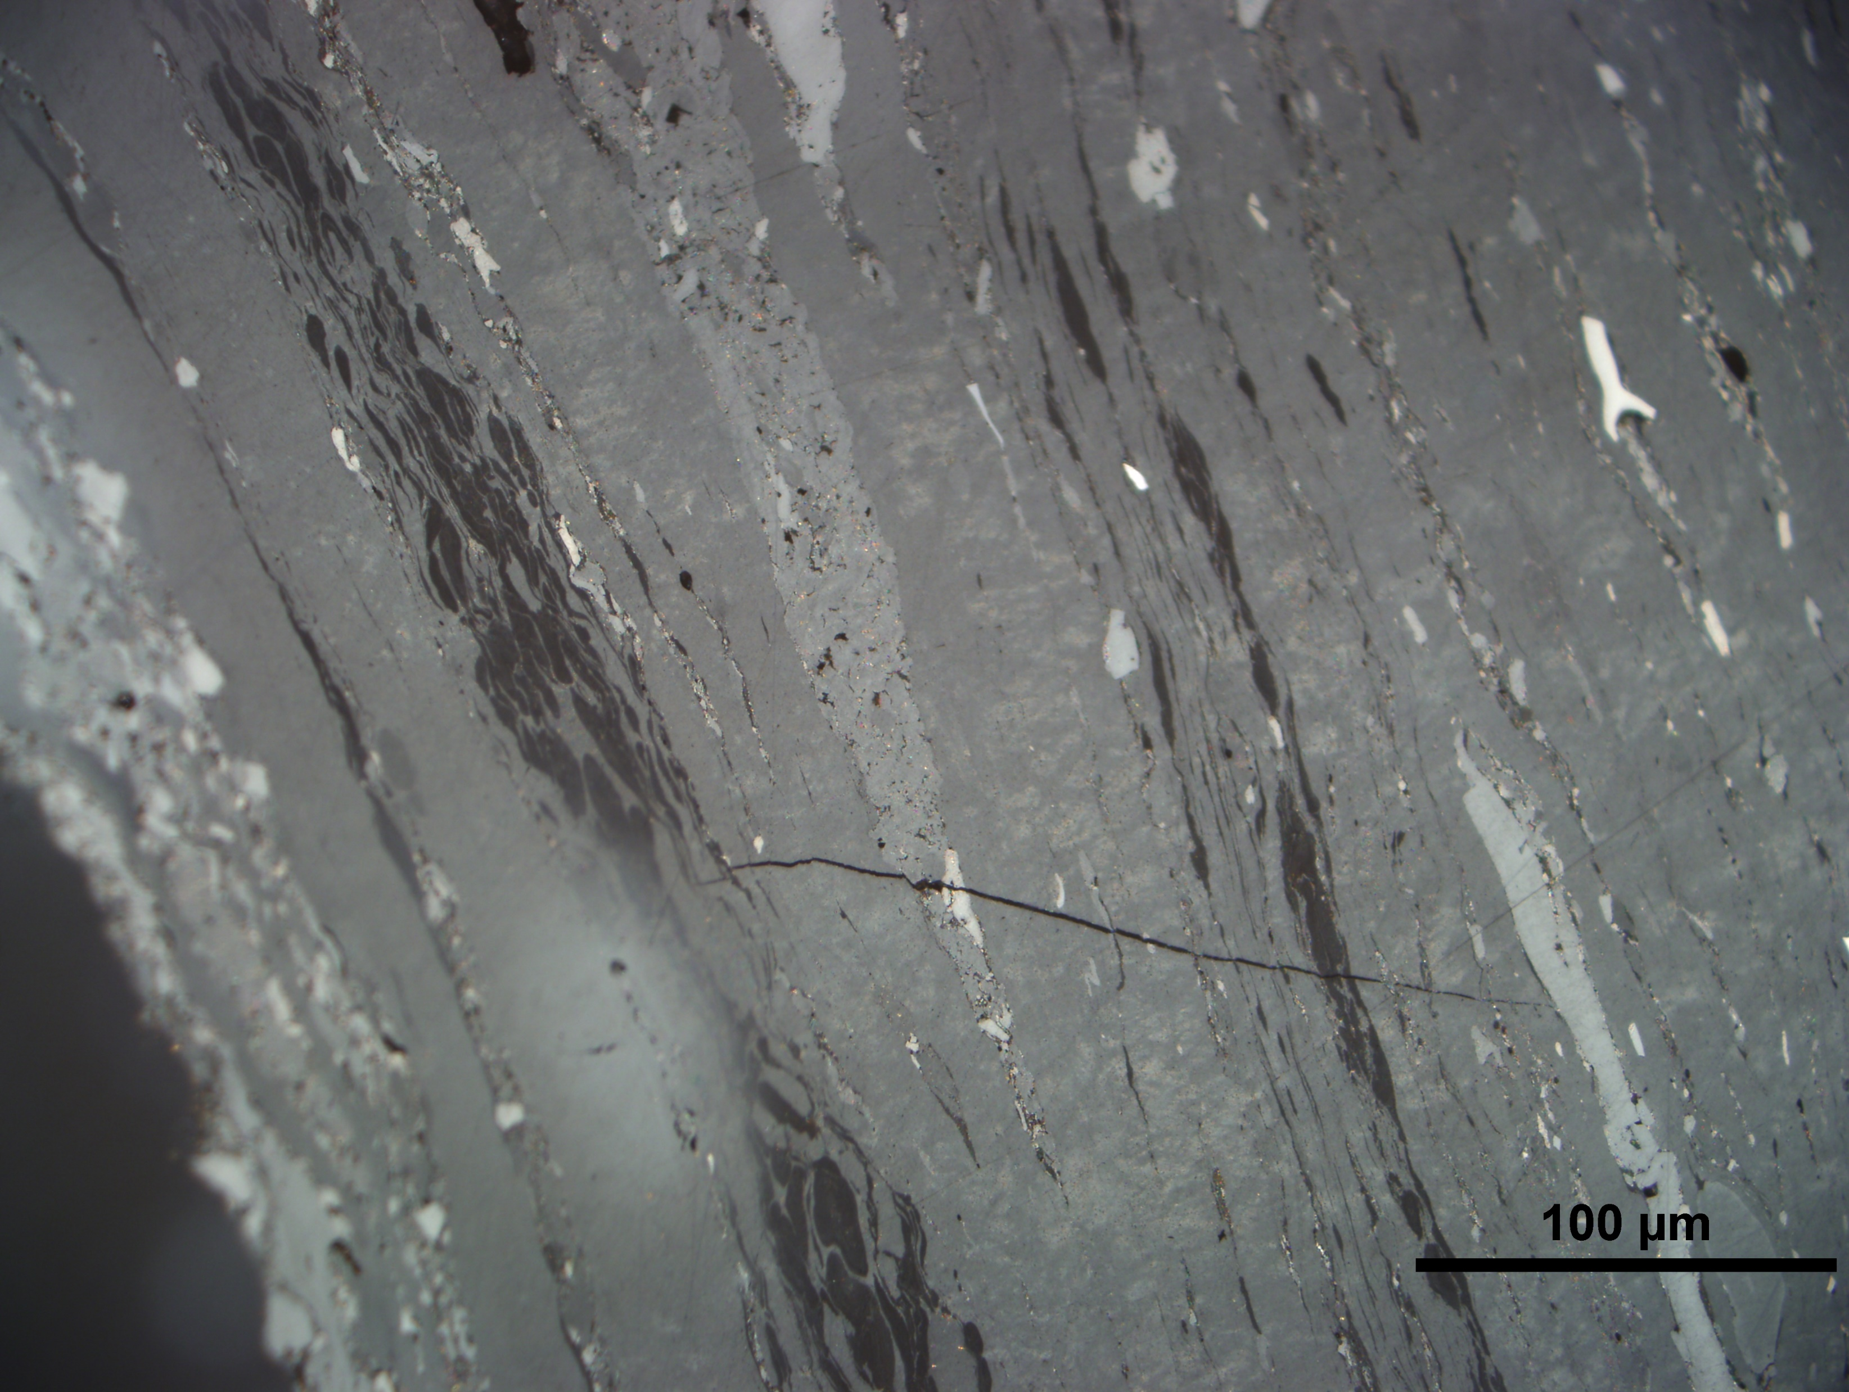
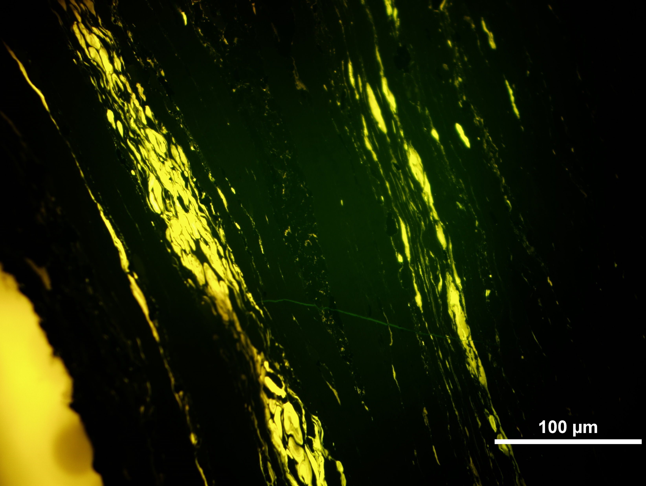
Photo 14:Uranium content 1 176 ppm; Vitrinite reflectance Rr = 0.74%; Reflectance of altered vitrinite Rav = 0.89%
A
A

Slide 16
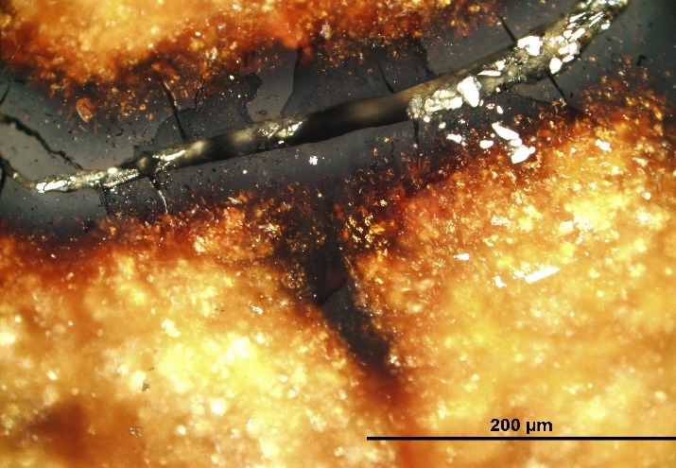
Photo 15: Uranium content 14 725 ppm; Resinite reflectance Rr = 0.10% reflectance of altered resinite Rar = 0.33 %
A
B

Slide 17
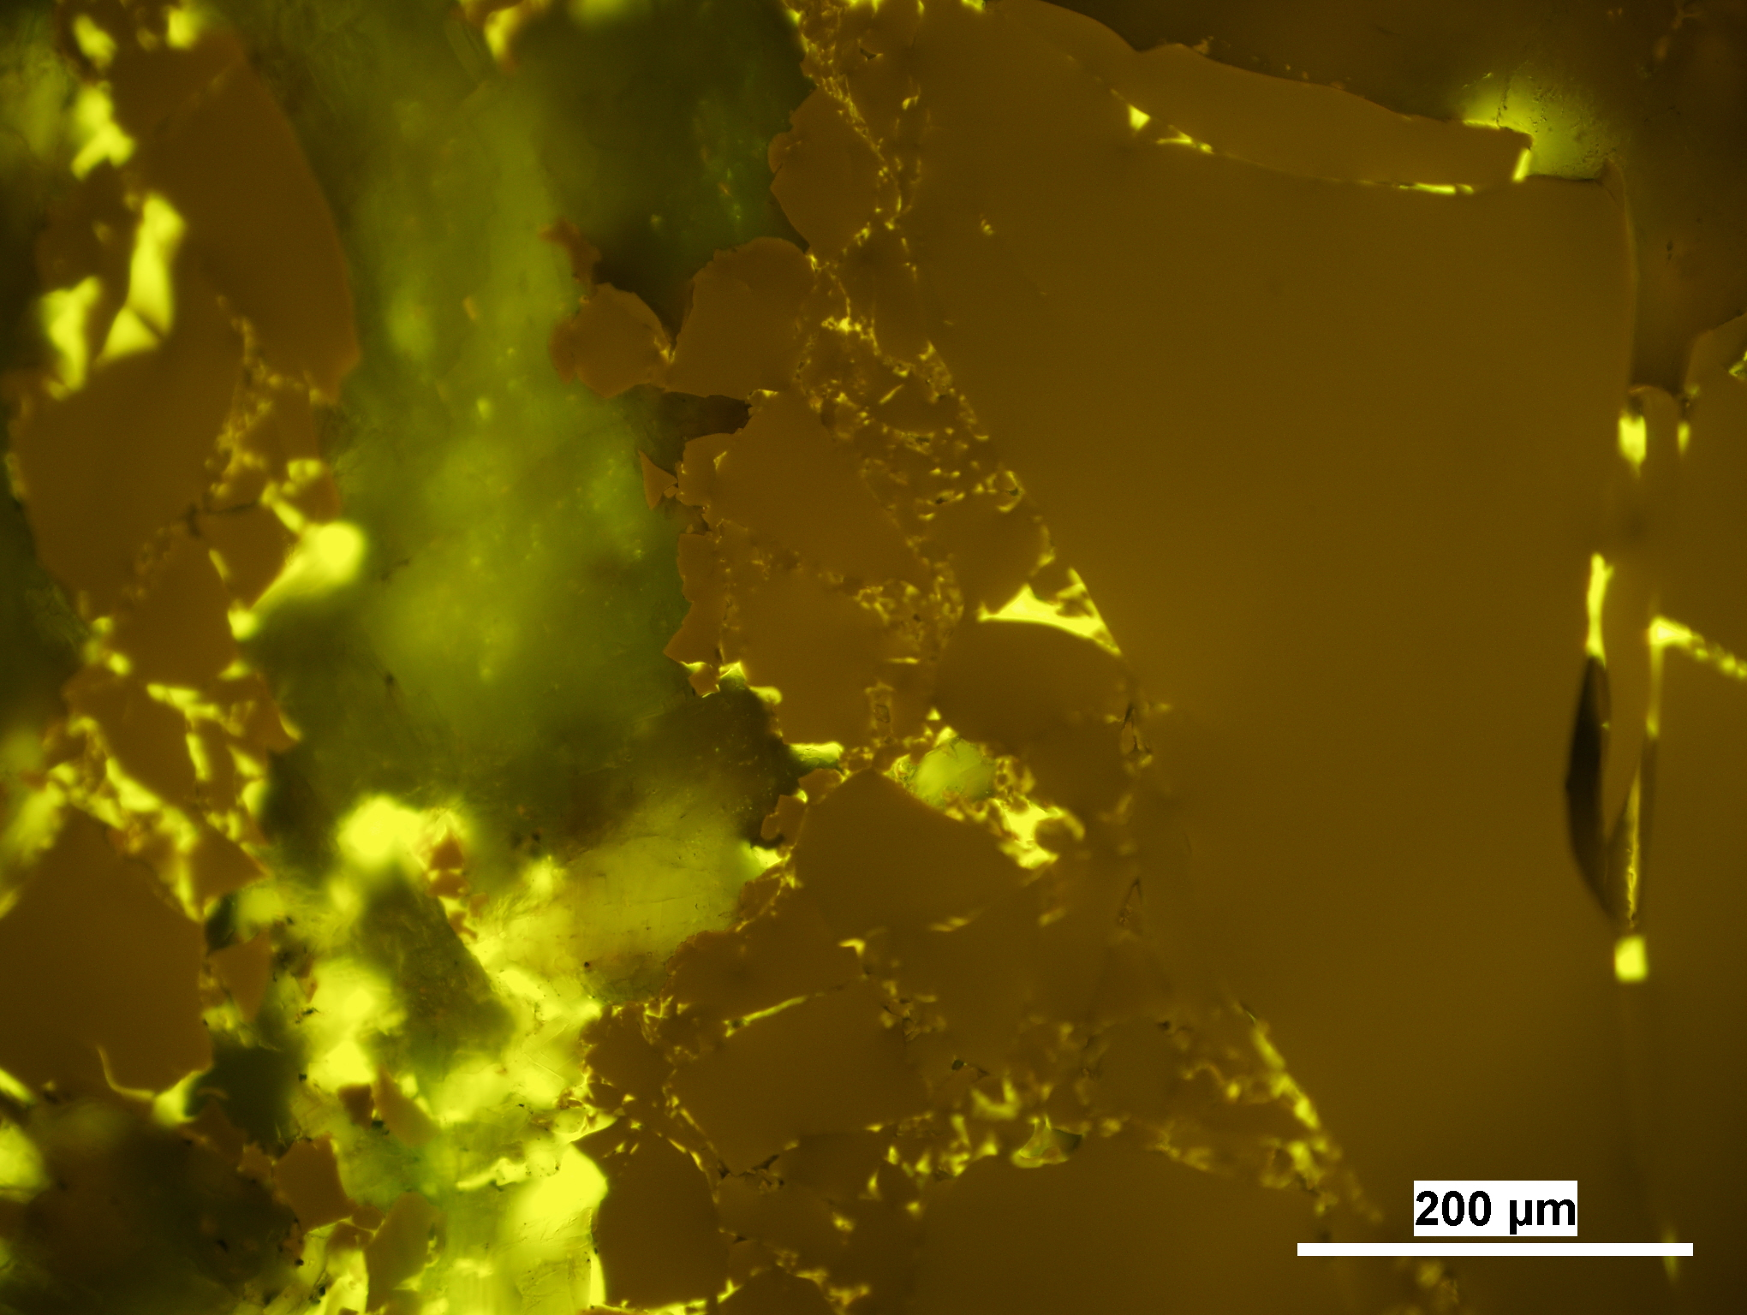
Photo 16: Uranium content 9.5 ppm; Bitumen reflectance Rb = 0.53%;
A
A
B
B

Slide 18
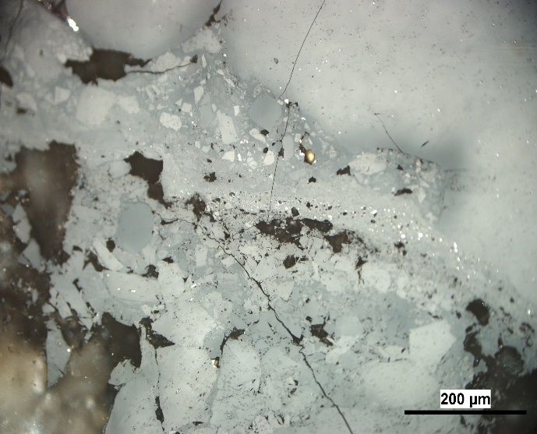
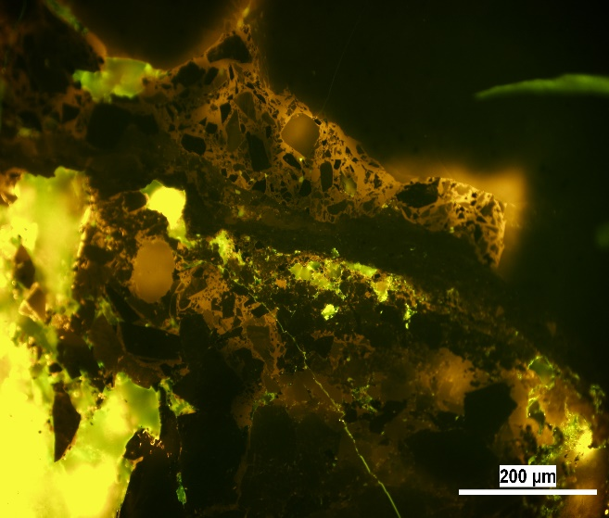
Photo 17: Uranium content 29 899 ppm; Bitumen reflectance Rb = 0.65%; Reflectance of altered bitumen:
weak ø Rwb = 1.18% ; strong ø Rsb = 3.10%
A
A
B
B
C
C

Slide 19
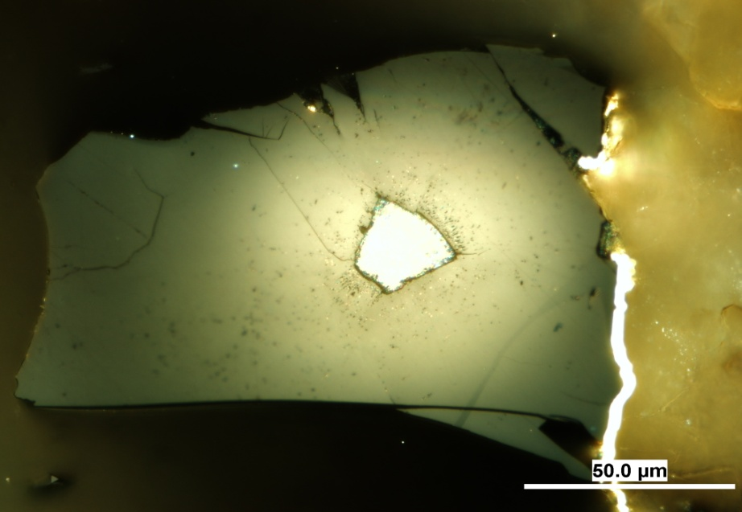
Photo 18: Uranium content 29 364 ppm; Bitumen reflectance Rb = 0.65%; Reflectance of altered bitumen:
weak ø Rwb = 1.19% ; strong ø Rsb = 3.05%
A

Slide 20
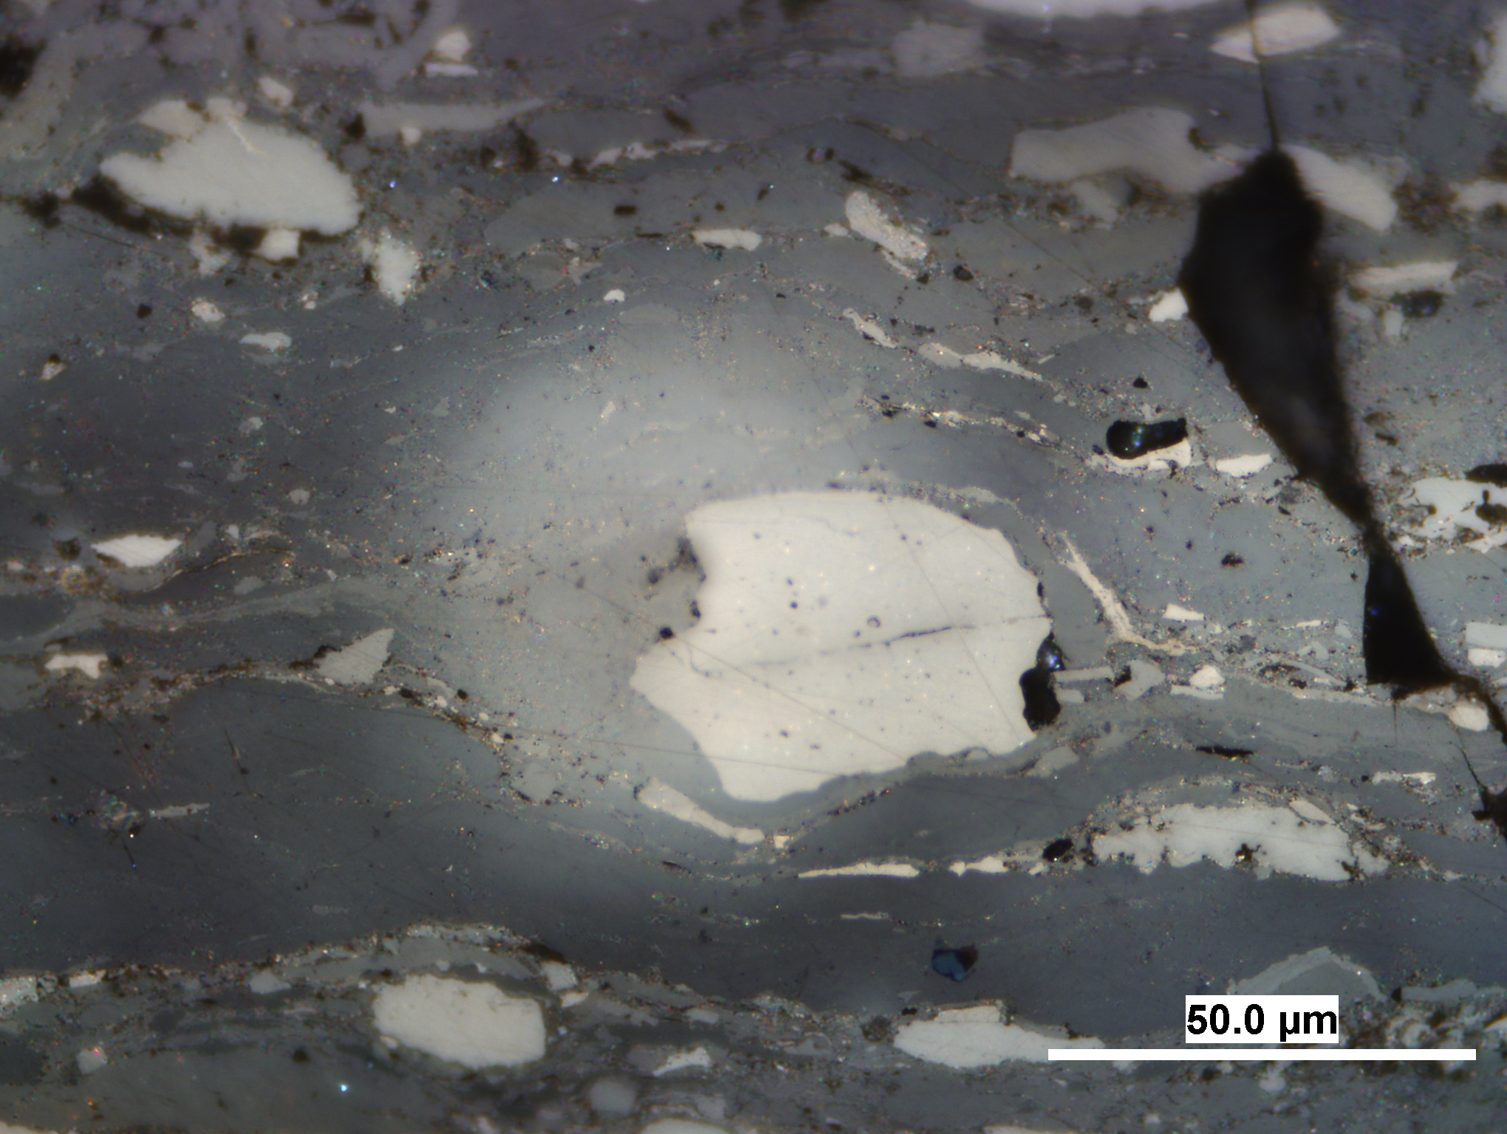
Photo 19: Uranium content 1 176 ppm; Vitrinite reflectance Rr = 0.74%; Reflectance of altered vitrinite Rav = 1.15%
A

Slide 21
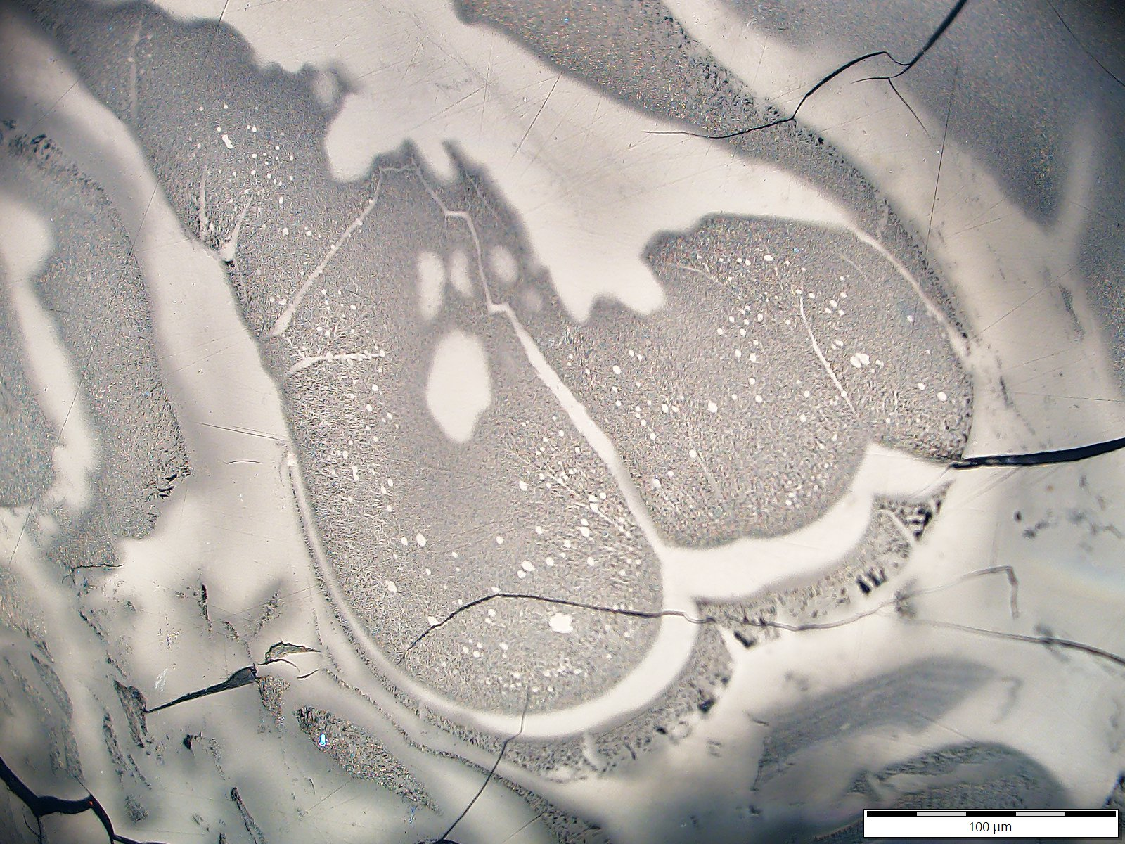
Photo 20: Uranium content 34 515 ppm; Bitumen reflectance Rb = 0.66%; Reflectance of altered bitumen:
weak ø Rwb = 1.23% ; strong ø Rsb = 3.57%
A
B

Slide 22
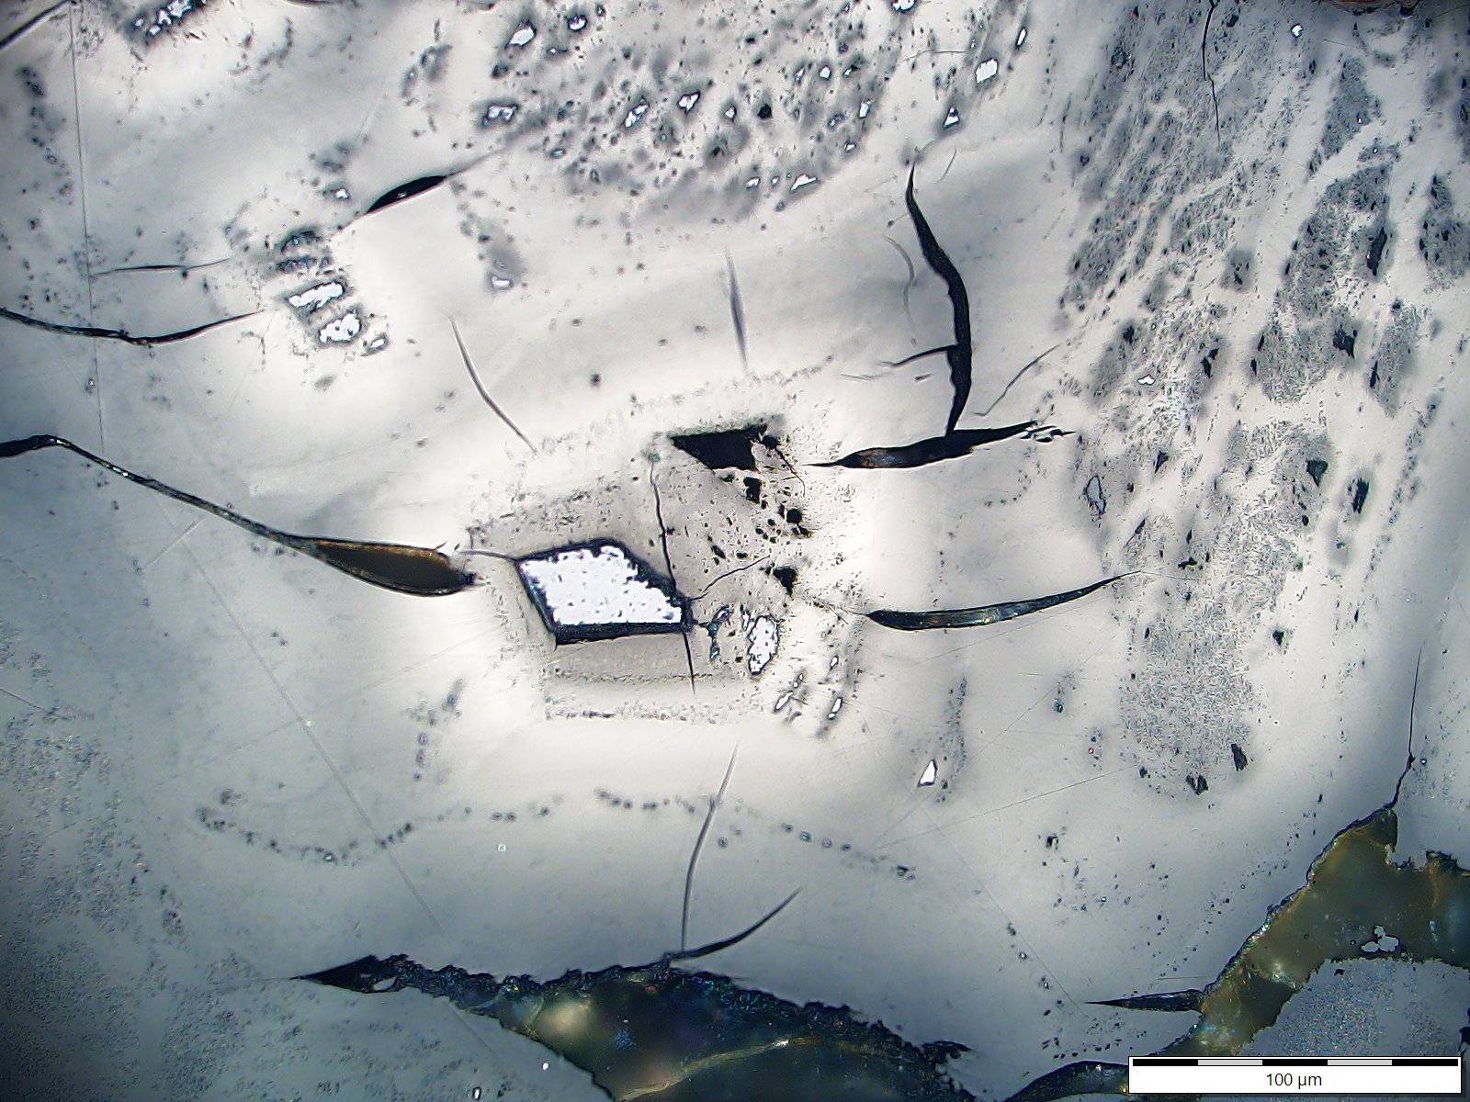
Photo 21: Uranium content 34 515 ppm; Bitumen reflectance Rb = 0.66%; Reflectance of altered bitumen:
weak ø Rwb = 1.23% ; strong ø Rsb = 3.57%
A
B
E
C
D
F

Slide 23
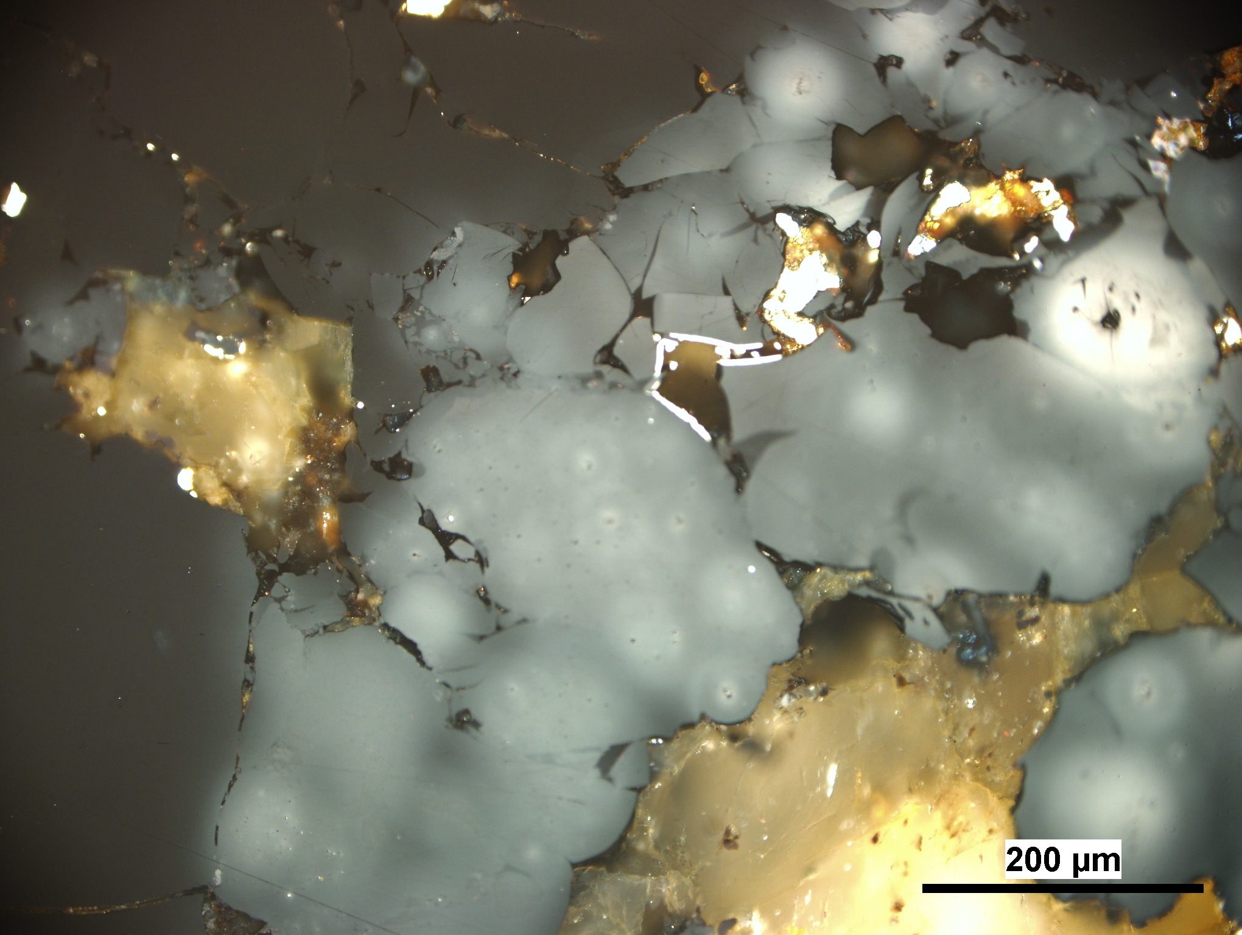
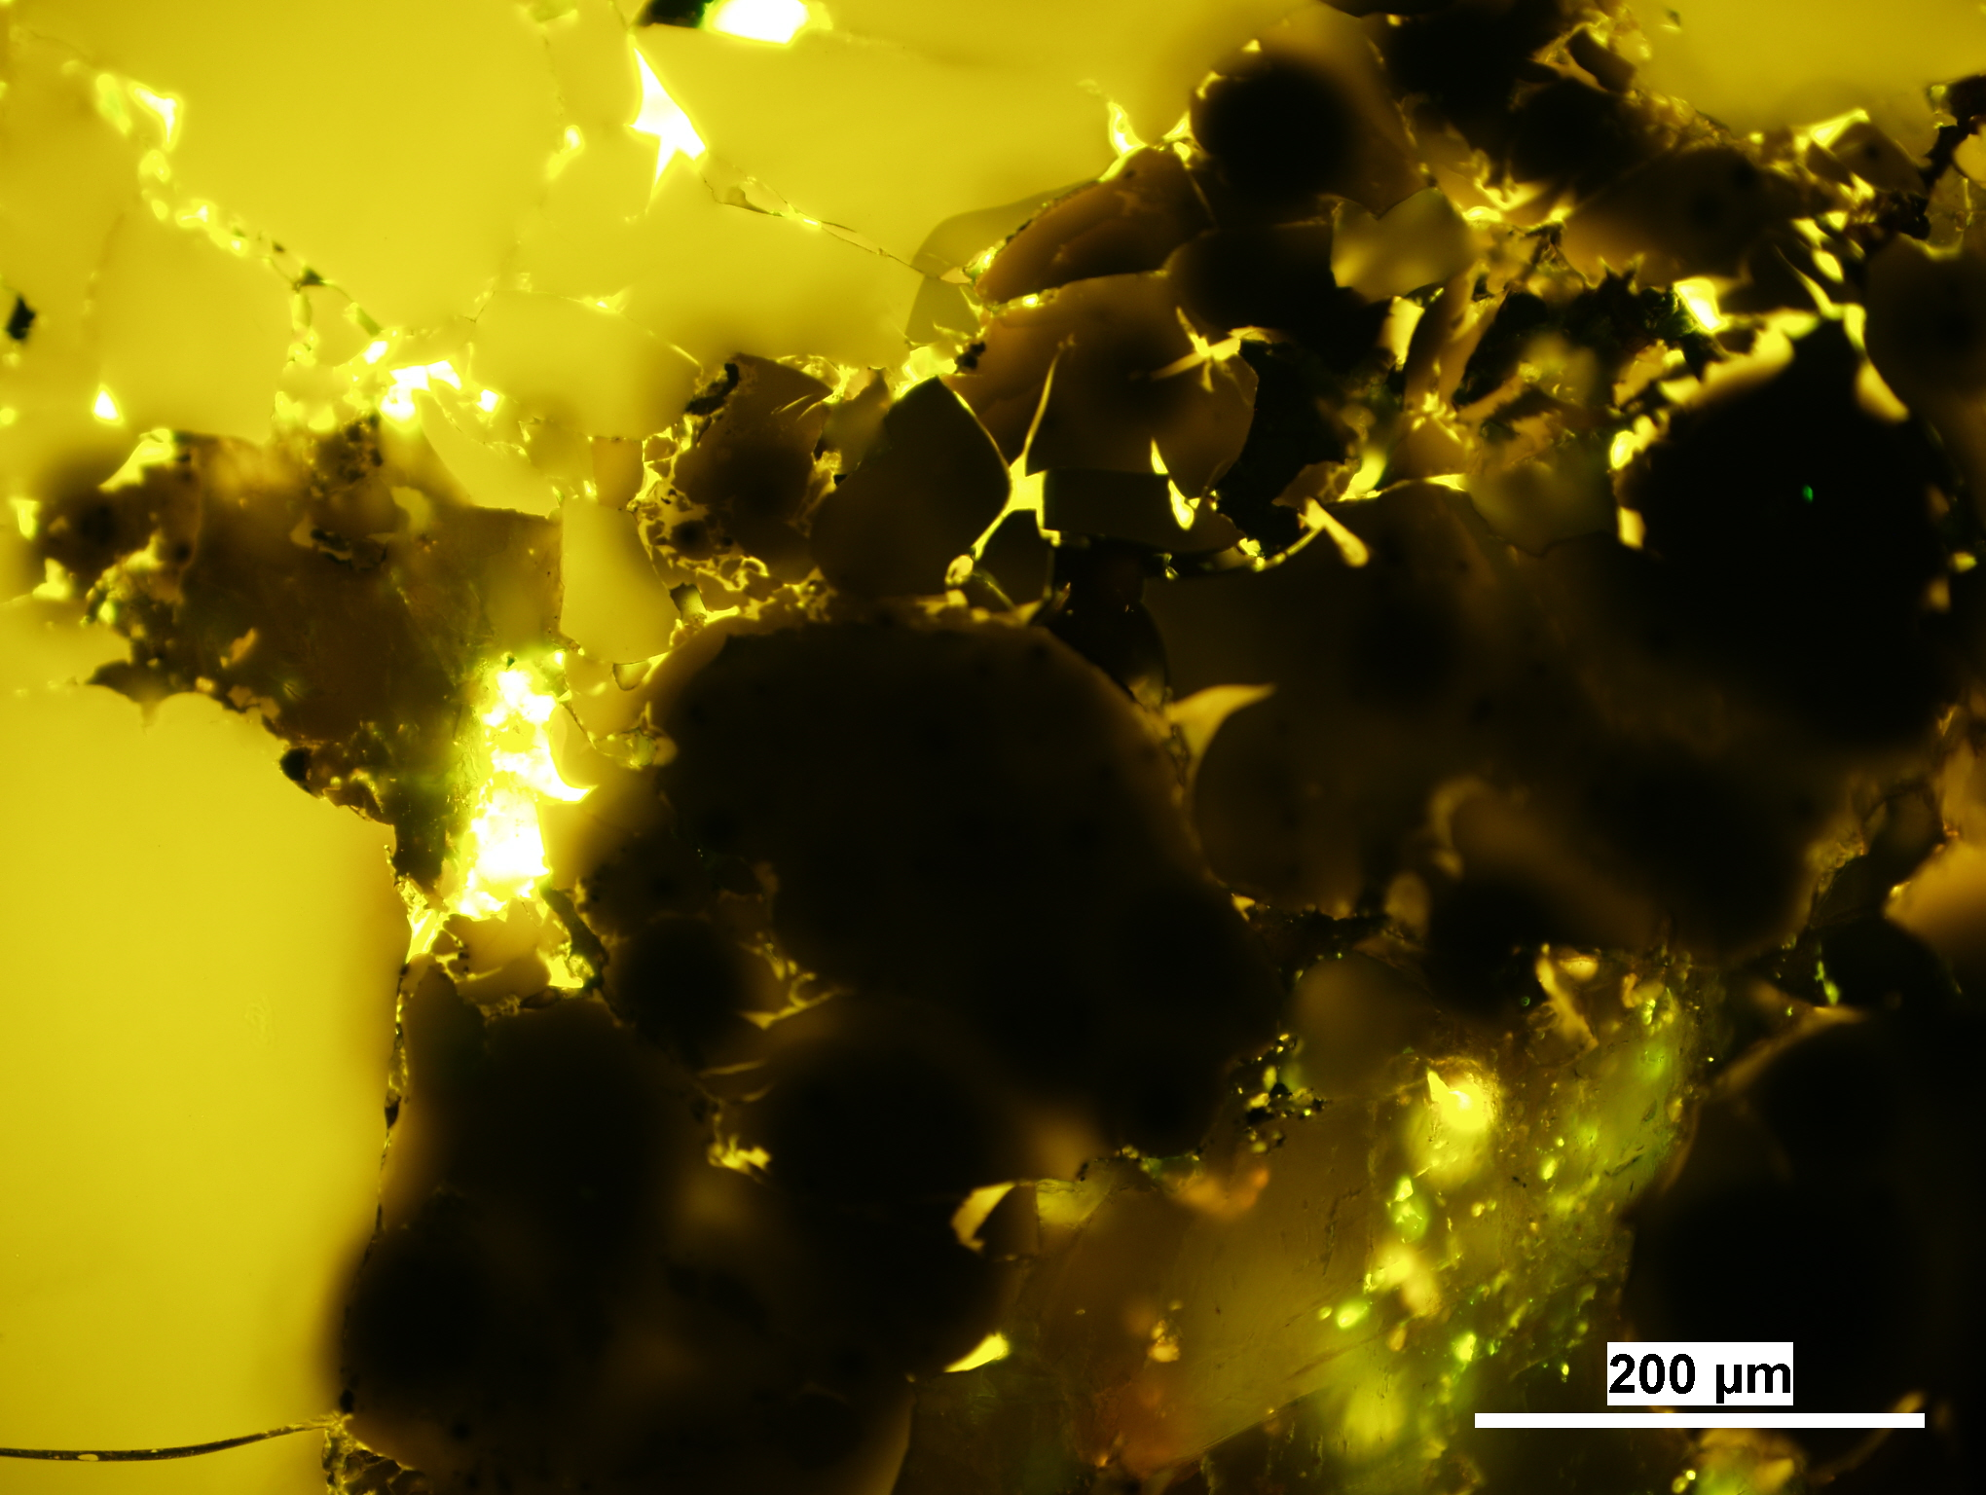
Photo 22: Uranium content 28 527 ppm; Bitumen reflectance Rb = 0.67%; Reflectance of altered bitumen:
weak ø Rwb = 1.21% ; strong ø Rsb = 3.05%
B
B
A
A

Slide 24
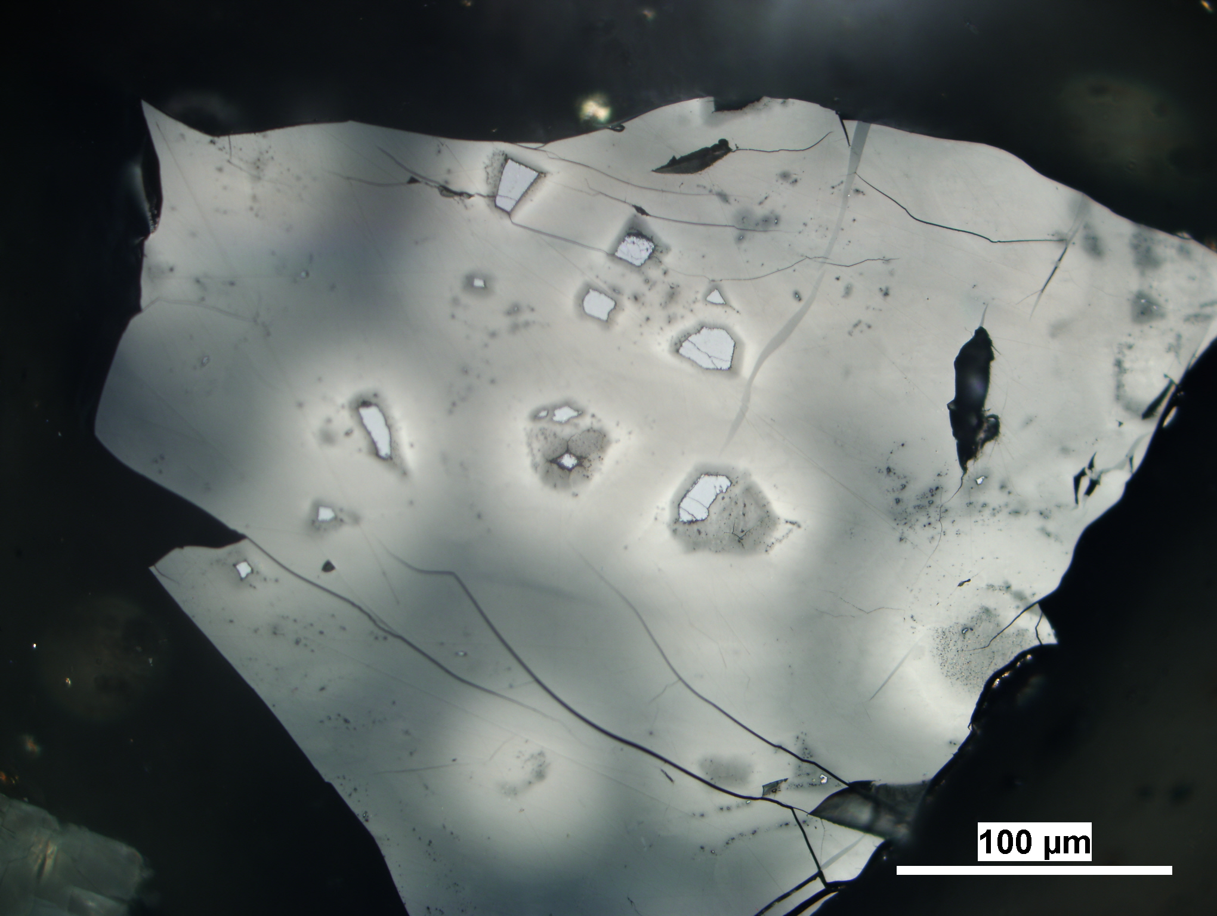
Photo 23: Uranium content 28 527 ppm; Bitumen reflectance Rb = 0.67%; Reflectance of altered bitumen:
weak ø Rwb = 1.21% ; strong ø Rsb = 3.05%
A

Slide 25
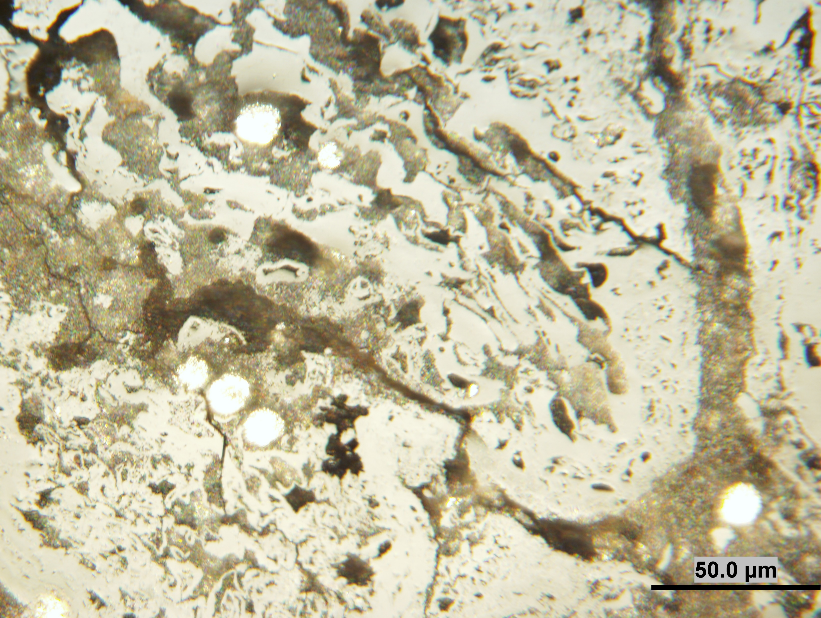
Photo 24: Uranium content 60 787 ppm; Huminite reflectance Rr =0.49%;
Reflectance of altered huminite Rah = 0.85%
A
B
C
D

Slide 26
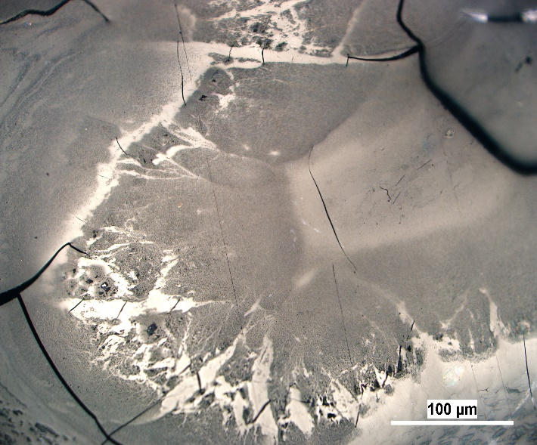
Photo 25: Uranium content 29 899 ppm; Bitumen reflectance Rb = 0.65%; Reflectance of altered bitumen:
weak ø Rwb = 1.17% ; strong ø Rsb = 3.45%
A
B

Slide 27
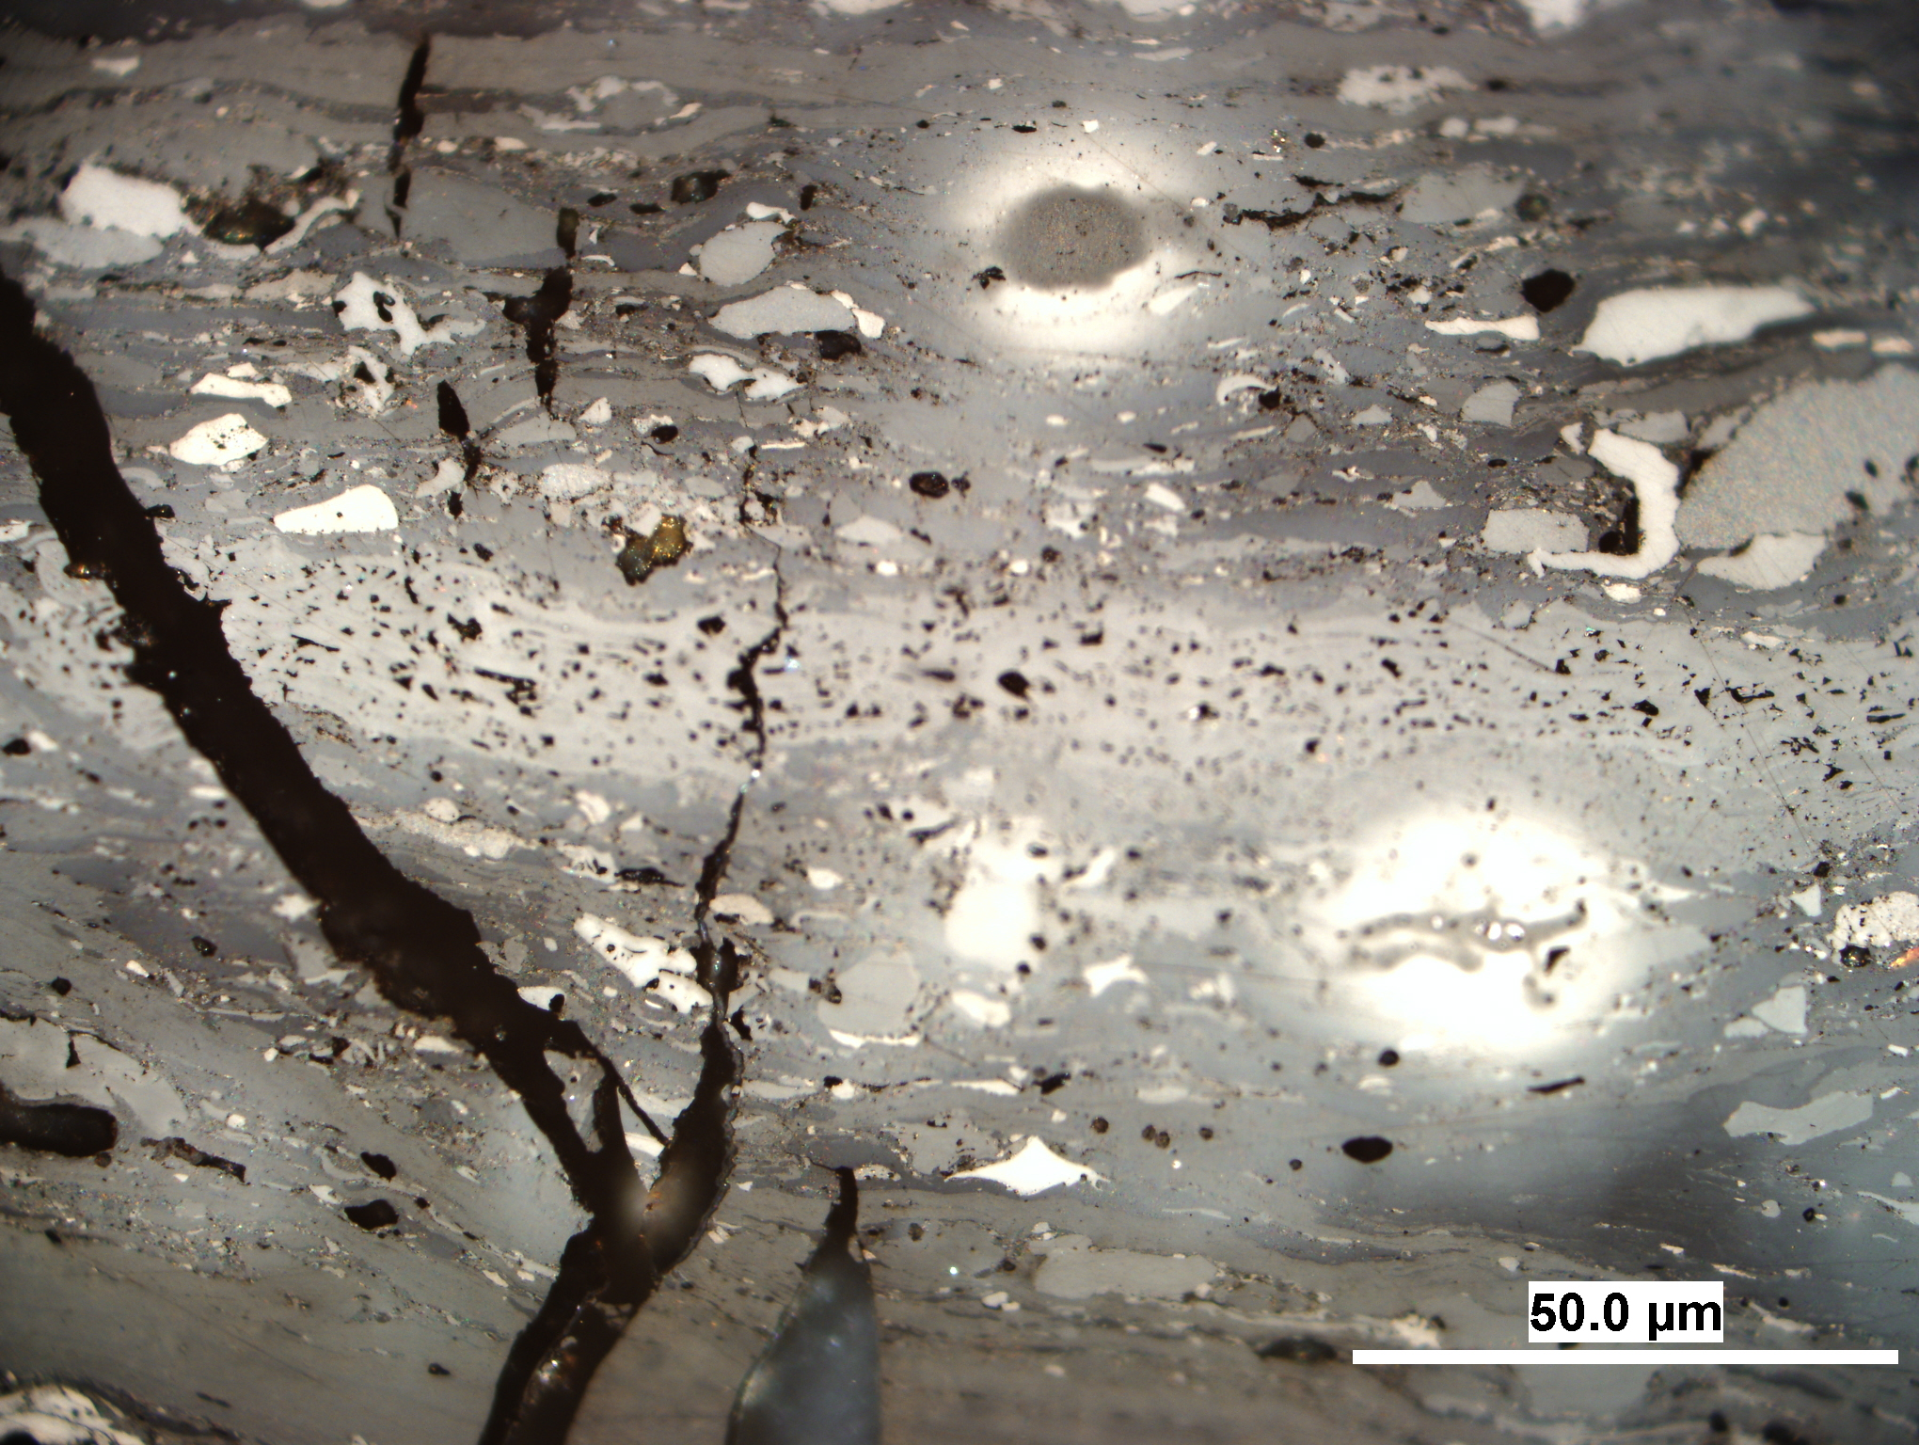
Photo 26: Uranium content 1 115 ppm; Vitrinite reflectance Rr = 0.79%; eflectance of altered vitrinite Rav = 0.90-3.2%
A
B
C

Slide 28
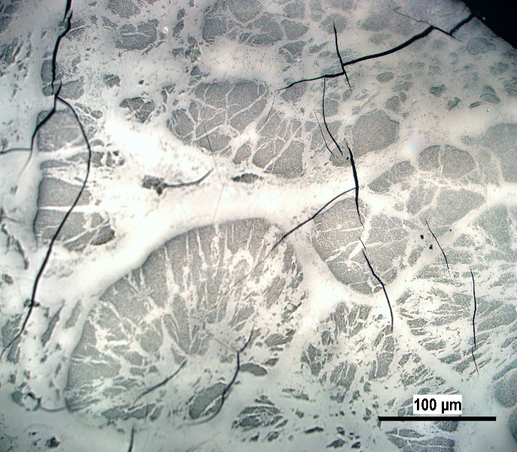
Photo 27: Uranium content 29 899 ppm; Bitumen reflectance Rb = 0.65%; Reflectance of altered bitumen:
weak ø Rwb = 1.17% ; strong ø Rsb = 3.45%
A
B

Slide 29
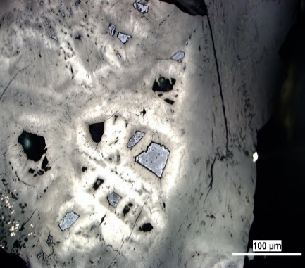
Photo 28: Uranium content 34 515 ppm; Bitumen reflectance Rb = 0.66%; Reflectance of altered bitumen:
weak ø Rwb = 1.23% ; strong ø Rsb = 3.57%
A
B

Slide 30
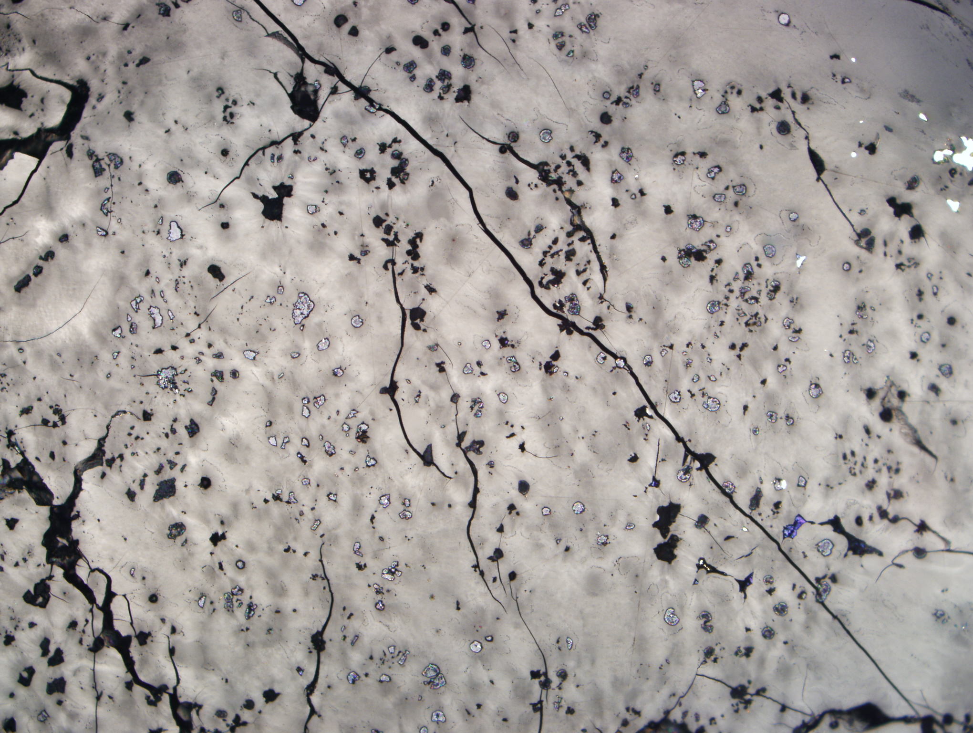
Photo 29: Uranium content 28 527 ppm; Bitumen reflectance Rb = 0.67%; Reflectance of altered bitumen:
weak ø Rwb = 1.21% ; strong ø Rsb = 3.05%
A
B

Slide 31
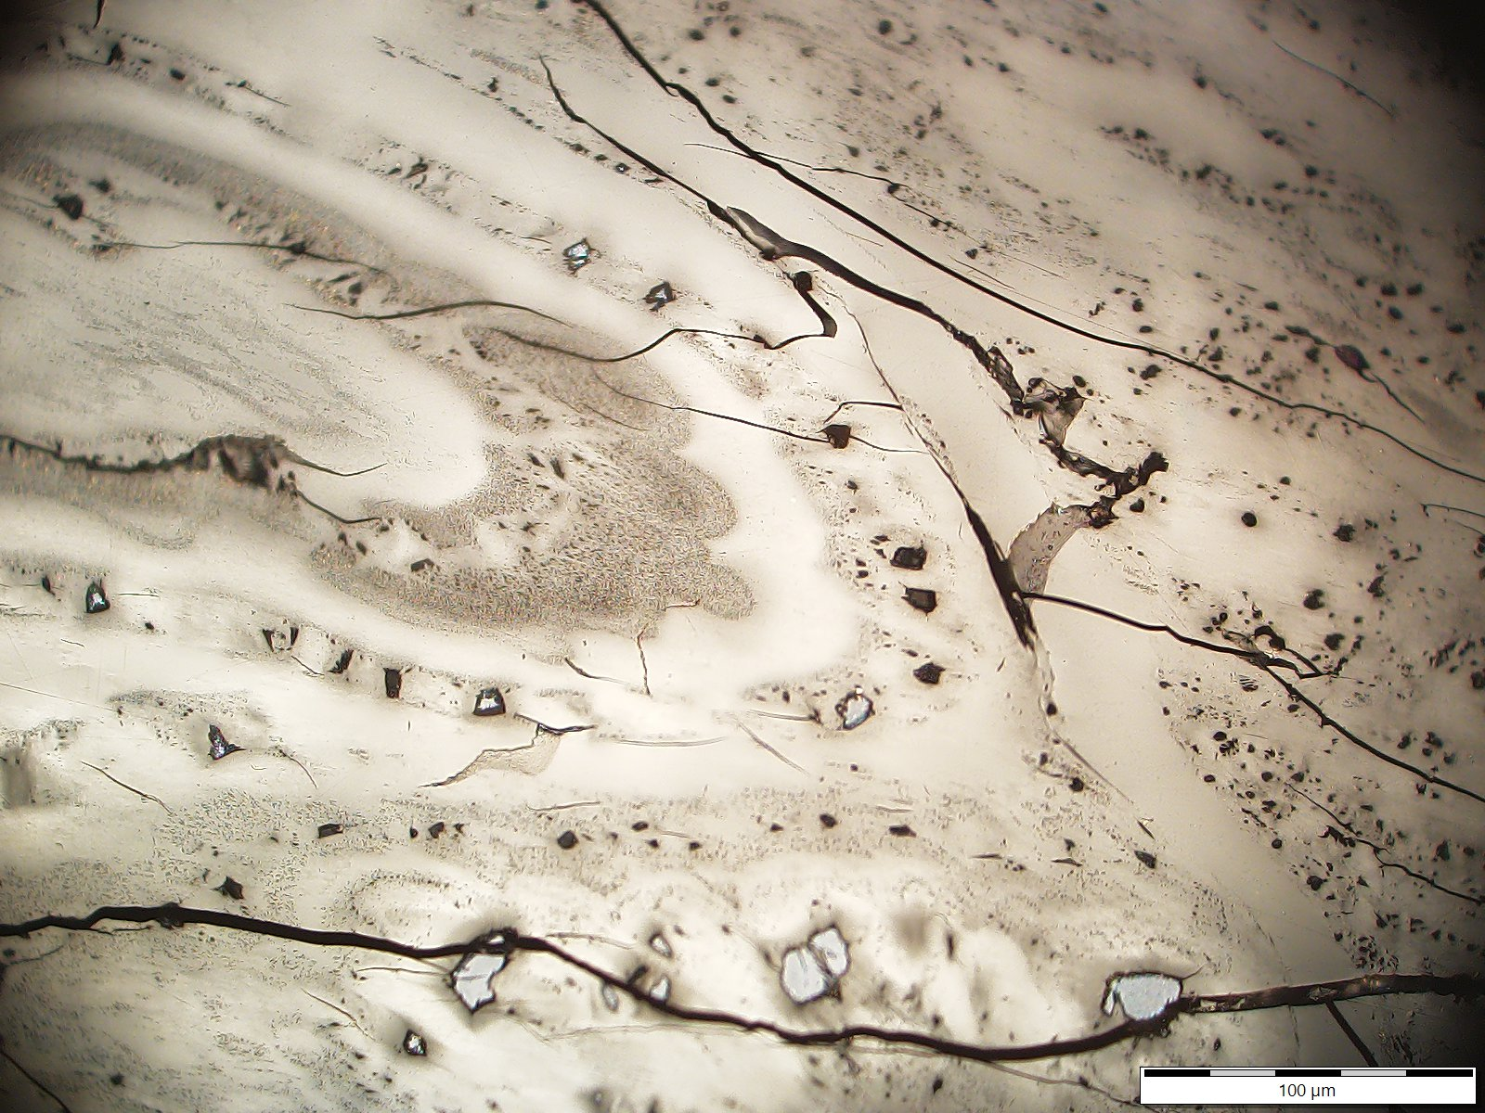
Photo 30: Uranium content 28 527 ppm; Bitumen reflectance Rb = 0.67%; Reflectance of altered bitumen:
weak ø Rwb = 1.21% ; strong ø Rsb = 3.05%
A
B
C

Slide 32
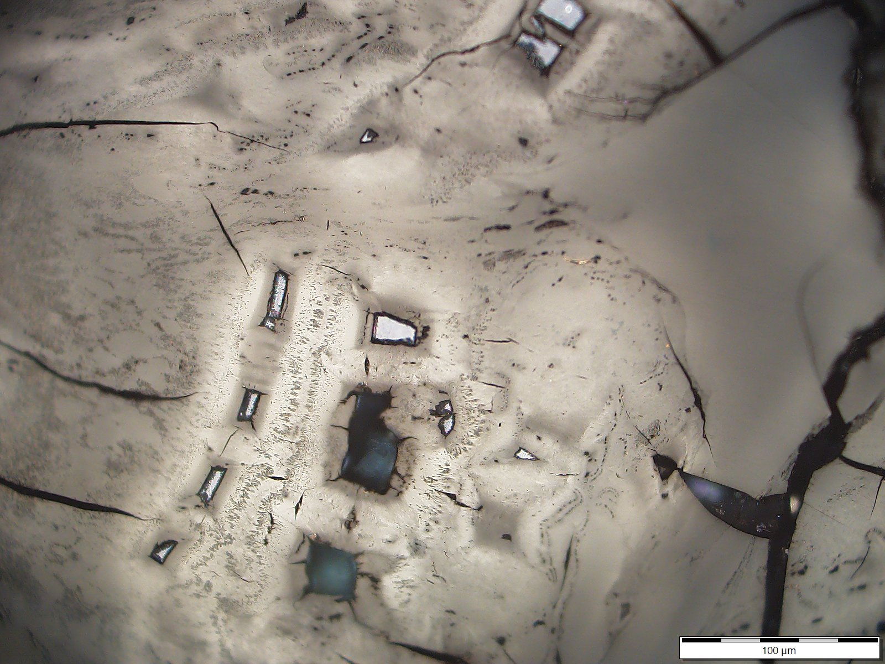
Photo 31: Uranium content 34 515 ppm; Bitumen reflectance Rb = 0.66%; Reflectance of altered bitumen:
weak ø Rwb = 1.23% ; strong ø Rsb = 3.57%
A
B
C

Slide 33
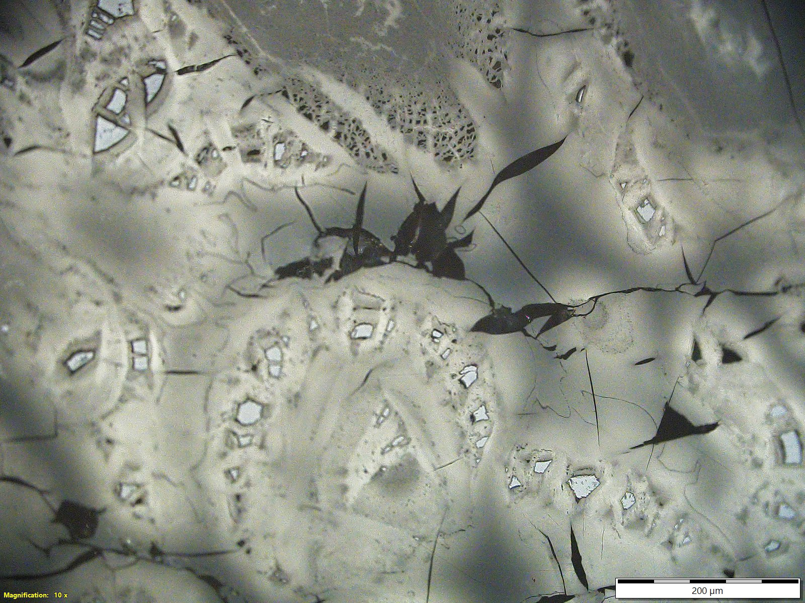
Photo 32: Uranium content 34 965 ppm; Bitumen reflectance Rb = 0.67%; Reflectance of altered bitumen:
weak ø Rwb = 1.26% ; strong ø Rsb = 3.57%
A
B
C
D

Slide 34
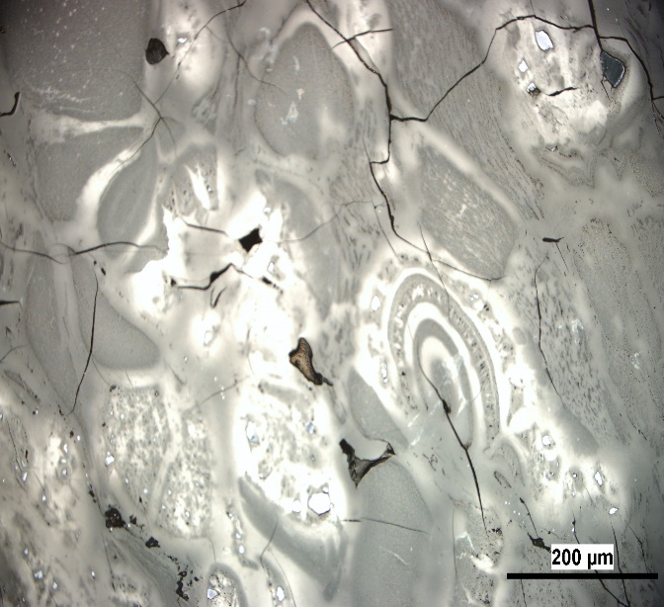
Photo 33: Uranium content 34 965 ppm; Bitumen reflectance Rb = 0.67%; Reflectance of altered bitumen:
weak ø Rwb = 1.26% ; strong ø Rsb = 3.57%
A
B
C
D

Slide 35
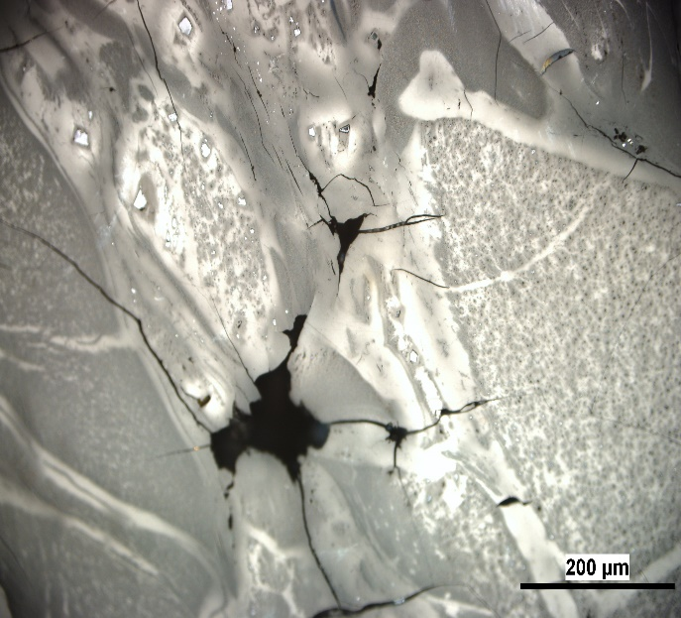
Photo 34: Uranium content 34 965 ppm; Bitumen reflectance Rb = 0.67%; Reflectance of altered bitumen: weak ø Rwb = 1.26% ; strong ø Rsb = 3.57%
A
B
C

Slide 36
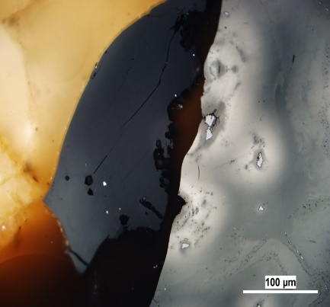
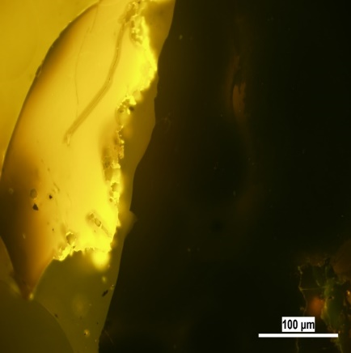
Photo 35: Uranium content 29 364 ppm; Bitumen reflectance Rb = 0.65%; Reflectance of altered bitumen:
weak ø Rwb = 1.18% ; strong ø Rsb = 3.08%
C
A
C
A
B
B

Slide 37
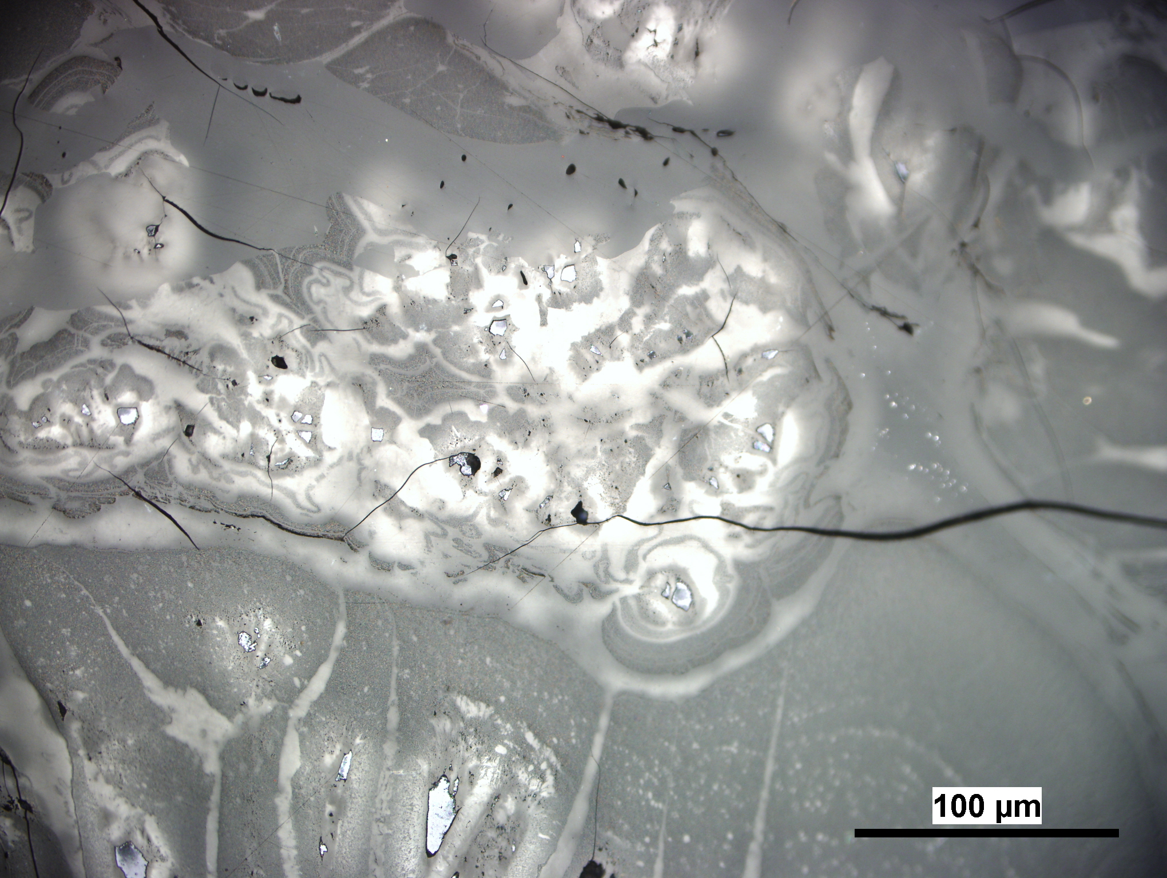
Photo 36: Uranium content 28 527 ppm; Bitumen reflectance Rb = 0.67%; Reflectance of altered bitumen:
weak ø Rwb = 1.21% ; strong ø Rsb = 3.05%
A
B
C
D

Slide 38
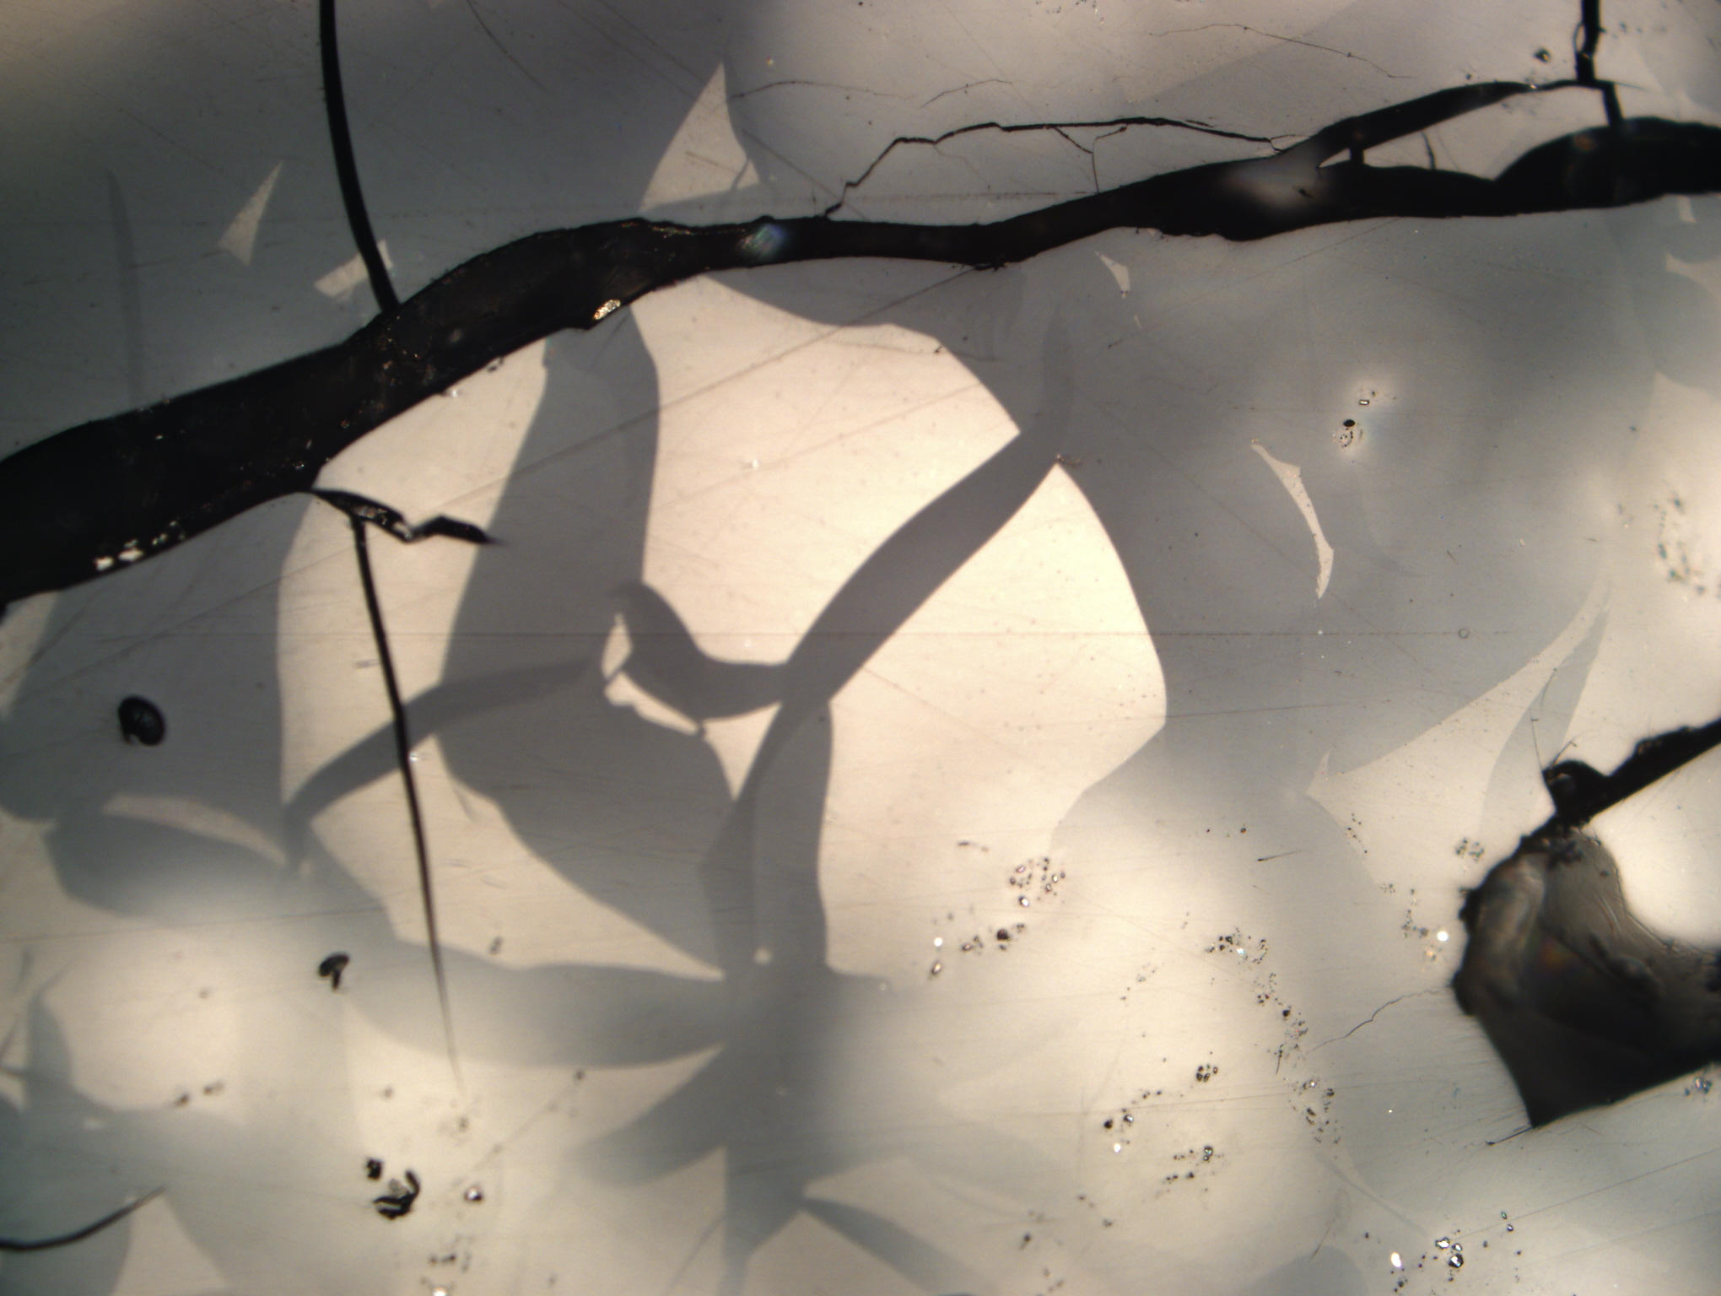
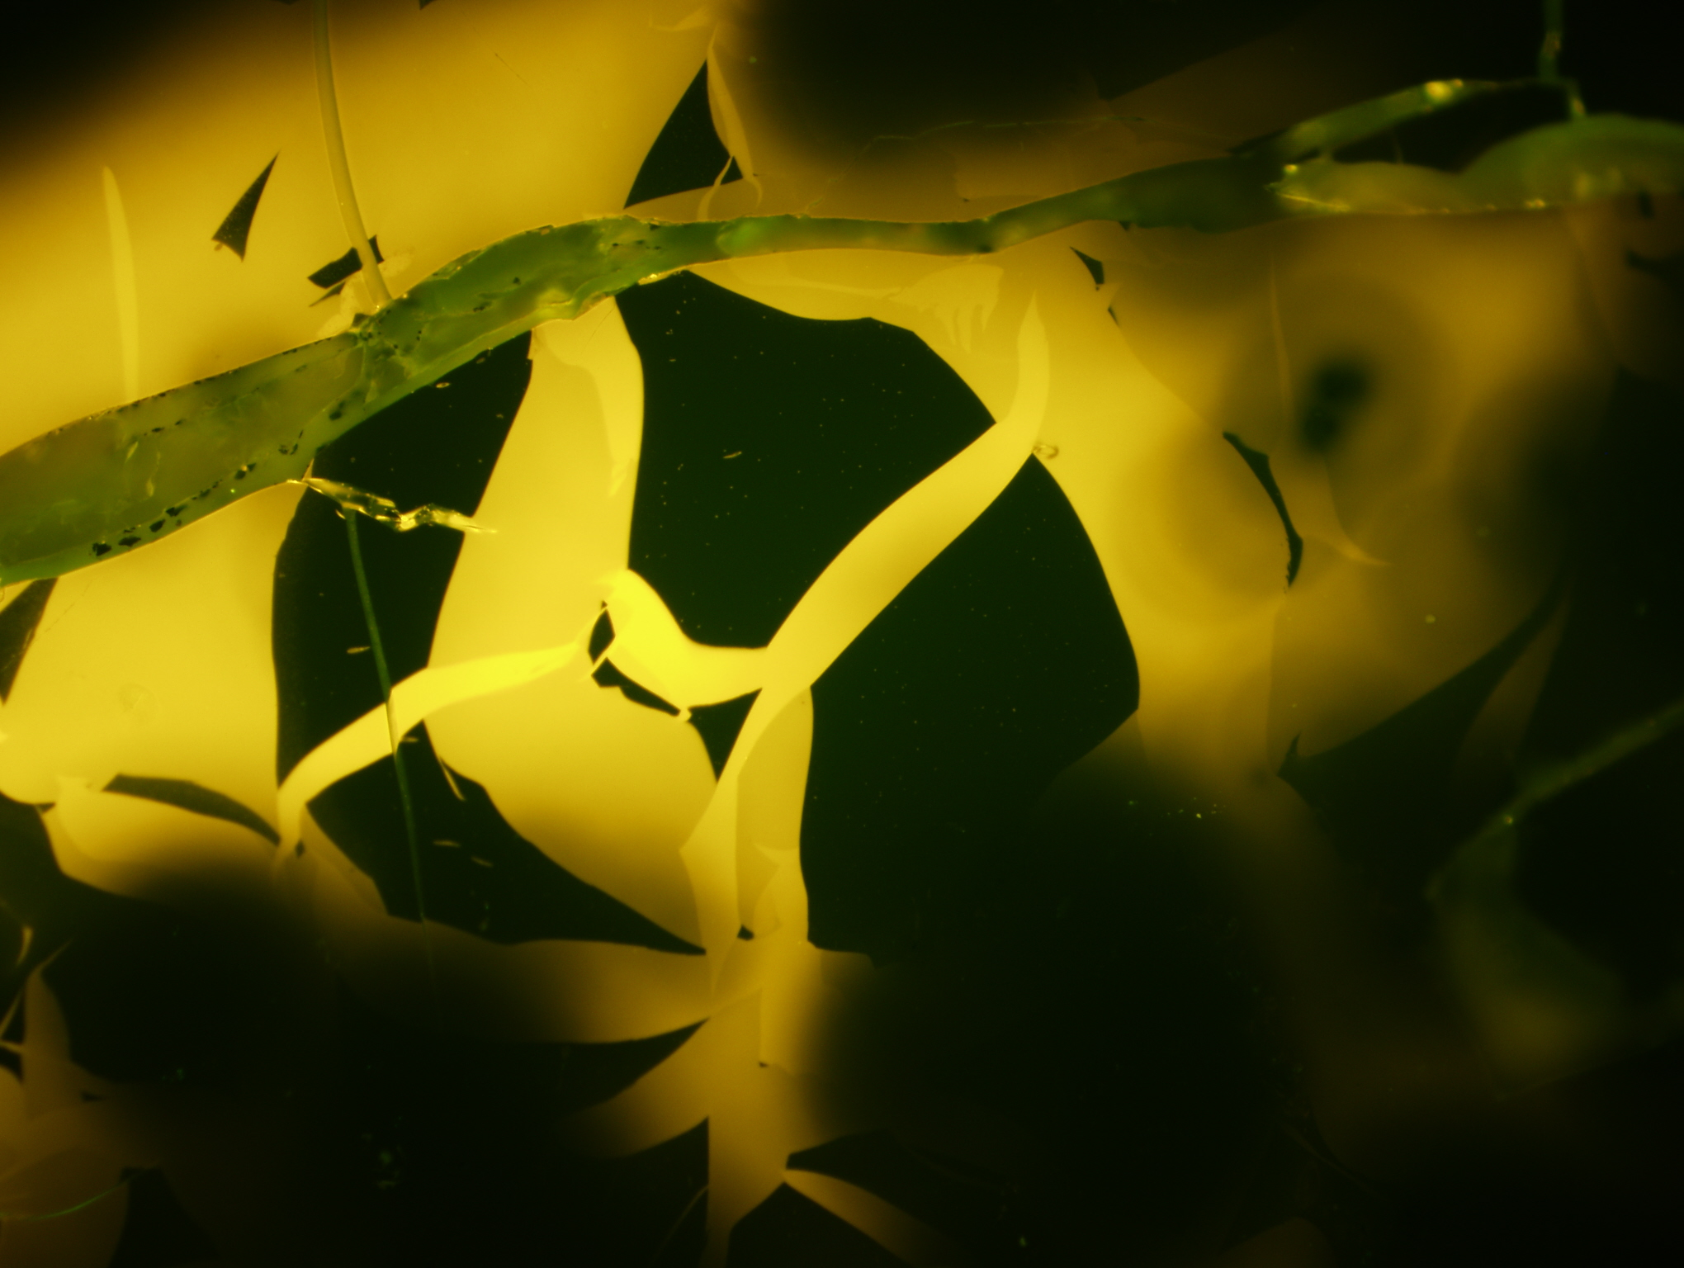
Photo 37: Uranium content 28 527 ppm; Bitumen reflectance Rb = 0.67%; Reflectance of altered bitumen:
weak ø Rwb = 1.21% ; strong ø Rsb = 3.05%
B
B
A
A
C
C
D
D

Slide 39
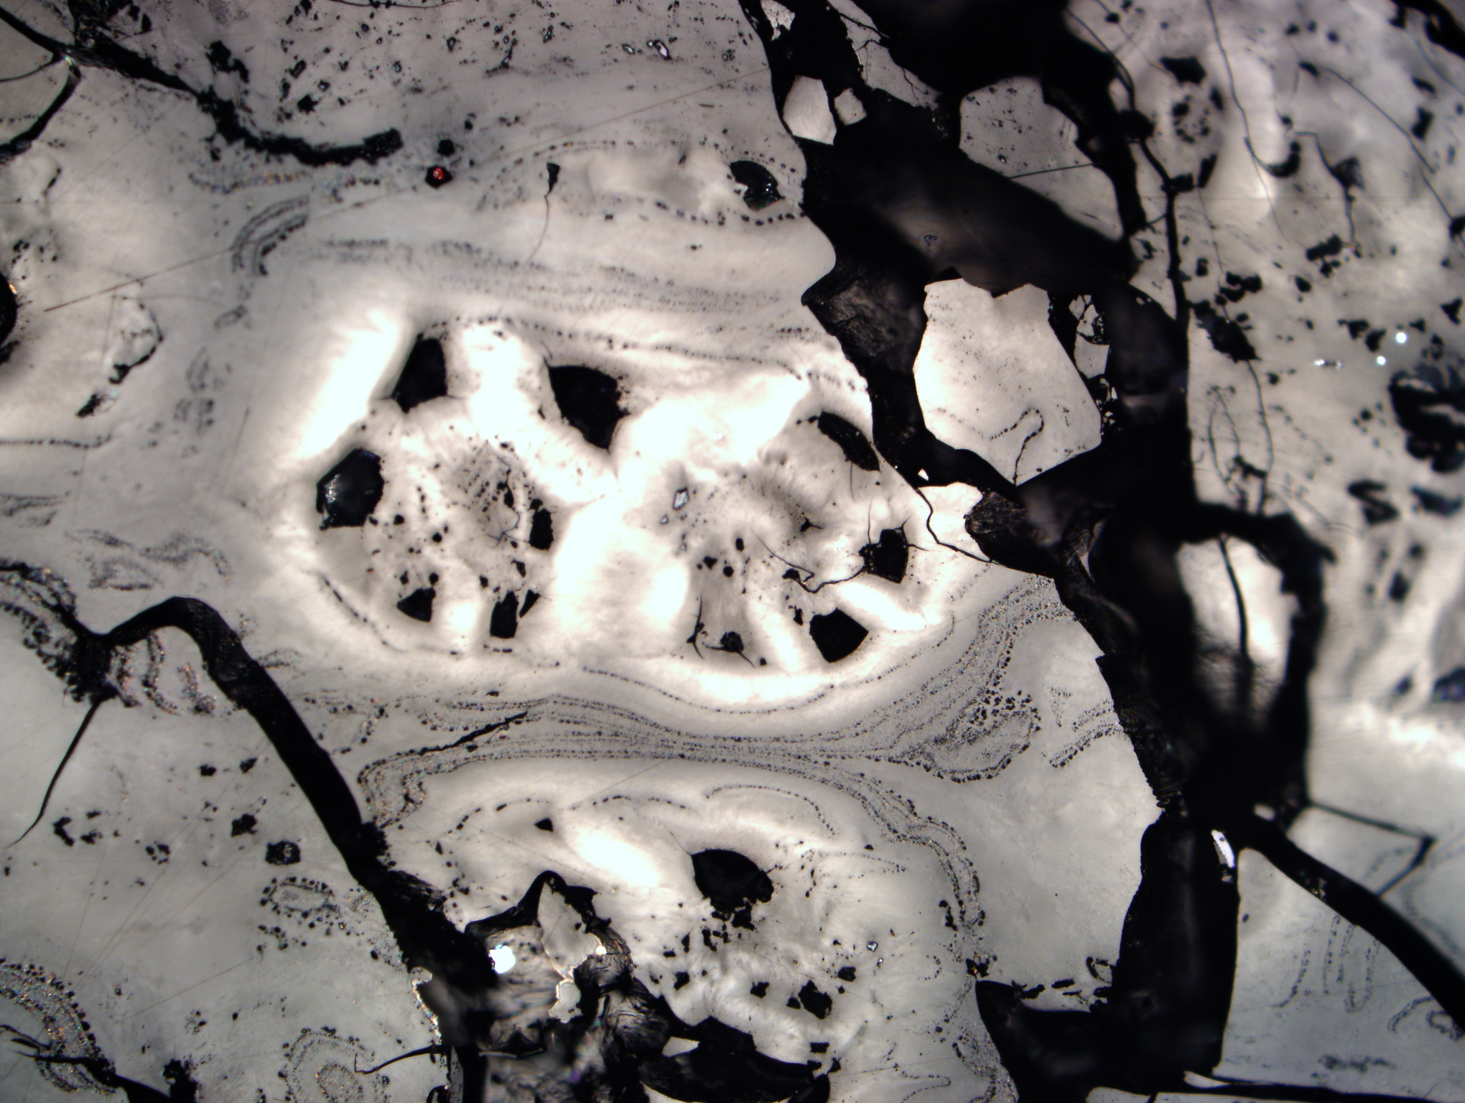
Photo 38: Uranium content 35 535 ppm; Bitumen reflectance Rb = 0.67%; Reflectance of altered bitumen:
weak ø Rwb = 1.28% ; strong ø Rsb = 3.65%
A
B

Slide 40
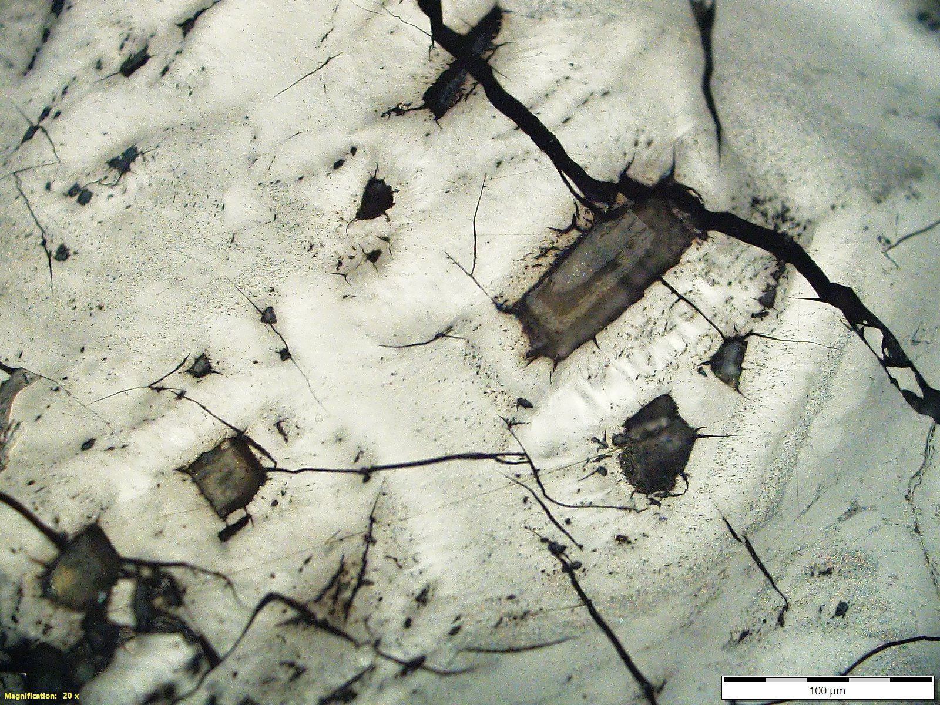
Photo 39: Uranium content 47964 ppm; Bitumen reflectance Rb = 0.69%; Reflectance of altered bitumen:
weak ø Rwb = 1.29% ; strong ø Rsb = 3.65%

