Slide 1
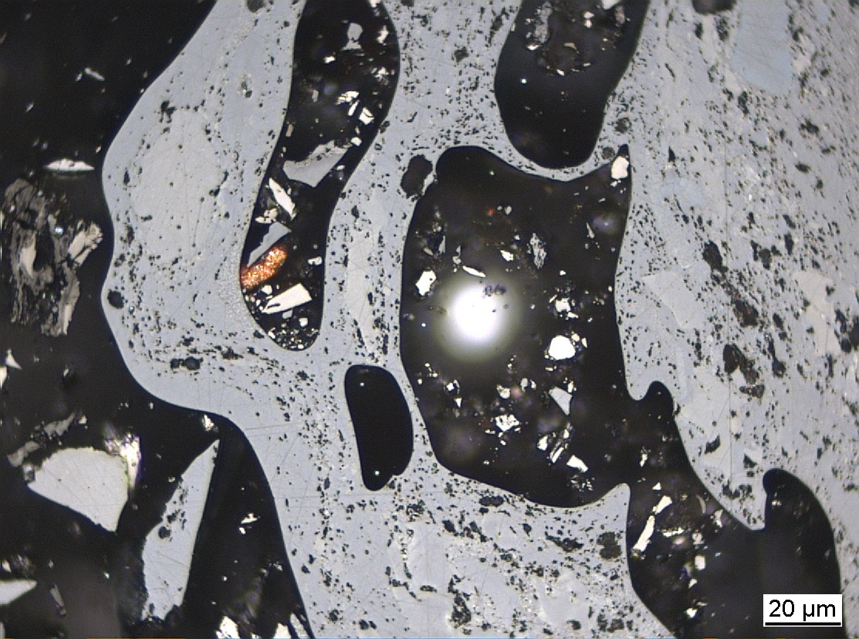

Self-heating WG
Commission III
China, Inner Mongolia,
Wuda Coalfield
Convenors:
Dr. Jolanta Kus
Dr. Magdalena Misz-Kennan
Prof. Deolinda Flores
ICCP Commission III
Joint 74th ICCP and 39th TSOP Meeting, Patras, Greece, 2023

Slide 2
Commission III: Self-heating WG
The aims of the SH WG are as follows:
to gather examples of various forms of transformation of organic matter in coal wastes and coal of various rank.
to establish a classification of transformed organic particles (oxidised and thermally altered) in coal wastes and in coals that will reflect the complex conditions in the waste dumps and in the thermally/oxidatively affected coal seams.
Meeting of ICCP SH WG 22.09.2023 – Joint 74th ICCP and 39th TSOP Meeting, Patras, 2023
Notes:
Fibered light sources of a given specification depending on the bulb type, wavelength, output mode and measurement type (Absorbance, Fluorescence, Reflectance, Transmission or Calibration and with options for UV, Visible
Tungsten HalogenHL-2000 – red
Deuterium Tungsten HalogenDH-2000-BAL – blue

Slide 3
Commission III: Self-heating WG
Past activities:
The SHWG was established during the 62nd ICCP Meeting in Oviedo (2008) and information about it was published in the ICCP News Letter No. 45, 2008.
In 2009, 2010, 2012, 2013, 2015, and 2016 Multiple Round Robin Exercises on coal waste were carried out.
In 2019 manuscript on the classification of coal waste subjected to self-heating and self-combustion processes submitted to IJCG for review and publication.
In 2018, 2020, and 2022 Round Robin Exercise on thermally/oxidatively affected coals in coal seams.
Meeting of ICCP SH WG 22.09.2023 – Joint 74th ICCP and 39th TSOP Meeting, Patras, 2023
Notes:
Fibered light sources of a given specification depending on the bulb type, wavelength, output mode and measurement type (Absorbance, Fluorescence, Reflectance, Transmission or Calibration and with options for UV, Visible
Tungsten HalogenHL-2000 – red
Deuterium Tungsten HalogenDH-2000-BAL – blue

Slide 4
Commission III: Self-heating WG
Objective of the 2022 SHWG Round Robin Exercise:
to apply the established classification of oxidatively and thermally affected organic matter in coal wastes to oxidatively and thermally affected coaly matter in coal seams.
to test the applicability of the established classification of oxidatively and thermally altered organic matter in coal wastes to self-heated coals in a ppt presentation.
Aim of the 2022 SHWG Round Robin Exercise:
to test the modified terminologies of the following categories: Porous and Massive, the Isotropic and Anisotropic, and Paler in colour particle.
Meeting of ICCP SH WG 22.09.2023 – Joint 74th ICCP and 39th TSOP Meeting, Patras, 2023
Notes:
Fibered light sources of a given specification depending on the bulb type, wavelength, output mode and measurement type (Absorbance, Fluorescence, Reflectance, Transmission or Calibration and with options for UV, Visible
Tungsten HalogenHL-2000 – red
Deuterium Tungsten HalogenDH-2000-BAL – blue

Slide 5
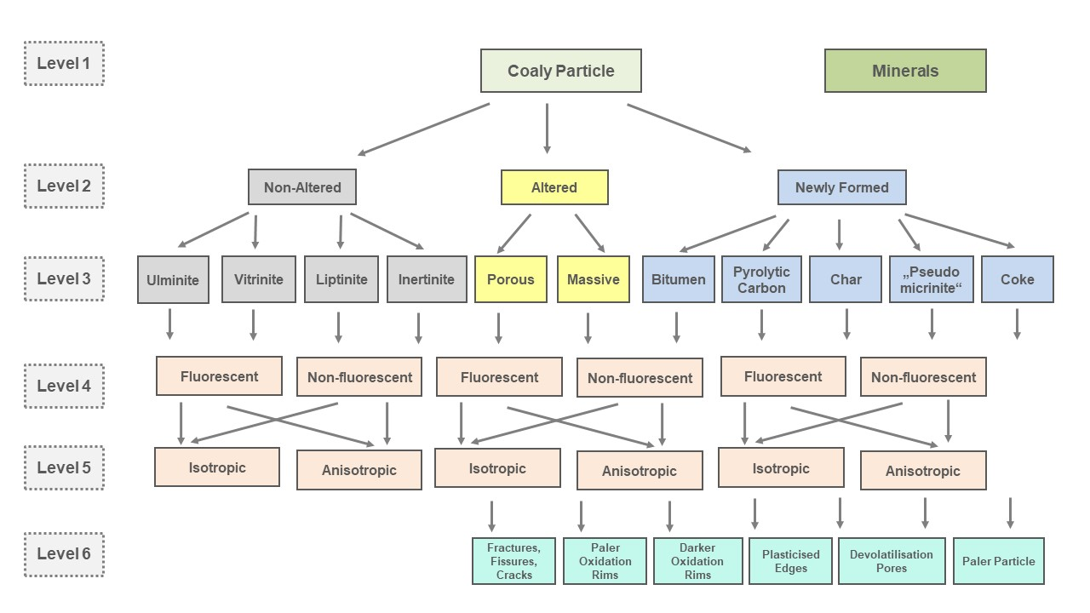
Commission III: Self-heating WG
2022 Classification of SHWG Round Robin Exercise:
The enclosed classification of oxidatively and thermally affected coals in self-hated coal seams differs slightly from one prepared for the 2020 SHWG Round Robin Exercise.
The difference includes amendments on definitions of the following categories:
isotropic, anisotropic,
porous, massive,
devolatilisation pores, and
paler in colour particle.
Meeting of ICCP SH WG 22.09.2023 – Joint 74th ICCP and 39th TSOP Meeting, Patras, 2023
Notes:
Fibered light sources of a given specification depending on the bulb type, wavelength, output mode and measurement type (Absorbance, Fluorescence, Reflectance, Transmission or Calibration and with options for UV, Visible
Tungsten HalogenHL-2000 – red
Deuterium Tungsten HalogenDH-2000-BAL – blue

Slide 6
Commission III: Self-heating WG
2022 Classification of SHWG Round Robin Exercise:
Isotropic - Coal grains with no optical anisotropy on the basis of optical examination of images of coal pellets by incident polarised light.
The measured optical anisotropy provided by Rmax/Rmin and Rbi values originate from a
coal grain located directly underneath the red rectangle. The measured optical anisotropy
is given solely as a general information and should be not taken into consideration at this
Level 5.
Non-isotropic - Coal grains with observable optical anisotropy on the basis of optical examination of images of coal pellets by incident polarised light.
The measured optical isotropy provided by Rmax/Rmin and Rbi values originate from a coal
grain located directly underneath the red rectangle. The measured optical isotropy is given
solely as a general information and should be not taken into consideration at this Level 5.
Meeting of ICCP SH WG 22.09.2023 – Joint 74th ICCP and 39th TSOP Meeting, Patras, 2023
Notes:
Fibered light sources of a given specification depending on the bulb type, wavelength, output mode and measurement type (Absorbance, Fluorescence, Reflectance, Transmission or Calibration and with options for UV, Visible
Tungsten HalogenHL-2000 – red
Deuterium Tungsten HalogenDH-2000-BAL – blue

Slide 7
Commission III: Self-heating WG
2022 Classification of SHWG Round Robin Exercise:
Massive - Area lacking any devolatilisation pores. It may contain fractures, fissures, and cracks.
Porous - Area marked by devolatilisation pores only. Devolatilisation pores result from formation of light gases and tar vapour during self-heating processes. Devolatilisation pores display rounded outlines with shapes from circular, through oval to stretched. They can be filled or unfilled.
Pores resulting from inertinite (thermally altered or non-altered) are not to be included
here.
Meeting of ICCP SH WG 22.09.2023 – Joint 74th ICCP and 39th TSOP Meeting, Patras, 2023
Notes:
Fibered light sources of a given specification depending on the bulb type, wavelength, output mode and measurement type (Absorbance, Fluorescence, Reflectance, Transmission or Calibration and with options for UV, Visible
Tungsten HalogenHL-2000 – red
Deuterium Tungsten HalogenDH-2000-BAL – blue

Slide 8
Commission III: Self-heating WG
2022 Classification of SHWG Round Robin Exercise:
Devolatilisation pores - Particles with devolatilisation pores that are usually round or oval in shape, sometimes they are elongated; their size is from a few to tens of µm; only pores related to thermal processes are included here.
Fractures, fissures, and cracks are not included here.
Porosity being an original feature of maceral, e.g. porosity of fusinite, is also not included
here.
Paler in colour particle - Vitrinite grains of lighter colour when compared with the background colour of non-altered vitrinite as provided in the upper right corner of the ppt-presentation.
Meeting of ICCP SH WG 22.09.2023 – Joint 74th ICCP and 39th TSOP Meeting, Patras, 2023
Notes:
Fibered light sources of a given specification depending on the bulb type, wavelength, output mode and measurement type (Absorbance, Fluorescence, Reflectance, Transmission or Calibration and with options for UV, Visible
Tungsten HalogenHL-2000 – red
Deuterium Tungsten HalogenDH-2000-BAL – blue

Slide 9
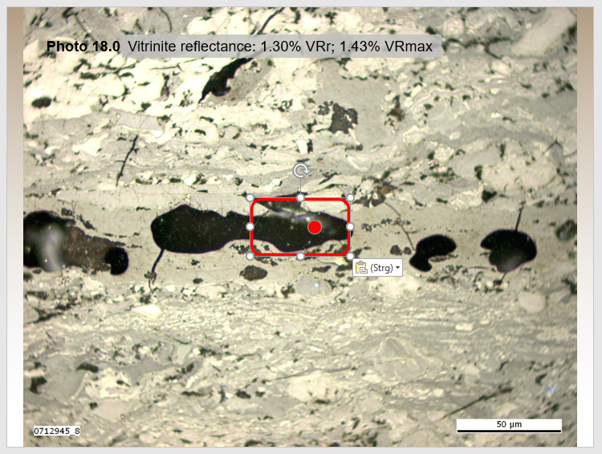

Commission III: Self-heating WG
Procedure of 2022 SHWG Round Robin Exercise:
Determine the form of coaly matter in the rectangle in accordance to the 2022 classification
In case of level 3: Altered – Porous, Massive, please mark one of them based on the dot located in the red rectangle. The dot dictates whether the area underneath is porous or massive.
Mark the answer in the attached Excel file
(2022 Round Robin Exercise SHWG.xls).
Background mean VRr – 0.94% with SD 0.04%.
0.90≤VRr≥0.98 were considered to be thermally/oxidatively altered coals in coal seams.
21 Participants
porous
massive
Meeting of ICCP SH WG 22.09.2023 – Joint 74th ICCP and 39th TSOP Meeting, Patras, 2023
Notes:
Fibered light sources of a given specification depending on the bulb type, wavelength, output mode and measurement type (Absorbance, Fluorescence, Reflectance, Transmission or Calibration and with options for UV, Visible
Tungsten HalogenHL-2000 – red
Deuterium Tungsten HalogenDH-2000-BAL – blue

Slide 10
Commission III: Self-heating WG
Participants of 2022 SHWG Round Robin Exercise:
Ali İhsan Karayiğit – Hacettepe University, Department of Geological Engineering, 06800 Ankara, Turkey
Ashok K. Singh – Coal Petrology Section, Resource Quality Assessment Division, CSIR-Central Institute of Mining and Fuel Research, Digwadih Campus, Dhanbad, India
Deolinda Flores – Institute of Earth Sciences - Pole of University of Porto, Rua do Campo Alegre, 687, 4169-007 Porto, Portugal; University of Porto, Department of Geosciences, Environment and Spatial Planning, Rua do Campo Alegre, 687, 4169-007 Porto, Portugal
Dragana Životić – Faculty of Mining and Geology, University of Belgrade, Djusina 7, 11000 Beograd, Serbia
Georgeta Predeanu – University Politehnica of Bucharest (UPB) ,Faculty of Applied Chemistry and Materials Science, PolizuSt.1–7, 011061Bucharest, Romania
Georgia Petratou – University of Patras, Department of Geology, Postal Code 265 04 Rio Patras, Greece
Ivana Sýkorová – Academy of Sciences of the Czech Republic, Institute of Rocks Structure and Mechanics, V Holešovičkách 94/41, Praha 18209, Czech Republic
Joana Ribeiro – Universidade do Porto, Departamento de Geociências, Ambiente e Ordenamento do Território, Rua do Campo Alegre, 687, 4169-007 Porto, Portugal
Meeting of ICCP SH WG 22.09.2023 – Joint 74th ICCP and 39th TSOP Meeting, Patras, 2023
Notes:
Fibered light sources of a given specification depending on the bulb type, wavelength, output mode and measurement type (Absorbance, Fluorescence, Reflectance, Transmission or Calibration and with options for UV, Visible
Tungsten HalogenHL-2000 – red
Deuterium Tungsten HalogenDH-2000-BAL – blue

Slide 11
Commission III: Self-heating WG
Participants of 2022 SHWG Round Robin Exercise:
Kimon Christanis – University of Patras, Department of Geology, Postal Code 265 04 Rio Patra, Greece
Magdalena Misz-Kennan – Faculty of Natural Sciences, Institute of Earth Sciences, University of Silesia, Katowice, Będzińska 60, 41-205 Sosnowiec, Poland
Małgorzata Wojtaszek-Kalaitzidi – Institute for Chemical Processing of Coal, 1 Zamkowa Street, 41-803 Zabrze, Poland
Marvin Moroeng – University of Johannesburg, Department of Geology, Johannesburg, South Africa
Nikki Wagner – University of Johannesburg, Department of Geology, Johannesburg, South Africa
Paul Hackley – U.S. Geological Survey, Geology, Energy & Minerals Science Center, 12201 Sunrise Valley Dr., MS 954, Reston, VA 20192, USA
Priya Kumari – Coal Petrology Section, Resource Quality Assessment Division, CSIR-Central Institute of Mining and Fuel Research, Digwadih Campus, Dhanbad, India
Sandra Rodrigues – Coal Lab., School of Earth and Environmental Sciences, The University of Queensland, Staff House Road, St Lucia 4072, QLD, Australia
Sławka Pusz – Polish Academy of Sciences, Centre of Polymer and Carbon Materials, M. Curie-Skłodowskiej 34, PL-41819 Zabrze, Poland
Meeting of ICCP SH WG 22.09.2023 – Joint 74th ICCP and 39th TSOP Meeting, Patras, 2023
Notes:
Fibered light sources of a given specification depending on the bulb type, wavelength, output mode and measurement type (Absorbance, Fluorescence, Reflectance, Transmission or Calibration and with options for UV, Visible
Tungsten HalogenHL-2000 – red
Deuterium Tungsten HalogenDH-2000-BAL – blue

Slide 12
Commission III: Self-heating WG
Participants of 2022 SHWG Round Robin Exercise:
Stavros Kalaitzidis – University of Patras, Department of Geology, Postal Code 265 04 Rio Patras, Greece
Tara Congo – Coal Lab., School of Earth and Environmental Sciences, The University of Queensland, Staff House Road, St Lucia 4072, QLD, Australia
Zeynep Buckun – Dokuz Eylul University, Department of Geology Engineering, Izmir, Turkey
Meeting of ICCP SH WG 22.09.2023 – Joint 74th ICCP and 39th TSOP Meeting, Patras, 2023
Notes:
Fibered light sources of a given specification depending on the bulb type, wavelength, output mode and measurement type (Absorbance, Fluorescence, Reflectance, Transmission or Calibration and with options for UV, Visible
Tungsten HalogenHL-2000 – red
Deuterium Tungsten HalogenDH-2000-BAL – blue

Slide 13
Commission III: Self-heating WG
Standard Statistical Evaluation of categories with the minimum, maximum, and average
Level 1
Level 2
Level 3
Level 4
Level 5
Level 6
Meeting of ICCP SH WG 22.09.2023 – Joint 74th ICCP and 39th TSOP Meeting, Patras, 2023
Notes:
Fibered light sources of a given specification depending on the bulb type, wavelength, output mode and measurement type (Absorbance, Fluorescence, Reflectance, Transmission or Calibration and with options for UV, Visible
Tungsten HalogenHL-2000 – red
Deuterium Tungsten HalogenDH-2000-BAL – blue

Slide 14
Commission III: Self-heating WG
Standard Statistical Evaluation of categories with the minimum, maximum, and average
Improvement in the following categories:
Massive
Porous
Isotropic
Non-Isotropic
Measures undertaken in 2021-2022:
Modified definitions
Provided examples
Meeting of ICCP SH WG 22.09.2023 – Joint 74th ICCP and 39th TSOP Meeting, Patras, 2023
Notes:
Fibered light sources of a given specification depending on the bulb type, wavelength, output mode and measurement type (Absorbance, Fluorescence, Reflectance, Transmission or Calibration and with options for UV, Visible
Tungsten HalogenHL-2000 – red
Deuterium Tungsten HalogenDH-2000-BAL – blue

Slide 15
Commission III: Self-heating WG
Standard Statistical Evaluation of categories with the minimum, maximum, and average
Deterioration in the following categories:
Pale particles
Plasticised edges
Measures undertaken in 2021-2022:
Modified definitions
Provided examples
Meeting of ICCP SH WG 22.09.2023 – Joint 74th ICCP and 39th TSOP Meeting, Patras, 2023
Notes:
Fibered light sources of a given specification depending on the bulb type, wavelength, output mode and measurement type (Absorbance, Fluorescence, Reflectance, Transmission or Calibration and with options for UV, Visible
Tungsten HalogenHL-2000 – red
Deuterium Tungsten HalogenDH-2000-BAL – blue

Slide 16
Commission III: Self-heating WG
Raw Agreement Indices with only the Overall Level of Agreement (LOA) being evaluated for each of the categories in this report. Level 3: MASSIVE – ALTERED
LOA were established by Uebersax (2001) and used by Predenau et al. (2015). The LOA gives a broader information of the evaluation status and is more accurate statistical approach then standard statistical evaluation.
Meeting of ICCP SH WG 22.09.2023 – Joint 74th ICCP and 39th TSOP Meeting, Patras, 2023
Notes:
Fibered light sources of a given specification depending on the bulb type, wavelength, output mode and measurement type (Absorbance, Fluorescence, Reflectance, Transmission or Calibration and with options for UV, Visible
Tungsten HalogenHL-2000 – red
Deuterium Tungsten HalogenDH-2000-BAL – blue

Slide 17
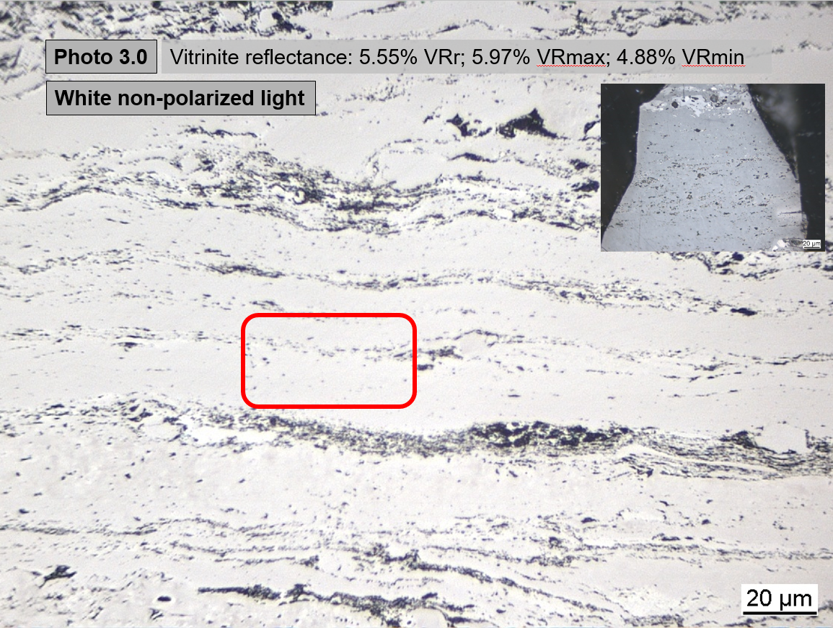
Commission III: Self-heating WG
Raw Agreement Indices with only the Overall Level of Agreement (LOA) being evaluated for each of the categories in this report.
Level 6: PALER PARTICLE – ALTERED / NEWLY FORMED
Vitrinite grains of higher reflectance compared with the background value.
Please, make multiple answers, if adequate for the Altered and Newly Formed categories.
In the photo 3.0, general 9 out of 21 participants marked the particle in the rectangle as paler compared to the background attached in the upper right corner.
But: sometimes particles in the rectangle are not vitrinite, so that a direct comparison is not possible.
But: the answer is not compulsory.
Meeting of ICCP SH WG 22.09.2023 – Joint 74th ICCP and 39th TSOP Meeting, Patras, 2023
Notes:
Fibered light sources of a given specification depending on the bulb type, wavelength, output mode and measurement type (Absorbance, Fluorescence, Reflectance, Transmission or Calibration and with options for UV, Visible
Tungsten HalogenHL-2000 – red
Deuterium Tungsten HalogenDH-2000-BAL – blue

Slide 18
Commission III: Self-heating WG
Detailed Statistical Evaluation being evaluated for each of the categories in this report.
The Paler particle category is one of the least
recognizable among the forms.
Meeting of ICCP SH WG 22.09.2023 – Joint 74th ICCP and 39th TSOP Meeting, Patras, 2023
Notes:
Fibered light sources of a given specification depending on the bulb type, wavelength, output mode and measurement type (Absorbance, Fluorescence, Reflectance, Transmission or Calibration and with options for UV, Visible
Tungsten HalogenHL-2000 – red
Deuterium Tungsten HalogenDH-2000-BAL – blue

Slide 19
Commission III: Self-heating WG
2024 Round Robin Exercise:
  Look into improvement of the categories: Paler particles and Plasticised edges.
  Differentiate between the different type of fractures:
  bifurcated/dendritic (weathering associated)
  concave (self-heating associated)
  Parallel to sub-parallel (tectonics associated)
  Focus on self-heated coke.
Meeting of ICCP SH WG 22.09.2023 – Joint 74th ICCP and 39th TSOP Meeting, Patras, 2023
Notes:
Fibered light sources of a given specification depending on the bulb type, wavelength, output mode and measurement type (Absorbance, Fluorescence, Reflectance, Transmission or Calibration and with options for UV, Visible
Tungsten HalogenHL-2000 – red
Deuterium Tungsten HalogenDH-2000-BAL – blue

Slide 20
Commission III: Self-heating WG
2022 Round Robin Exercise:
  The Conveners wish to thank the Participants for commitment and feedback!!
  The Conveners would like to express their great thankfulness to
  Ewa Szram at Faculty of Natural Sciences, Institute of Earth Sciences,
  University of Silesia in Katowice, Poland for preparation of the detailed statistical evaluation !!!
  The Conveners would like also to to thank Stavros Kalaitzidis for updating the webpage of the SH WG !!!
Meeting of ICCP SH WG 222.09.2023 – Joint 74th ICCP and 39th TSOP Meeting, Patras, 2023
Notes:
Fibered light sources of a given specification depending on the bulb type, wavelength, output mode and measurement type (Absorbance, Fluorescence, Reflectance, Transmission or Calibration and with options for UV, Visible
Tungsten HalogenHL-2000 – red
Deuterium Tungsten HalogenDH-2000-BAL – blue

Slide 21
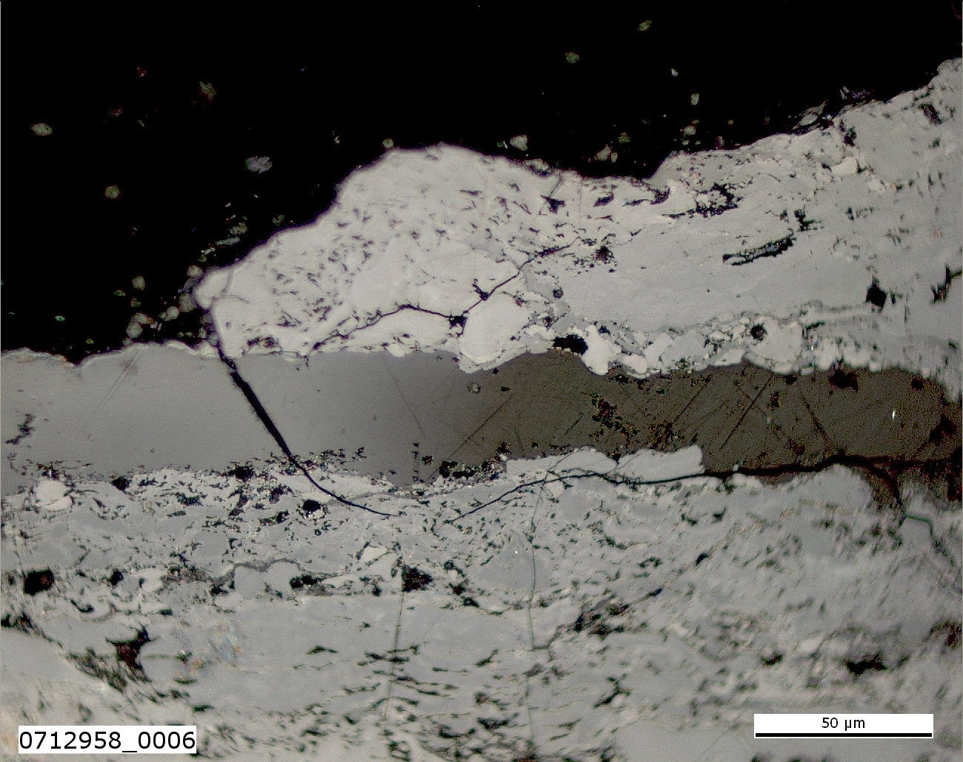
Thank you very much for your attention!
China, Wuda Coalfield
Suihaitu Mine
Coal fire zone 18
Coal seam No. 4
Description: Microfracture with pale oxidation rim in sporinite.
Lithology: coal
Stratigraphy: Shanxi Fm. (Permian)
Sample ID: 0712958 (W7-18)
Meeting of ICCP SH WG 22.09.2023 – Joint 74th ICCP and 39th TSOP Meeting, Patras, 2023

Slide 22
Impressum
Herausgeber:
Bundesanstalt für Geowissenschaften und Rohstoffe
Stilleweg 2
30655 Hannover
Contact:
Dr. Jolanta Kus
Jolanta.Kus@bgr.de
Joint 74th ICCP and 39th TSOP Meeting, Patras, Greece, 2023
ICCP Commission III
Self-heating WG
Stand: September 2023
Meeting of ICCP SH WG 22.09.2023 – Joint 74th ICCP and 39th TSOP Meeting, Patras, 2023

