Slide 1
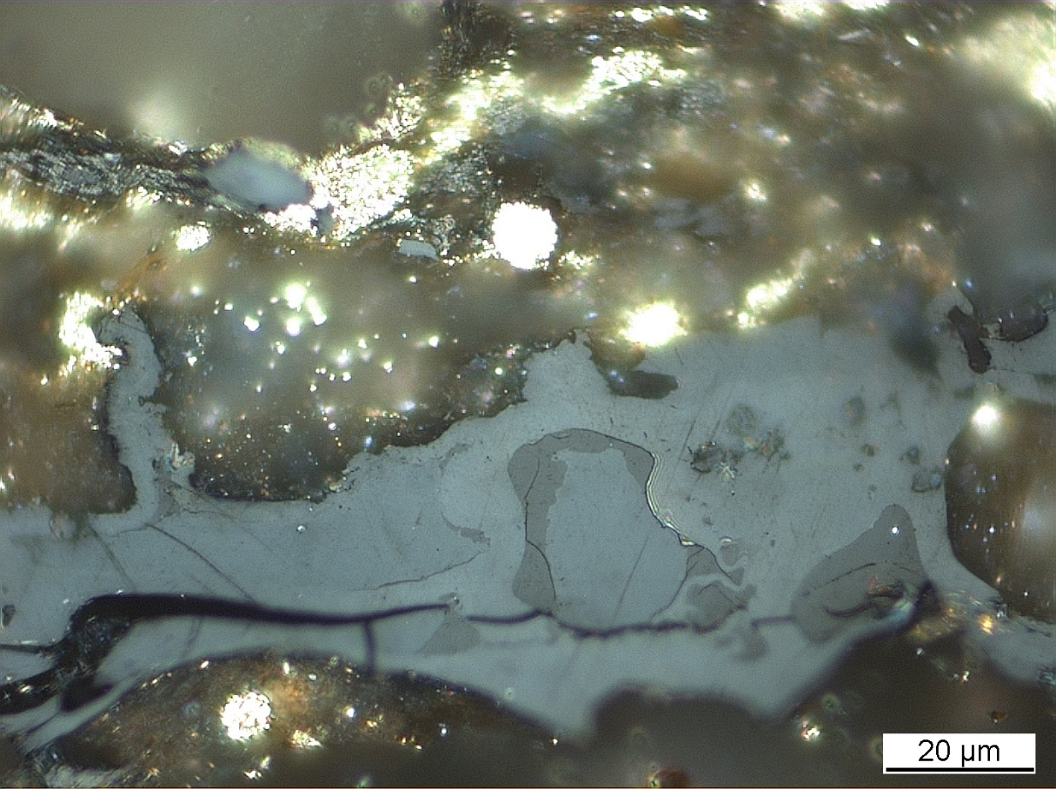
Identification of Dispersed organic Matter WG
Commission II
British Geological Survey, National Geological Repository
North Sea, UK, offshore well 16/17-14
Kimmeridge Clay Formation
Convenor: Dr. Jolanta Kus
ICCP Commission II
Joint 74th ICCP and 39th TSOP Meeting, Patras, Greece, 2023

Slide 2
Commission II: Identification of Dispersed Organic Matter WG
The aims of the IDOM WG are as follows:
1. to examine and asses a potential suitability of the ICCP-TSOP Classification System of DOM in identification of organic components in whole rock pellets,
2. to modify, if necessary the ICCP definitions of liptinite macerals (lamalginite, telalginite and bituminite (ICCP, 1993).
Meeting of ICCP IDOM WG 19.09.2023 – Joint 74th ICCP and 39th TSOP Meeting, Patras, 2023
Notes:
Fibered light sources of a given specification depending on the bulb type, wavelength, output mode and measurement type (Absorbance, Fluorescence, Reflectance, Transmission or Calibration and with options for UV, Visible
Tungsten HalogenHL-2000 – red
Deuterium Tungsten HalogenDH-2000-BAL – blue

Slide 3
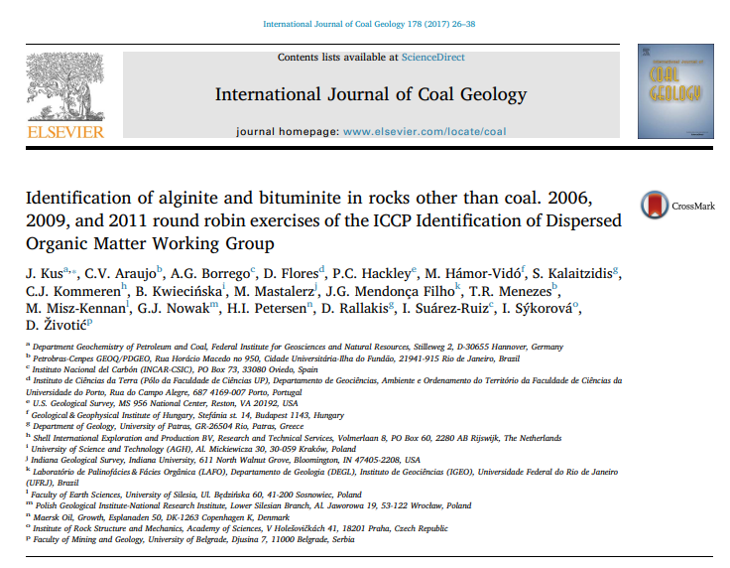
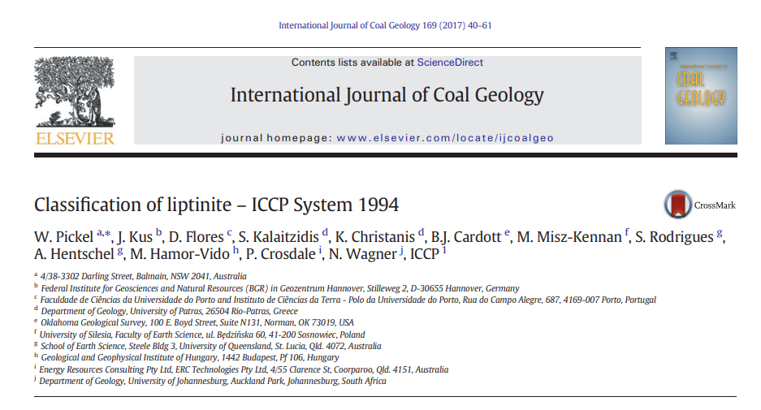
Commission II: Identification of Dispersed Organic Matter WG
Achievements of the IDOM WG are as follows:
1. Running round robin exercises in 2006, 2009, 2011, 2016, 2018, 2020, and 2022.
2. Publication of results from the 2006, 2009, and 2011 round robin exercises in 2017 in: Kus et al. (2017).
3. Contribution of results of the IDOM round robin exercises to the Classification of liptinite – ICCP System 1994 in Pickel et al. (2017).
4. Preparation of Case study of maturity series with Posidonia Shale from Hills area in Lower Saxoany Basin, Germany in 2013 and 2014.
Meeting of ICCP IDOM WG 19.09.2023 – Joint 74th ICCP and 39th TSOP Meeting, Patras, 2023
Notes:
Fibered light sources of a given specification depending on the bulb type, wavelength, output mode and measurement type (Absorbance, Fluorescence, Reflectance, Transmission or Calibration and with options for UV, Visible
Tungsten HalogenHL-2000 – red
Deuterium Tungsten HalogenDH-2000-BAL – blue

Slide 4
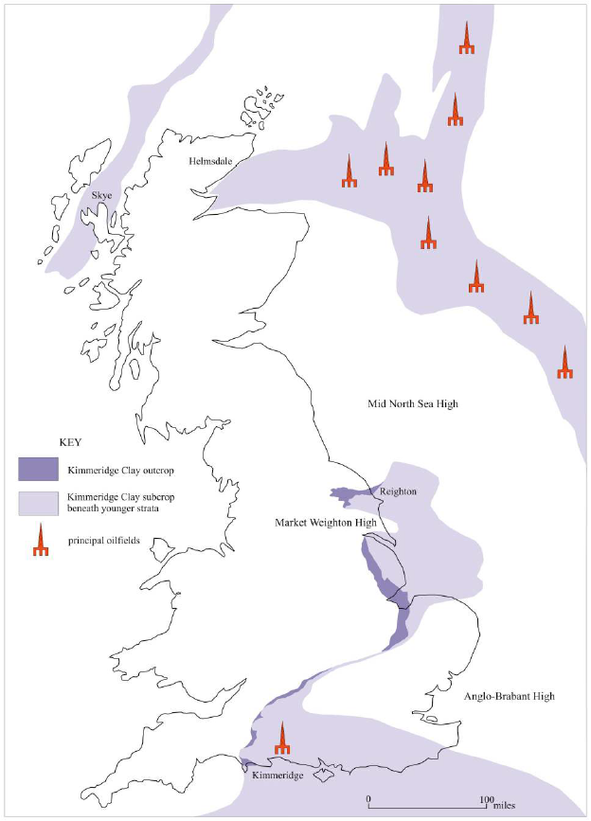
Commission II: Identification of Dispersed Organic Matter WG
Summary of the 2016, 2018, and 2020 Round Robin Exercises:
2016 Kimmeridge Bay: (N=21)
1. No preparation difficulties with possible effects on analyses in VRr (%):
GM – 0.476%
GSD – 0.1021
2. If excluding the signed multiple of standard deviation (SMSD)> 1.0 sensu Hackley et al. (2020):
GM – 0.499% (0.34 – 0.58%)
GSD – 0,0927
2020
North Sea
2018
Filey Bay
Gallois, R. W. 2004. Open University Geological Journal, Vol. 25, Part 2.
2016
Kimmeridge Bay
Meeting of ICCP IDOM WG 19.09.2023 – Joint 74th ICCP and 39th TSOP Meeting, Patras, 2023
Notes:
Fibered light sources of a given specification depending on the bulb type, wavelength, output mode and measurement type (Absorbance, Fluorescence, Reflectance, Transmission or Calibration and with options for UV, Visible
Tungsten HalogenHL-2000 – red
Deuterium Tungsten HalogenDH-2000-BAL – blue

Slide 5
Commission II: Identification of Dispersed Organic Matter WG
Summary of the 2016, 2018, and 2020 Round Robin Exercises:
2018 Filey Bay: (N=20)
1. Sever preparation difficulties with possible effects on analyses in VRr (%):
GM – 0.466%
GSD – 0.1099
2. If excluding the signed multiple of standard deviation (SMSD)> 1.0 sensu Hackley et al. (2020):
GM – 0.453%
GSD – 0.1081
2020
North Sea
2018
Filey Bay
Gallois, R. W. 2004. Open University Geological Journal, Vol. 25, Part 2.
2016
Kimmeridge Bay
Meeting of ICCP IDOM WG 19.09.2023 – Joint 74th ICCP and 39th TSOP Meeting, Patras, 2023
Notes:
Fibered light sources of a given specification depending on the bulb type, wavelength, output mode and measurement type (Absorbance, Fluorescence, Reflectance, Transmission or Calibration and with options for UV, Visible
Tungsten HalogenHL-2000 – red
Deuterium Tungsten HalogenDH-2000-BAL – blue

Slide 6
Commission II: Identification of Dispersed Organic Matter WG
Summary of the 2016, 2018, and 2020 Round Robin Exercises:
2020 North Sea: (N=19; 18 plus 1 add. Participant)
1. Severe preparation difficulties with possible explanation for analyses in VRr (%):
GM – 0.708%
GSD – 0,0951
2. If excluding the signed multiple of standard deviation (SMSD)> 1.0 sensu Hackley et al. (2020):
GM – 0,717%
GSD – 0,0912
2020
North Sea
2018
Filey Bay
Gallois, R. W. 2004. Open University Geological Journal, Vol. 25, Part 2.
2016
Kimmeridge Bay
Meeting of ICCP IDOM WG 19.09.2023 – Joint 74th ICCP and 39th TSOP Meeting, Patras, 2023
Notes:
Fibered light sources of a given specification depending on the bulb type, wavelength, output mode and measurement type (Absorbance, Fluorescence, Reflectance, Transmission or Calibration and with options for UV, Visible
Tungsten HalogenHL-2000 – red
Deuterium Tungsten HalogenDH-2000-BAL – blue

Slide 7
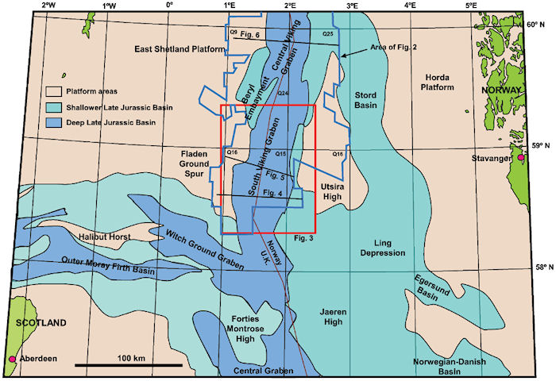
Commission II: Identification of Dispersed Organic Matter WG
2020 and 2023 Round Robin Exercises
Location of the sample:
North Sea Graben Province
South Viking Graben
Neighbouring the East Shetland
Platform
https://wiki.aapg.org/
Meeting of ICCP IDOM WG 19.09.2023 – Joint 74th ICCP and 39th TSOP Meeting, Patras, 2023
Notes:
Fibered light sources of a given specification depending on the bulb type, wavelength, output mode and measurement type (Absorbance, Fluorescence, Reflectance, Transmission or Calibration and with options for UV, Visible
Tungsten HalogenHL-2000 – red
Deuterium Tungsten HalogenDH-2000-BAL – blue

Slide 8
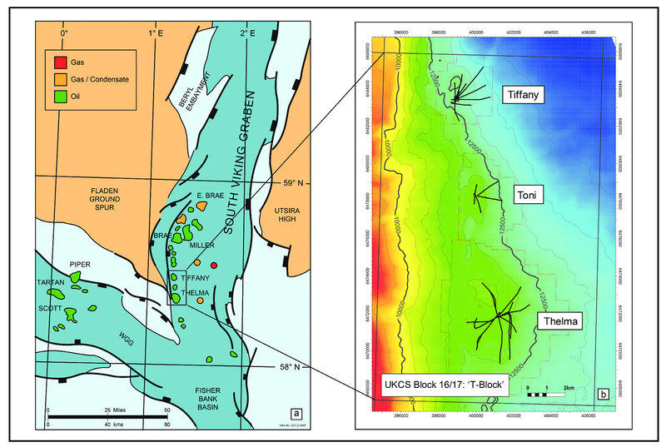
Commission II: Identification of Dispersed Organic Matter WG
2020 and 2023 Round Robin Exercises
Location of the sample:
South Viking Graben
Western margin of the Tiffany field
North Sea: 16/17-14 well
Depth: 13779.2 to 13779.5 ft
https://wiki.aapg.org/
Meeting of ICCP IDOM WG 19.09.2023 – Joint 74th ICCP and 39th TSOP Meeting, Patras, 2023
Notes:
Fibered light sources of a given specification depending on the bulb type, wavelength, output mode and measurement type (Absorbance, Fluorescence, Reflectance, Transmission or Calibration and with options for UV, Visible
Tungsten HalogenHL-2000 – red
Deuterium Tungsten HalogenDH-2000-BAL – blue

Slide 9
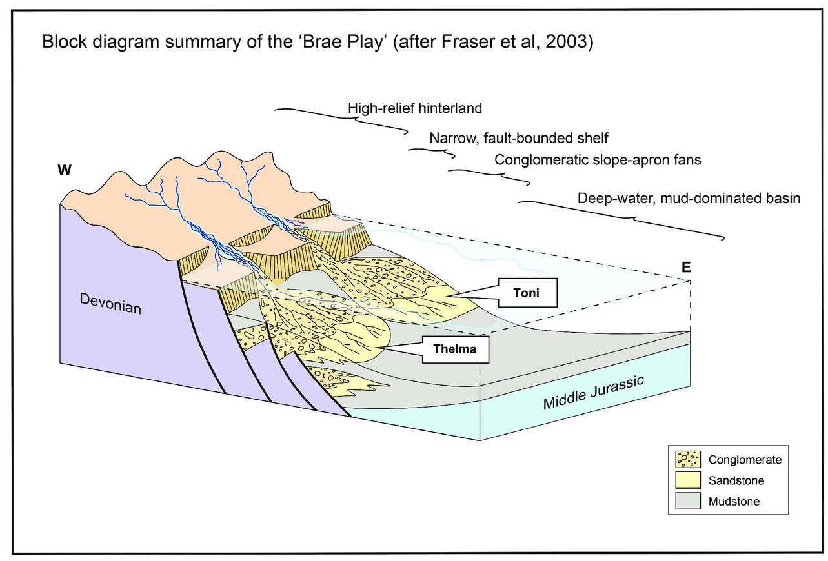
Commission II: Identification of Dispersed Organic Matter WG
2020 and 2023 Round Robin Exercises
Basin morphology Mid to Upper Jurassic:
Asymmetric fault-bounded trough.
Late Jurassic with faulting and rapid basin
subsidence.
Predomination of classic sedimentation (fluvial)
in nearshore area.
Deposition of submarine platform-margin fans.
Mud-supported conglomerates and sandstones interbedded with subordinate amounts of
mudstone.
https://wiki.aapg.org/
Meeting of ICCP IDOM WG 19.09.2023 – Joint 74th ICCP and 39th TSOP Meeting, Patras, 2023
Notes:
Fibered light sources of a given specification depending on the bulb type, wavelength, output mode and measurement type (Absorbance, Fluorescence, Reflectance, Transmission or Calibration and with options for UV, Visible
Tungsten HalogenHL-2000 – red
Deuterium Tungsten HalogenDH-2000-BAL – blue

Slide 10
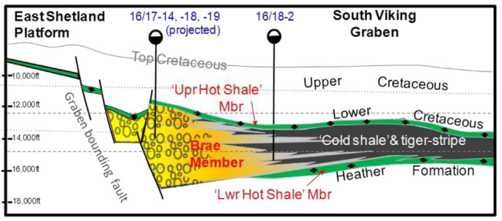
Commission II: Identification of Dispersed Organic Matter WG
2020 and 2023 Round Robin Exercises
Basin morphology Mid to Upper Jurassic:
Proximal fan-apron systems at the margin of East Shetland Platform as reservoir of “T Block” (16/17) fields (Tiffany, Toni, and Thelma).
Meeting of ICCP IDOM WG 19.09.2023 – Joint 74th ICCP and 39th TSOP Meeting, Patras, 2023
Notes:
Fibered light sources of a given specification depending on the bulb type, wavelength, output mode and measurement type (Absorbance, Fluorescence, Reflectance, Transmission or Calibration and with options for UV, Visible
Tungsten HalogenHL-2000 – red
Deuterium Tungsten HalogenDH-2000-BAL – blue

Slide 11
Commission II: Identification of Dispersed Organic Matter WG
2020 and 2023 Round Robin Exercises
Sample collection:
North Sea: 16/17-14 well
Depth: 13779.2 to 13779.5 ft
Sample collection: British Geological Survey core storage in Keyworth, Nottingham, UK.
Tracey Gallagher and Prof. H. Chris Greenwell are greatly acknowledged.
Mudstone dominated with interbedded fine to medium grained sandstones.
Meeting of ICCP IDOM WG 19.09.2023 – Joint 74th ICCP and 39th TSOP Meeting, Patras, 2023
Notes:
Fibered light sources of a given specification depending on the bulb type, wavelength, output mode and measurement type (Absorbance, Fluorescence, Reflectance, Transmission or Calibration and with options for UV, Visible
Tungsten HalogenHL-2000 – red
Deuterium Tungsten HalogenDH-2000-BAL – blue

Slide 12
Commission II: Identification of Dispersed Organic Matter WG
2020 and 2023 Round Robin Exercises
Organic Geochemistry:
North Sea well 16/17-14
Depth: 13779.2 to 13779.5 ft
2020
North Sea
S1 (mg/g) | S2 (mg/g) | S3 (mg/g) | Tmax (°C)
3.97 | 6.01 | 0.36 | 439
TC (%) | TOC (%) | TS (%)
5.32 | 5.32 | 4.95
2018
Filey Bay
Gallois, R. W. 2004. Open University Geological Journal, Vol. 25, Part 2.
2016
Kimmeridge Bay
Meeting of ICCP IDOM WG 19.09.2023 – Joint 74th ICCP and 39th TSOP Meeting, Patras, 2023
Notes:
Fibered light sources of a given specification depending on the bulb type, wavelength, output mode and measurement type (Absorbance, Fluorescence, Reflectance, Transmission or Calibration and with options for UV, Visible
Tungsten HalogenHL-2000 – red
Deuterium Tungsten HalogenDH-2000-BAL – blue

Slide 13
Commission II: Identification of Dispersed Organic Matter WG
2023 Round Robin Exercise: raw data (N-17)
Vitrinite – whole rock sample – dry polished
GM – 0.69% (0.60 – 0.81%)
GSD – 0.044
PSD – 0.025 – 0.091
Two high SMSDs (2.179≥ UMSD ≤2.569)
2020 Round Robin Exercise: raw data (N-19)
Vitrinite – whole rock sample – wet polished
GM – 0.71% (0.54 – 0.98%)
GSD – 0.095
PSD – 0.026 – 0.147
Two high SMSDs (1.824≥PSD≤2.836)
Median (0.688)
Median (0.695)
Meeting of ICCP IDOM WG 19.09.2023 – Joint 74th ICCP and 39th TSOP Meeting, Patras, 2023
Notes:
Fibered light sources of a given specification depending on the bulb type, wavelength, output mode and measurement type (Absorbance, Fluorescence, Reflectance, Transmission or Calibration and with options for UV, Visible
Tungsten HalogenHL-2000 – red
Deuterium Tungsten HalogenDH-2000-BAL – blue

Slide 14
Commission II: Identification of Dispersed Organic Matter WG
2023 Round Robin Exercise: Difference in VRr % 2023 (dry polishing) vs. VRr % 2020 (wet polishing).
eg.: 0.02 = difference in VRr(%)
0.03
0.02
Outliers
0.21
0.02
0.02
0.07
0.10
0.01
0.02
0.10
0.30
0.07
Very low scatter of VRr (%) around iso-line when discarding outliers; (N16-4Outliers).
Lower VRr in dry than VRr in wet-polishing with difference ≤ 0.03 %.
Meeting of ICCP IDOM WG 19.09.2023 – Joint 74th ICCP and 39th TSOP Meeting, Patras, 2023
Notes:
Fibered light sources of a given specification depending on the bulb type, wavelength, output mode and measurement type (Absorbance, Fluorescence, Reflectance, Transmission or Calibration and with options for UV, Visible
Tungsten HalogenHL-2000 – red
Deuterium Tungsten HalogenDH-2000-BAL – blue

Slide 15
Commission II: Identification of Dispersed Organic Matter WG
2023 Round Robin Exercise: Dry polishing
Vitrinite reflectance measurements by ASTM D7708-14
ASTM D7708. Test method for microscopical determination of the reflectance of vitrinite dispersed in sedimentary rocks.
Sample preparation by DIN 22020-2:1998-08
Investigations of raw material in hard-coal-mining - Microscopical examination of hard
coal, coke and briquettes - Part 2: Preparation of polished surface from lump material and
particulate blocks.
Borrego (2017): A dry polishing technique for the petrographic examination of mudrocks: Discussion. IJCG 183, 136-137.
Dry polishing – Dr. Bertrand Ligouis (LAOP), Germany
The last stage of final dry polishing is performed with 0.05 µm aluminium oxide powder. Dry polishing is performed without pressure at very low speeds and the steps take only a few seconds (bertrand.ligouis@uni-tuebingen.de).
Meeting of ICCP IDOM WG 19.09.2023 – Joint 74th ICCP and 39th TSOP Meeting, Patras, 2023
Notes:
Fibered light sources of a given specification depending on the bulb type, wavelength, output mode and measurement type (Absorbance, Fluorescence, Reflectance, Transmission or Calibration and with options for UV, Visible
Tungsten HalogenHL-2000 – red
Deuterium Tungsten HalogenDH-2000-BAL – blue

Slide 16
Commission II: Identification of Dispersed Organic Matter WG
2023 Round Robin Exercise: Difference in PSD 2023 (dry polishing) vs. PSD 2020 (wet polishing)
0.02
0.02
0.03
0.01
0.02
0.06
0.00
0.06
Very low scatter around iso-line without outliers at 0.06.
Slightly lower PSD in dry- than PSD in wet-polishing (difference ≤ 0.03 %)
Meeting of ICCP IDOM WG 19.09.2023 – Joint 74th ICCP and 39th TSOP Meeting, Patras, 2023
Notes:
Fibered light sources of a given specification depending on the bulb type, wavelength, output mode and measurement type (Absorbance, Fluorescence, Reflectance, Transmission or Calibration and with options for UV, Visible
Tungsten HalogenHL-2000 – red
Deuterium Tungsten HalogenDH-2000-BAL – blue

Slide 17
Commission II: Identification of Dispersed Organic Matter WG
2023 Round Robin Exercise: Difference in N 2023 (dry polishing) vs. N 2020 (wet polishing)
Participants measured nearly equally either higher number values in wet polishing or higher number values in dry polishing.
Data points above the iso-line indicate higher number of measurements for dry polishing.
N wet range: 8 – 100 (aver.: 44)
N dry range: 7 – 100 (aver.: 34)
Lower average N for dry polishing
Meeting of ICCP IDOM WG 19.09.2023 – Joint 74th ICCP and 39th TSOP Meeting, Patras, 2023
Notes:
Fibered light sources of a given specification depending on the bulb type, wavelength, output mode and measurement type (Absorbance, Fluorescence, Reflectance, Transmission or Calibration and with options for UV, Visible
Tungsten HalogenHL-2000 – red
Deuterium Tungsten HalogenDH-2000-BAL – blue

Slide 18
Commission II: Identification of Dispersed Organic Matter WG
2023 Round Robin Exercise: raw data
Vitrinite – whole rock sample – dry polished
2020 Round Robin Exercise: raw data
Vitrinite – whole rock sample – wet polished
Class: 0.05
Class: 0.05
Anomalous
population
(0.98% VRr;
high SMSD)
MD=0.688
MD=0.695
Anomalous
population
(0.81% VRr;
high SMSD)
Anomalous
population
(0.60% VRr;
high SMSD)
Anomalous
population
(0.54% VRr;
high SMSD)
Meeting of ICCP IDOM WG 19.09.2023 – Joint 74th ICCP and 39th TSOP Meeting, Patras, 2023
Notes:
Fibered light sources of a given specification depending on the bulb type, wavelength, output mode and measurement type (Absorbance, Fluorescence, Reflectance, Transmission or Calibration and with options for UV, Visible
Tungsten HalogenHL-2000 – red
Deuterium Tungsten HalogenDH-2000-BAL – blue

Slide 19
Commission II: Identification of Dispersed Organic Matter WG
2023 Round Robin Exercise:
Vitrinite – whole rock sample – dry polished
2020 Round Robin Exercise: raw data
Vitrinite – whole rock sample – wet polished
Mixed
Population
Mixed Population
or recycled
High SMSD
High SMSD
Vitrinite
population
Vitrinite
population
Meeting of ICCP IDOM WG 19.09.2023 – Joint 74th ICCP and 39th TSOP Meeting, Patras, 2023
Notes:
Fibered light sources of a given specification depending on the bulb type, wavelength, output mode and measurement type (Absorbance, Fluorescence, Reflectance, Transmission or Calibration and with options for UV, Visible
Tungsten HalogenHL-2000 – red
Deuterium Tungsten HalogenDH-2000-BAL – blue

Slide 20
Commission II: Identification of Dispersed Organic Matter WG
2023 Round Robin Exercise:
Vitrinite – whole rock sample – dry polished
2nd population
2nd population
Meeting of ICCP IDOM WG 19.09.2023 – Joint 74th ICCP and 39th TSOP Meeting, Patras, 2023
Notes:
Fibered light sources of a given specification depending on the bulb type, wavelength, output mode and measurement type (Absorbance, Fluorescence, Reflectance, Transmission or Calibration and with options for UV, Visible
Tungsten HalogenHL-2000 – red
Deuterium Tungsten HalogenDH-2000-BAL – blue

Slide 21
Commission II: Identification of Dispersed Organic Matter WG
2023 Round Robin Exercise:
Vitrinite – whole rock sample – dry re-polished
Solid bitumen
Recycled vitrinite or Inertinite ?
Bituminite
Meeting of ICCP IDOM WG 19.09.2023 – Joint 74th ICCP and 39th TSOP Meeting, Patras, 2023
Notes:
Fibered light sources of a given specification depending on the bulb type, wavelength, output mode and measurement type (Absorbance, Fluorescence, Reflectance, Transmission or Calibration and with options for UV, Visible
Tungsten HalogenHL-2000 – red
Deuterium Tungsten HalogenDH-2000-BAL – blue

Slide 22
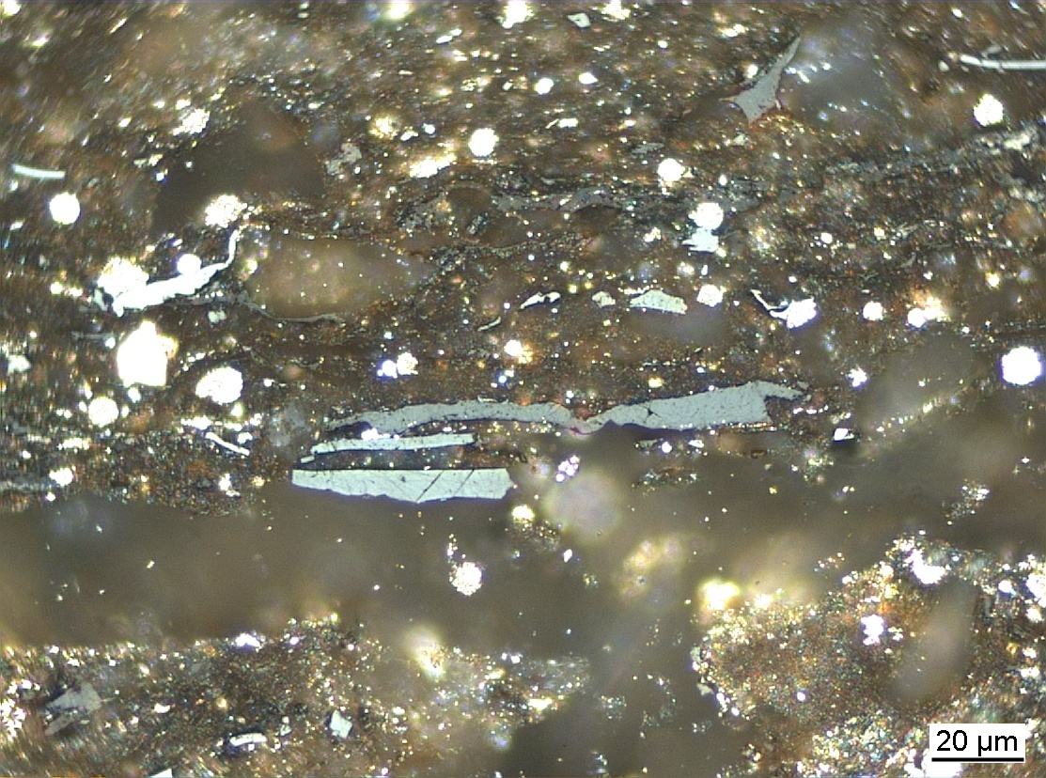
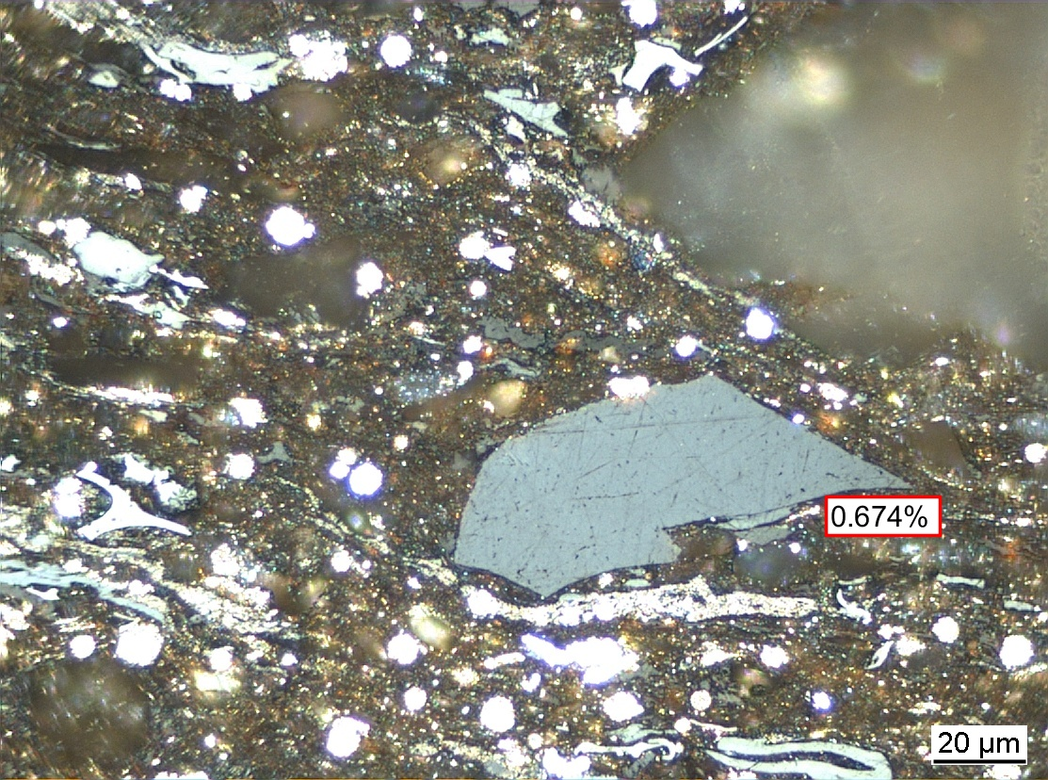
Commission II: Identification of Dispersed Organic Matter WG
2023 Round Robin Exercise:
Vitrinite – whole rock sample – dry polishing
V
Meeting of ICCP IDOM WG 19.09.2023 – Joint 74th ICCP and 39th TSOP Meeting, Patras, 2023
Notes:
Fibered light sources of a given specification depending on the bulb type, wavelength, output mode and measurement type (Absorbance, Fluorescence, Reflectance, Transmission or Calibration and with options for UV, Visible
Tungsten HalogenHL-2000 – red
Deuterium Tungsten HalogenDH-2000-BAL – blue

Slide 23
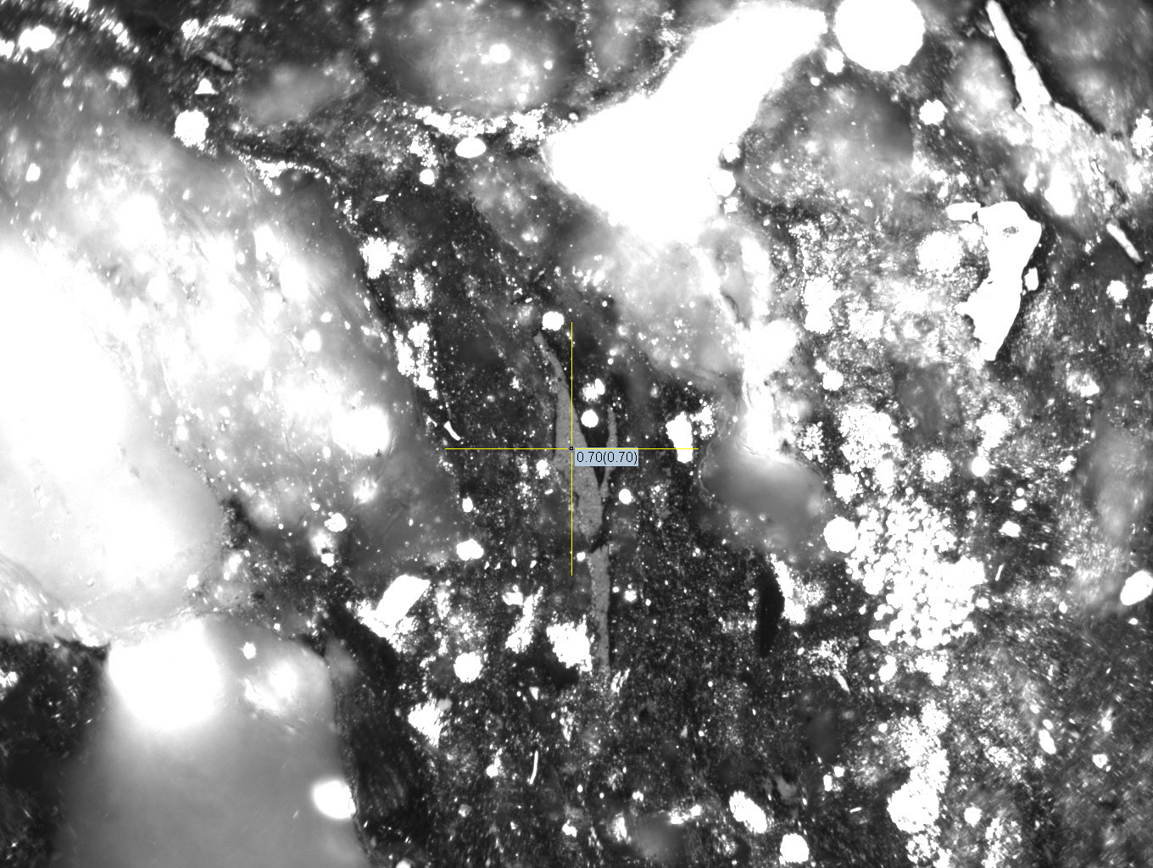
Commission II: Identification of Dispersed Organic Matter WG
2023 Round Robin Exercise:
Vitrinite – whole rock sample – dry polishing
Meeting of ICCP IDOM WG 19.09.2023 – Joint 74th ICCP and 39th TSOP Meeting, Patras, 2023
Notes:
Fibered light sources of a given specification depending on the bulb type, wavelength, output mode and measurement type (Absorbance, Fluorescence, Reflectance, Transmission or Calibration and with options for UV, Visible
Tungsten HalogenHL-2000 – red
Deuterium Tungsten HalogenDH-2000-BAL – blue

Slide 24
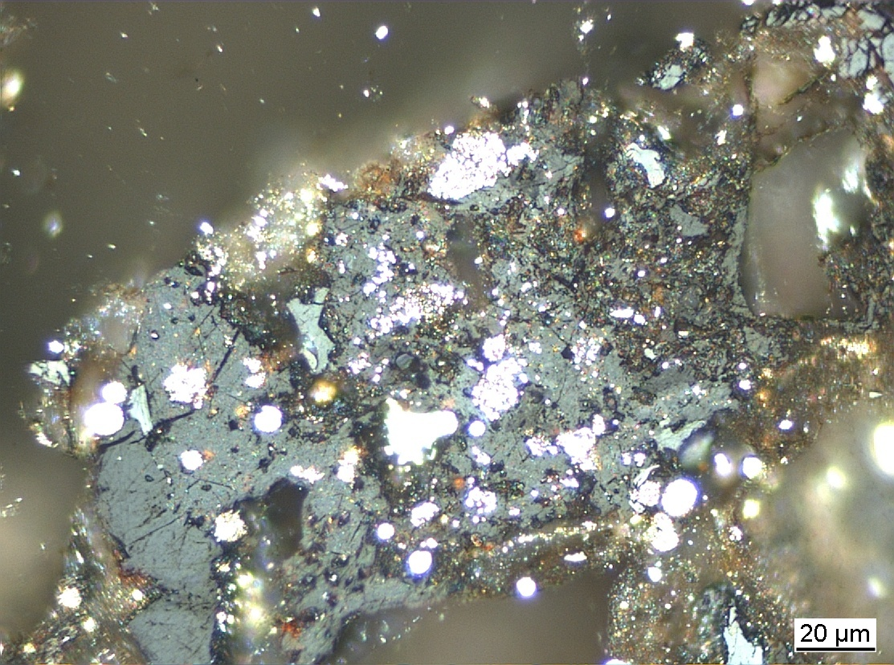
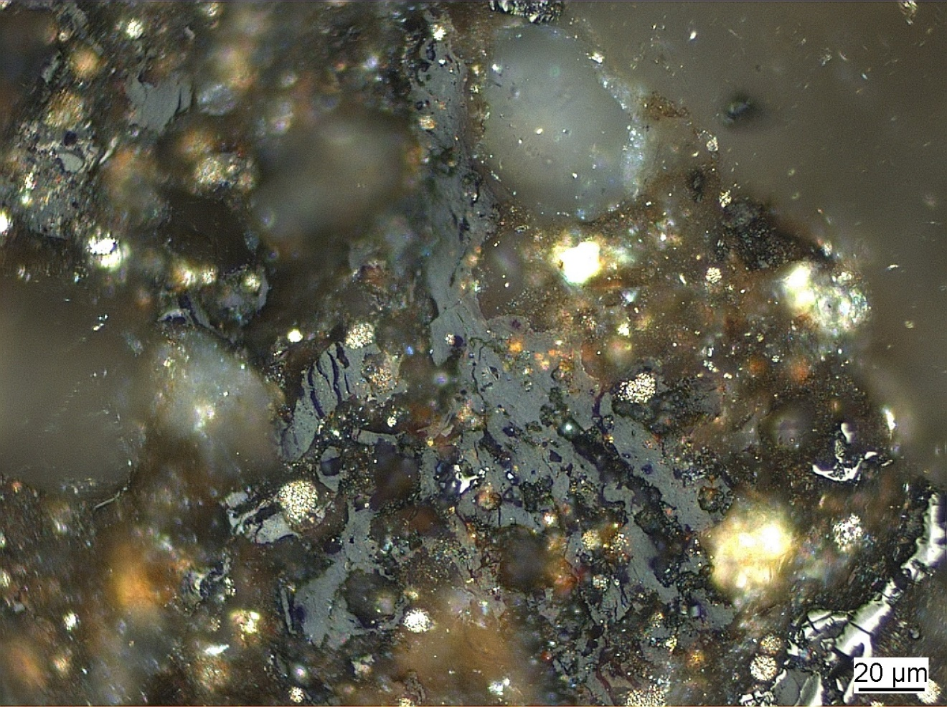
Commission II: Identification of Dispersed Organic Matter WG
2023 Round Robin Exercise:
Solid bitumen – whole rock sample – dry polishing
sb
sb
Meeting of ICCP IDOM WG 19.09.2023 – Joint 74th ICCP and 39th TSOP Meeting, Patras, 2023
Notes:
Fibered light sources of a given specification depending on the bulb type, wavelength, output mode and measurement type (Absorbance, Fluorescence, Reflectance, Transmission or Calibration and with options for UV, Visible
Tungsten HalogenHL-2000 – red
Deuterium Tungsten HalogenDH-2000-BAL – blue

Slide 25
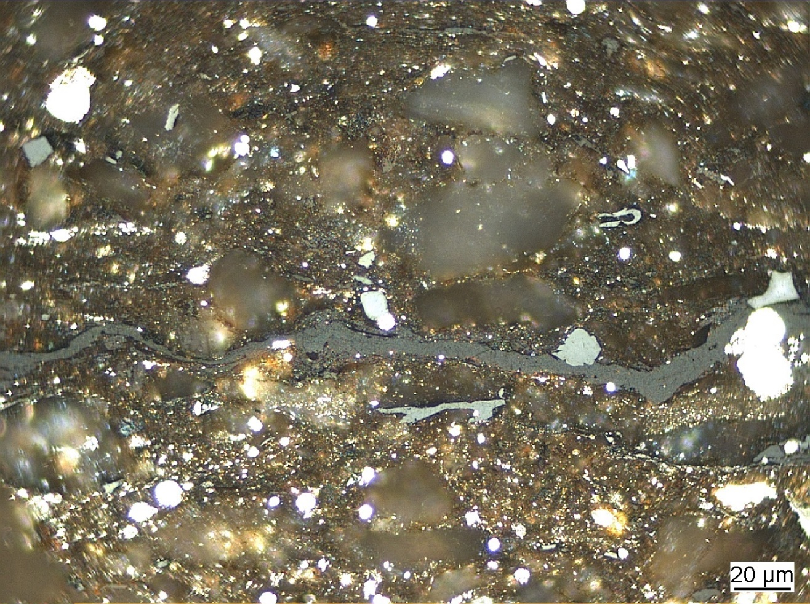
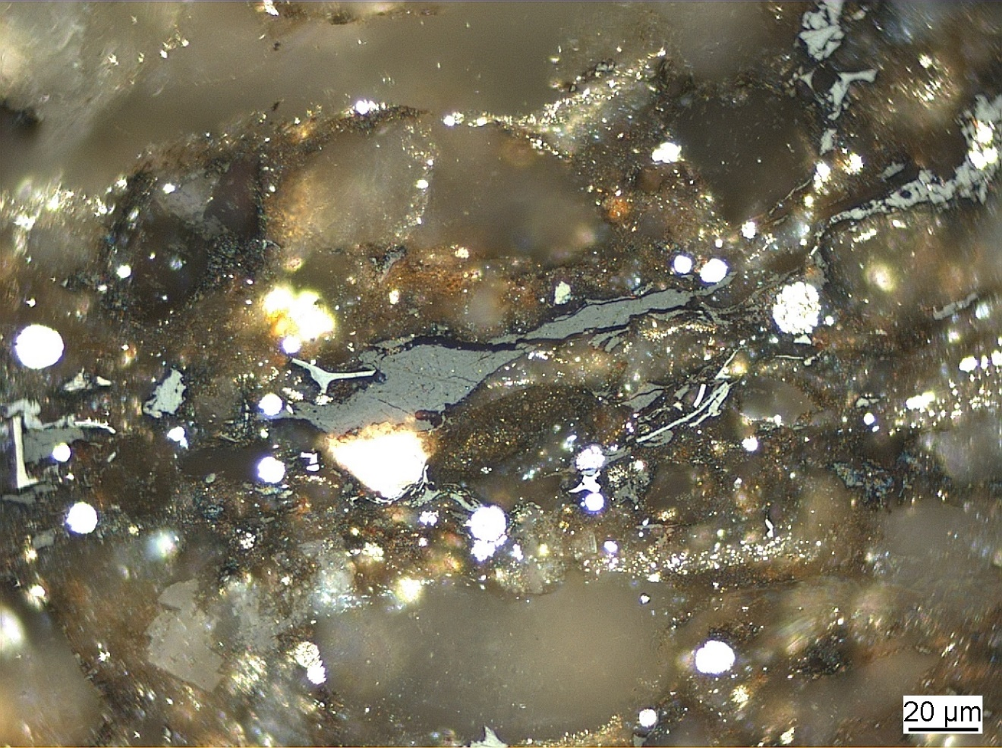
Commission II: Identification of Dispersed Organic Matter WG
2023 Round Robin Exercise:
Solid bitumen – whole rock sample – dry polishing
sb
sb
Meeting of ICCP IDOM WG 19.09.2023 – Joint 74th ICCP and 39th TSOP Meeting, Patras, 2023
Notes:
Fibered light sources of a given specification depending on the bulb type, wavelength, output mode and measurement type (Absorbance, Fluorescence, Reflectance, Transmission or Calibration and with options for UV, Visible
Tungsten HalogenHL-2000 – red
Deuterium Tungsten HalogenDH-2000-BAL – blue

Slide 26
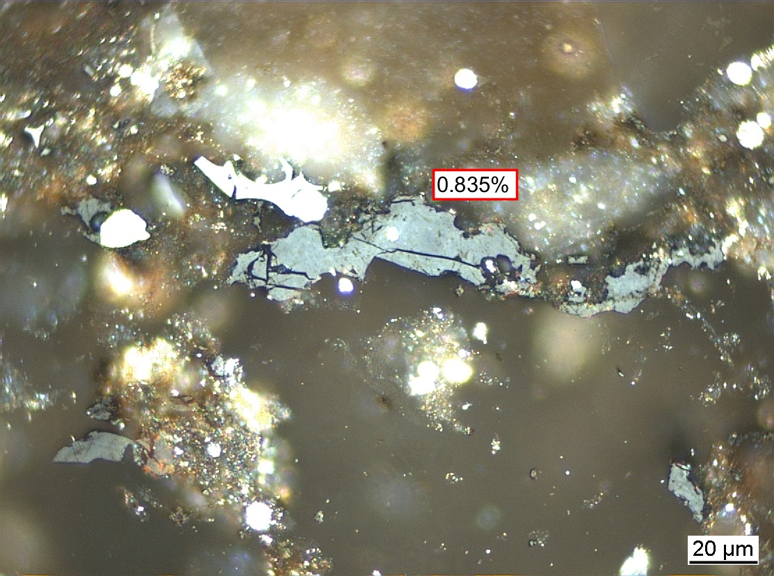
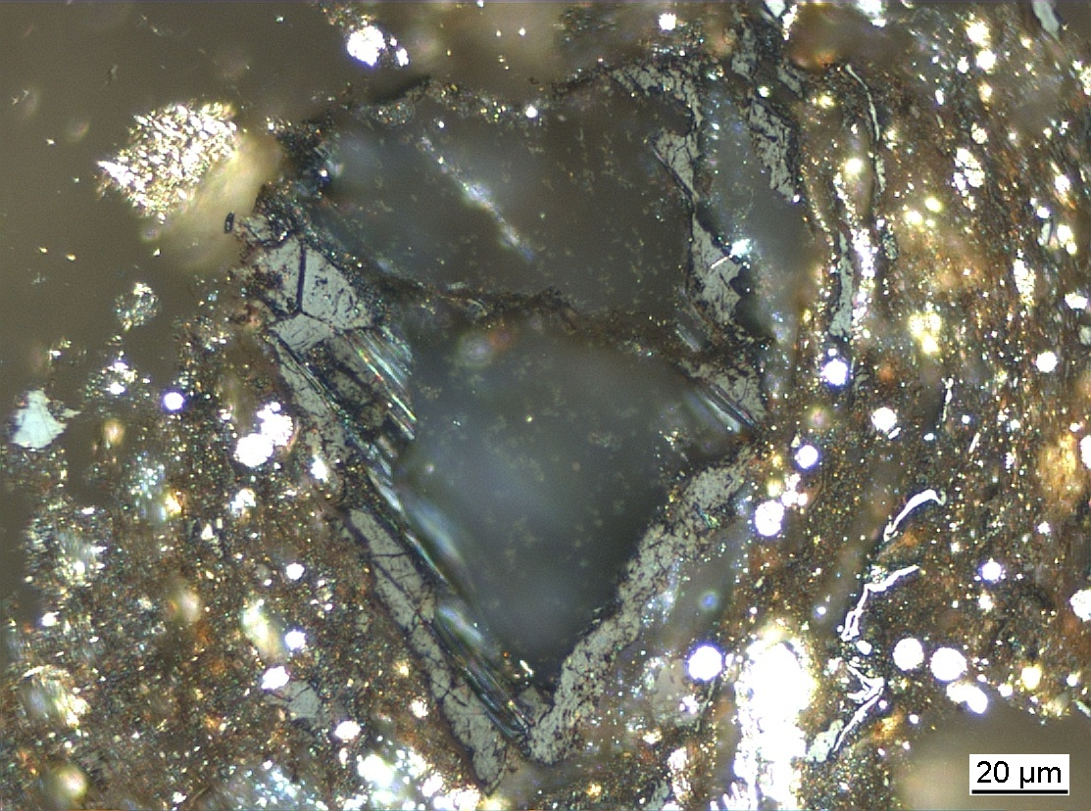
Commission II: Identification of Dispersed Organic Matter WG
2023 Round Robin Exercise:
Solid bitumen – whole rock sample – dry polishing
sb
sb
Meeting of ICCP IDOM WG 19.09.2023 – Joint 74th ICCP and 39th TSOP Meeting, Patras, 2023
Notes:
Fibered light sources of a given specification depending on the bulb type, wavelength, output mode and measurement type (Absorbance, Fluorescence, Reflectance, Transmission or Calibration and with options for UV, Visible
Tungsten HalogenHL-2000 – red
Deuterium Tungsten HalogenDH-2000-BAL – blue

Slide 27
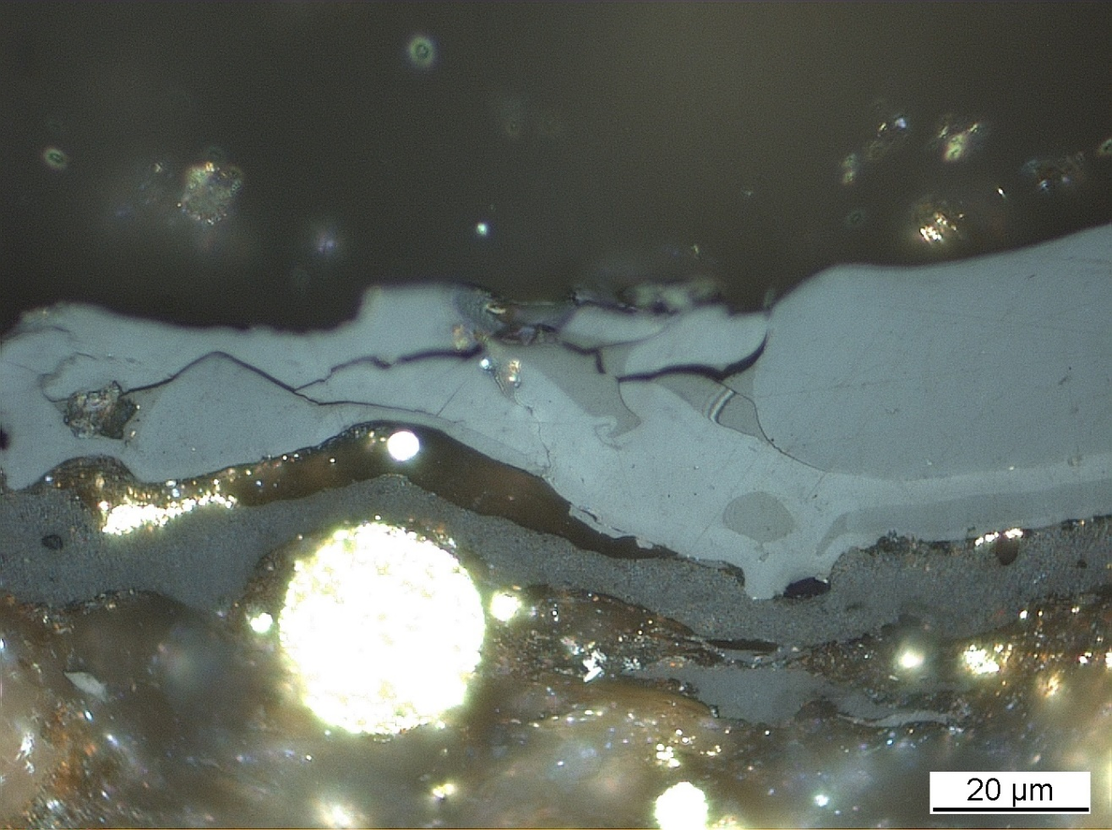
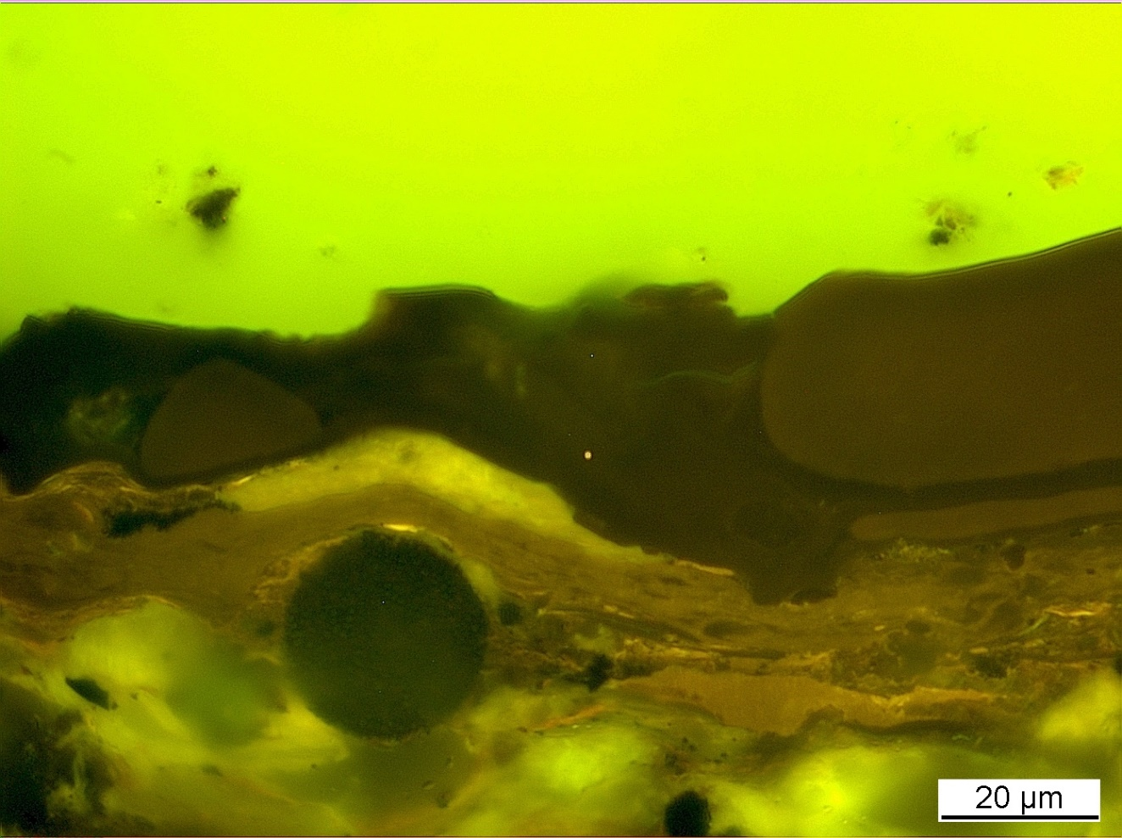
Commission II: Identification of Dispersed Organic Matter WG
2023 Round Robin Exercise:
Solid bitumen – whole rock sample – dry polishing
sb
sb
sb
sb
sb
sb
Meeting of ICCP IDOM WG 19.09.2023 – Joint 74th ICCP and 39th TSOP Meeting, Patras, 2023
Notes:
Fibered light sources of a given specification depending on the bulb type, wavelength, output mode and measurement type (Absorbance, Fluorescence, Reflectance, Transmission or Calibration and with options for UV, Visible
Tungsten HalogenHL-2000 – red
Deuterium Tungsten HalogenDH-2000-BAL – blue

Slide 28
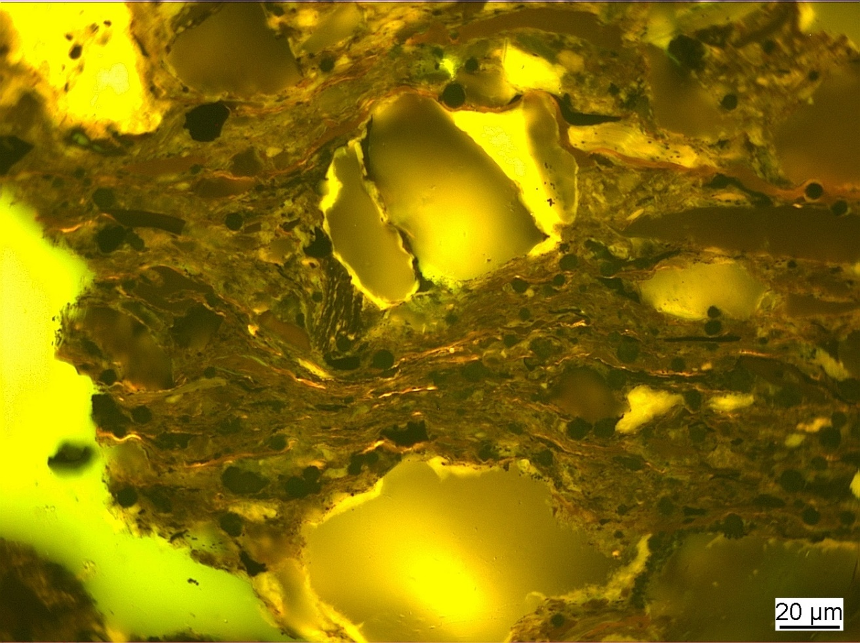
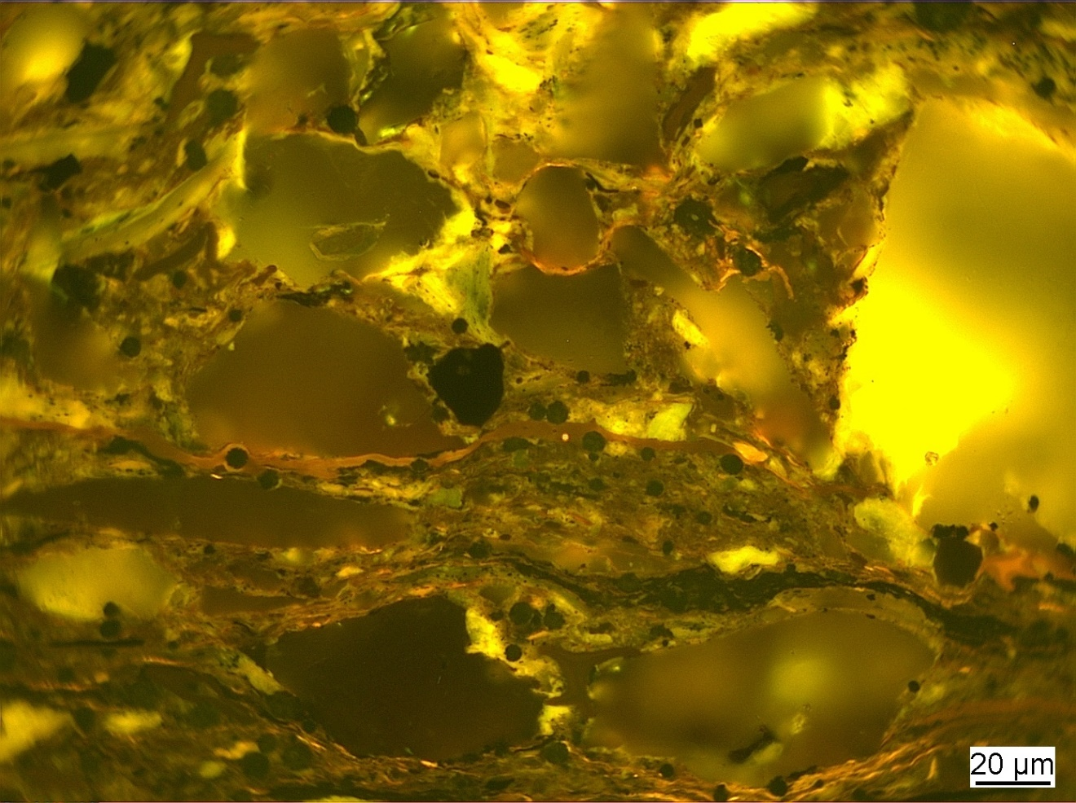
Commission II: Identification of Dispersed Organic Matter WG
2023 Round Robin Exercise:
Solid bitumen – whole rock sample – dry polishing
sb
sb
Meeting of ICCP IDOM WG 19.09.2023 – Joint 74th ICCP and 39th TSOP Meeting, Patras, 2023
Notes:
Fibered light sources of a given specification depending on the bulb type, wavelength, output mode and measurement type (Absorbance, Fluorescence, Reflectance, Transmission or Calibration and with options for UV, Visible
Tungsten HalogenHL-2000 – red
Deuterium Tungsten HalogenDH-2000-BAL – blue

Slide 29
Commission II: Identification of Dispersed Organic Matter WG
2023 Round Robin Exercise:
Solid bitumen – whole rock sample – dry polishing
sb
sb
Meeting of ICCP IDOM WG 19.09.2023 – Joint 74th ICCP and 39th TSOP Meeting, Patras, 2023
Notes:
Fibered light sources of a given specification depending on the bulb type, wavelength, output mode and measurement type (Absorbance, Fluorescence, Reflectance, Transmission or Calibration and with options for UV, Visible
Tungsten HalogenHL-2000 – red
Deuterium Tungsten HalogenDH-2000-BAL – blue

Slide 30
Commission II: Identification of Dispersed Organic Matter WG
2023 Round Robin Exercise:
Solid bitumen – whole rock sample – dry polishing
sb
sb
Meeting of ICCP IDOM WG 19.09.2023 – Joint 74th ICCP and 39th TSOP Meeting, Patras, 2023
Notes:
Fibered light sources of a given specification depending on the bulb type, wavelength, output mode and measurement type (Absorbance, Fluorescence, Reflectance, Transmission or Calibration and with options for UV, Visible
Tungsten HalogenHL-2000 – red
Deuterium Tungsten HalogenDH-2000-BAL – blue

Slide 31
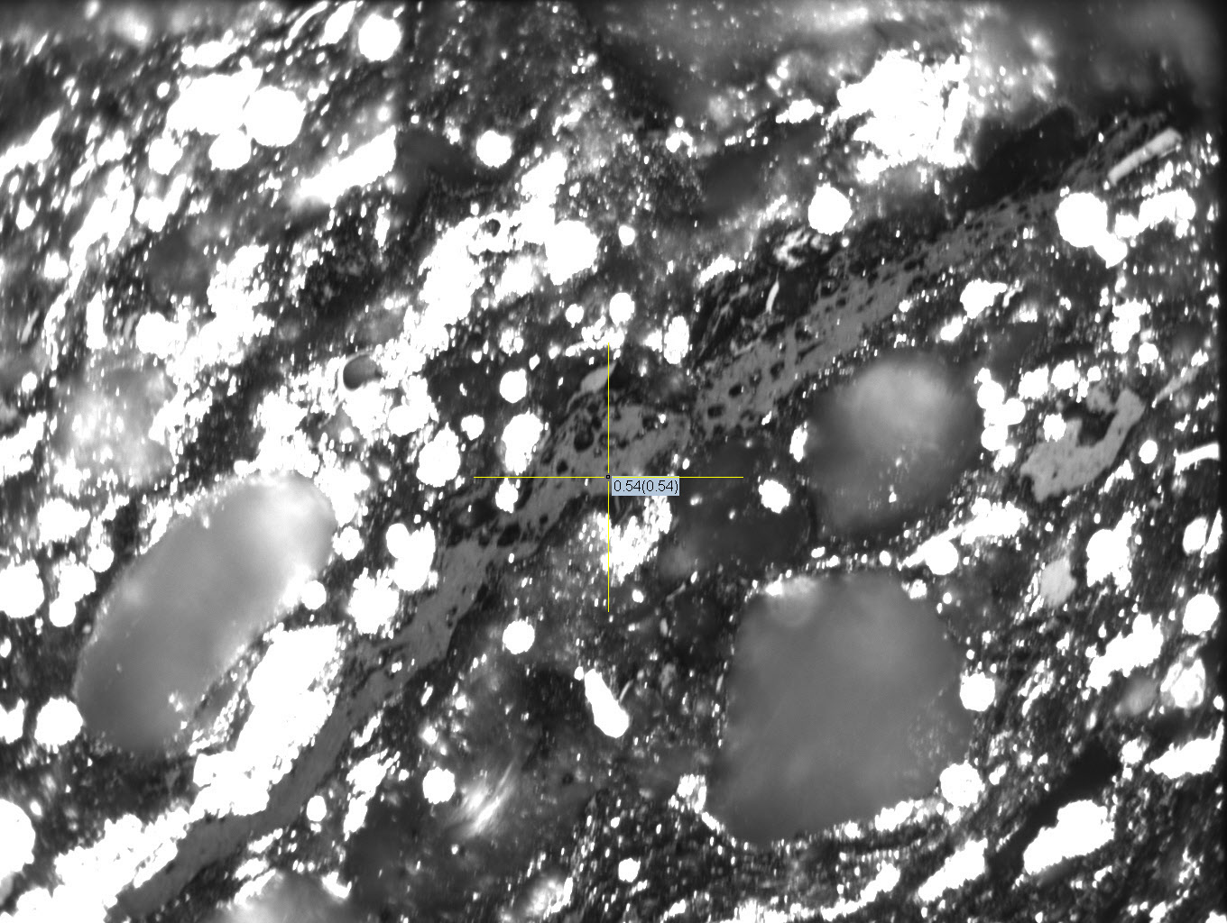
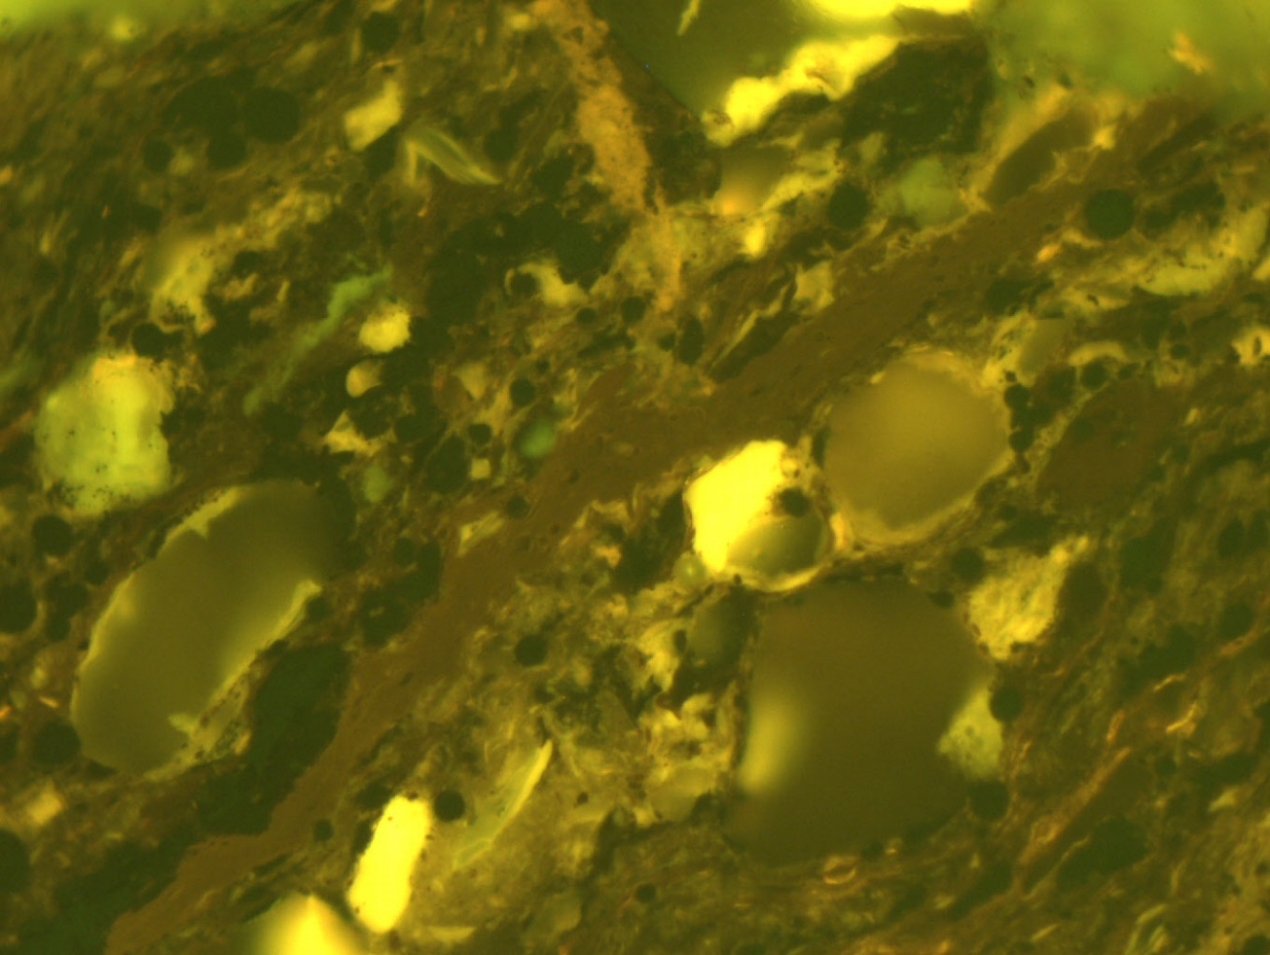
Commission II: Identification of Dispersed Organic Matter WG
2023 Round Robin Exercise:
Solid bitumen – whole rock sample – dry polishing
sb
sb
Meeting of ICCP IDOM WG 19.09.2023 – Joint 74th ICCP and 39th TSOP Meeting, Patras, 2023
Notes:
Fibered light sources of a given specification depending on the bulb type, wavelength, output mode and measurement type (Absorbance, Fluorescence, Reflectance, Transmission or Calibration and with options for UV, Visible
Tungsten HalogenHL-2000 – red
Deuterium Tungsten HalogenDH-2000-BAL – blue

Slide 32
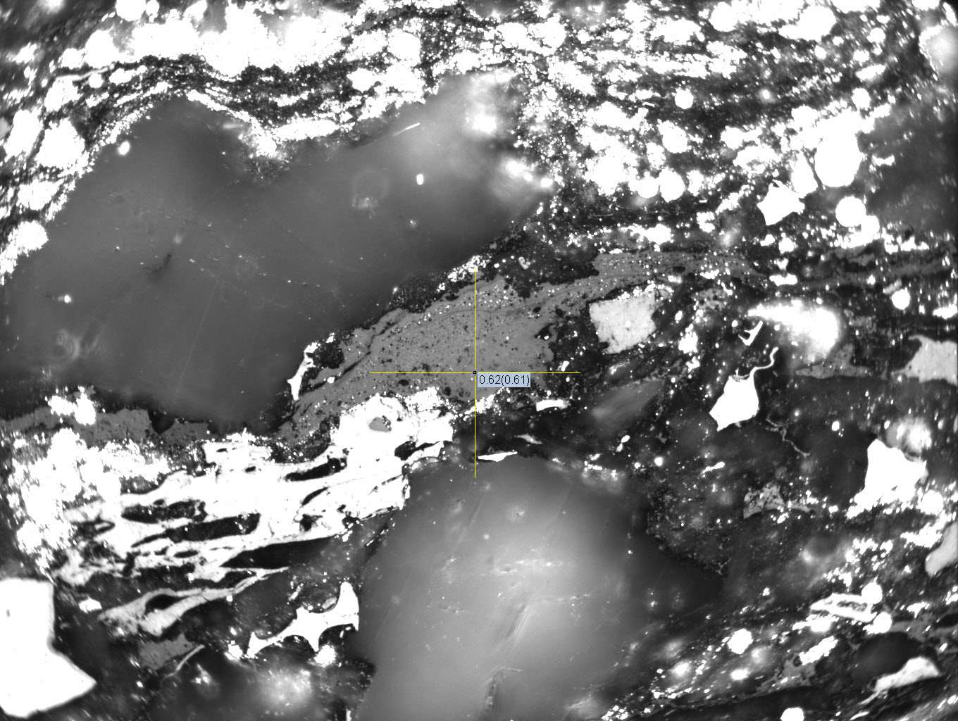
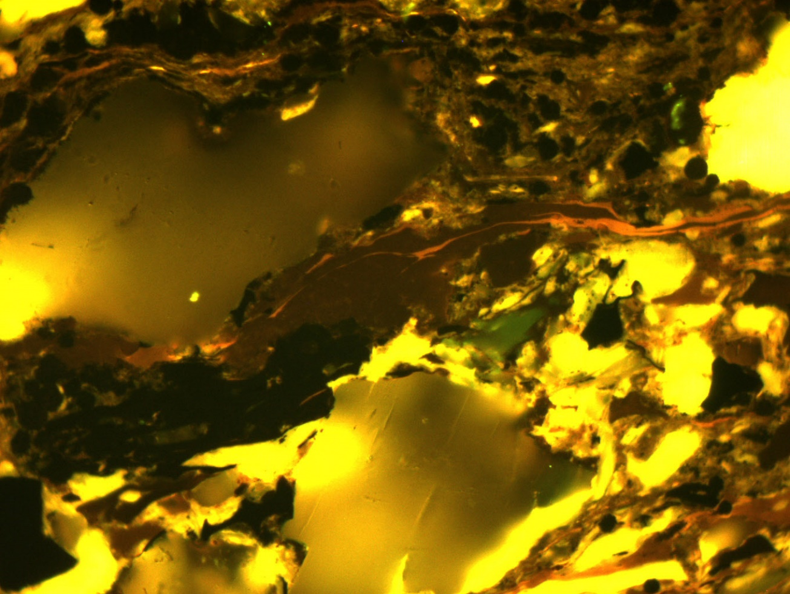
Commission II: Identification of Dispersed Organic Matter WG
2023 Round Robin Exercise:
Solid bitumen – whole rock sample – dry polishing
sb
sb
Meeting of ICCP IDOM WG 19.09.2023 – Joint 74th ICCP and 39th TSOP Meeting, Patras, 2023
Notes:
Fibered light sources of a given specification depending on the bulb type, wavelength, output mode and measurement type (Absorbance, Fluorescence, Reflectance, Transmission or Calibration and with options for UV, Visible
Tungsten HalogenHL-2000 – red
Deuterium Tungsten HalogenDH-2000-BAL – blue

Slide 33
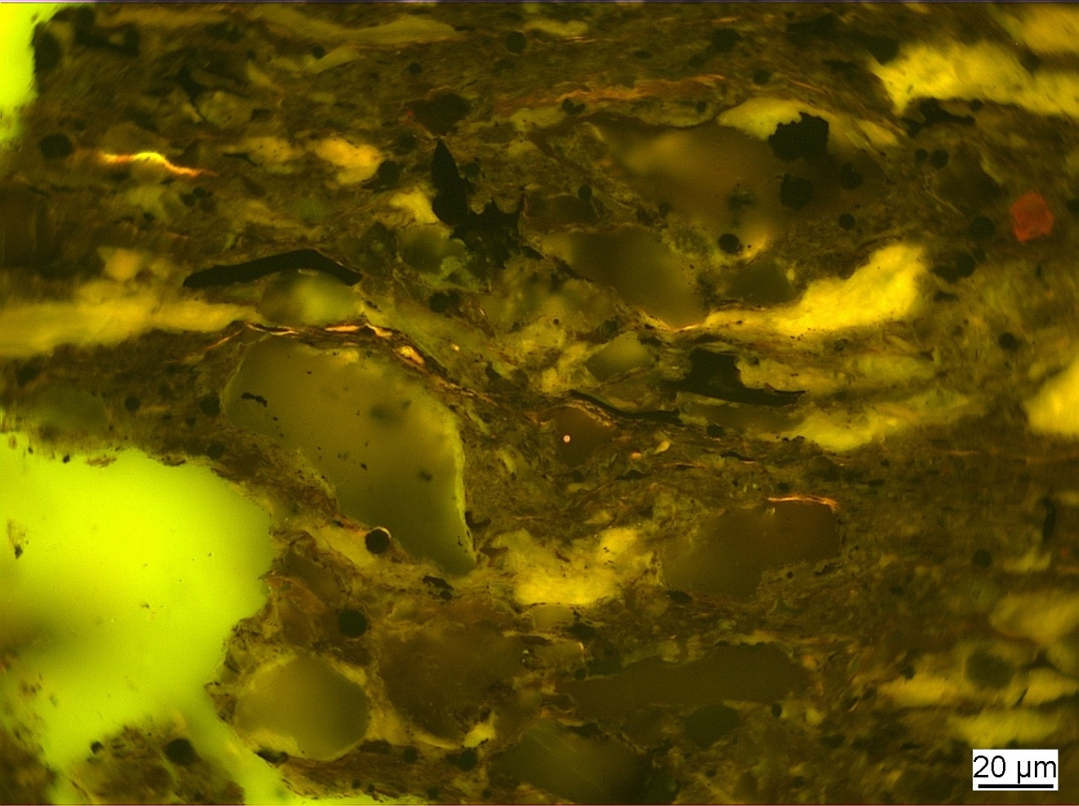
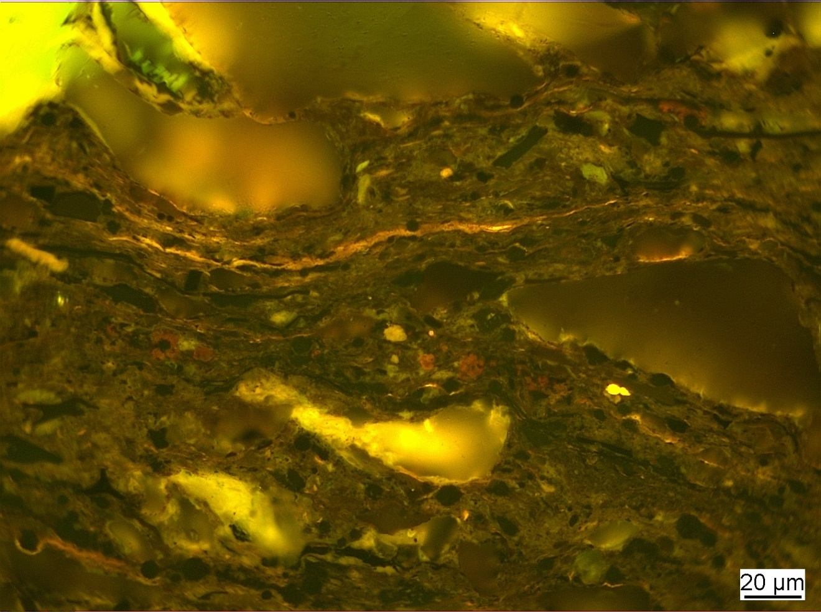
Commission II: Identification of Dispersed Organic Matter WG
2023 Round Robin Exercise:
Lamalginite – whole rock sample – dry polishing
Lam
B-ite
B-ite
Meeting of ICCP IDOM WG 19.09.2023 – Joint 74th ICCP and 39th TSOP Meeting, Patras, 2023
Notes:
Fibered light sources of a given specification depending on the bulb type, wavelength, output mode and measurement type (Absorbance, Fluorescence, Reflectance, Transmission or Calibration and with options for UV, Visible
Tungsten HalogenHL-2000 – red
Deuterium Tungsten HalogenDH-2000-BAL – blue

Slide 34
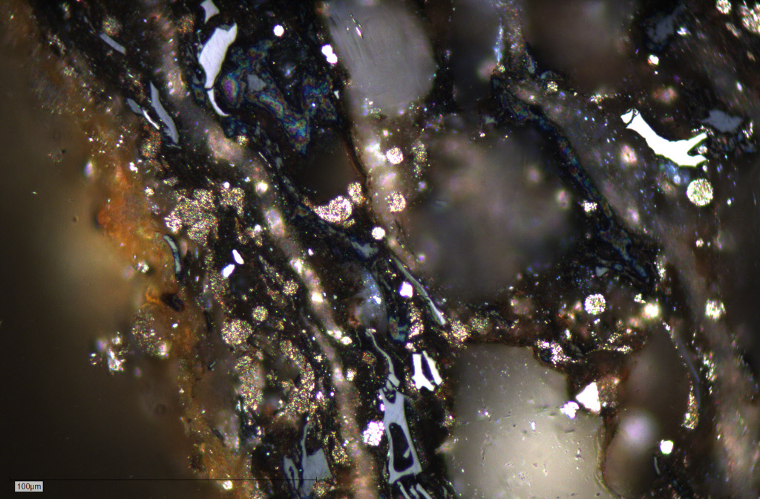
Commission II: Identification of Dispersed Organic Matter WG
2023 Round Robin Exercise:
Vitrinite – whole rock sample – dry polishing
No evidence for scratches, plucking, or topographic relief, unlike in the prior preparation.
Presence of tarnish residues was avoided for reflectance measurement and description of vitrinite and bituminite.
Vitrinite particles being more available for the reflectance measurements.
Improved the surface quality of both vitrinite and bituminite for reflectance measurements.
Increased ability of a participant to discern between vitrinite and other components in the sample.
Meeting of ICCP IDOM WG 19.09.2023 – Joint 74th ICCP and 39th TSOP Meeting, Patras, 2023
Notes:
Fibered light sources of a given specification depending on the bulb type, wavelength, output mode and measurement type (Absorbance, Fluorescence, Reflectance, Transmission or Calibration and with options for UV, Visible
Tungsten HalogenHL-2000 – red
Deuterium Tungsten HalogenDH-2000-BAL – blue

Slide 35
Commission II: Identification of Dispersed Organic Matter WG
2023 Round Robin Exercise: raw data (N-16)
Bituminite – whole rock sample – dry polished
GM – 0.34% (0.13 – 0.49%)
GSD – 0.094
PSD – 0.019– 0.142
Three high UMSDs (1.601≥ UMSD ≤2.181)
2020 Round Robin Exercise: raw data (N-19)
Bituminite – whole rock sample – wet polished
GM – 0.35% (0.09 – 0.59%)
GSD – 0.170
PSD – 0.043 – 0.283
Two high UMSDs (1.497≥PSD≤1.556)
Median (0.378)
Median (0.413)
Meeting of ICCP IDOM WG 19.09.2023 – Joint 74th ICCP and 39th TSOP Meeting, Patras, 2023
Notes:
Fibered light sources of a given specification depending on the bulb type, wavelength, output mode and measurement type (Absorbance, Fluorescence, Reflectance, Transmission or Calibration and with options for UV, Visible
Tungsten HalogenHL-2000 – red
Deuterium Tungsten HalogenDH-2000-BAL – blue

Slide 36
Commission II: Identification of Dispersed Organic Matter WG
2023 Round Robin Exercise: Difference in VRr % 2023 (dry polishing) vs. VRr % 2020 (wet polishing).
eg.: 0.07 = difference in BRr(%)
N=16
Very high scatter of VRr (%) around iso-line.
Lower BRr in dry than VRr in wet-polishing with difference ≤ 0.21 % for half of values.
Only 4 values above the iso-line.
Only 3 values at the iso-line.
0.18
0.31
0.20
0.11
0.21
0.07
0.20
Meeting of ICCP IDOM WG 19.09.2023 – Joint 74th ICCP and 39th TSOP Meeting, Patras, 2023
Notes:
Fibered light sources of a given specification depending on the bulb type, wavelength, output mode and measurement type (Absorbance, Fluorescence, Reflectance, Transmission or Calibration and with options for UV, Visible
Tungsten HalogenHL-2000 – red
Deuterium Tungsten HalogenDH-2000-BAL – blue

Slide 37
Commission II: Identification of Dispersed Organic Matter WG
2023 Round Robin Exercise: raw data
Bituminite – whole rock sample – dry polished
2022 Round Robin Exercise: raw data
Bituminite – whole rock sample – wet polished
Class: 0.05
Class: 0.05
Anomalous
population
(0.58-59% BRr)
MD=0.378
Anomalous
population
(0.14; 0.49% VRr)
(High SMSD)
MD=0.413
Meeting of ICCP IDOM WG 19.09.2023 – Joint 74th ICCP and 39th TSOP Meeting, Patras, 2023
Notes:
Fibered light sources of a given specification depending on the bulb type, wavelength, output mode and measurement type (Absorbance, Fluorescence, Reflectance, Transmission or Calibration and with options for UV, Visible
Tungsten HalogenHL-2000 – red
Deuterium Tungsten HalogenDH-2000-BAL – blue

Slide 38
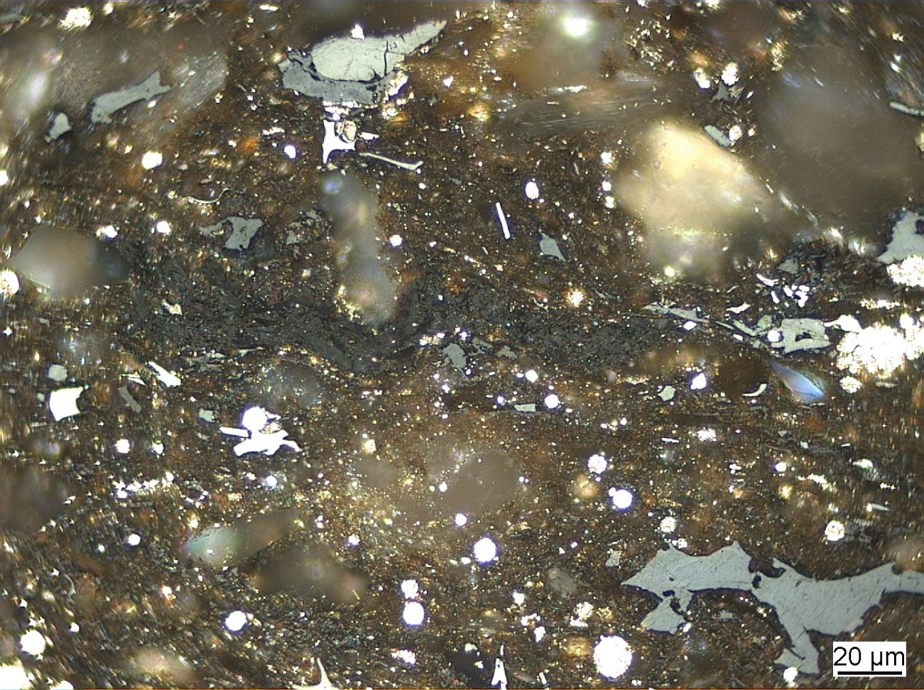
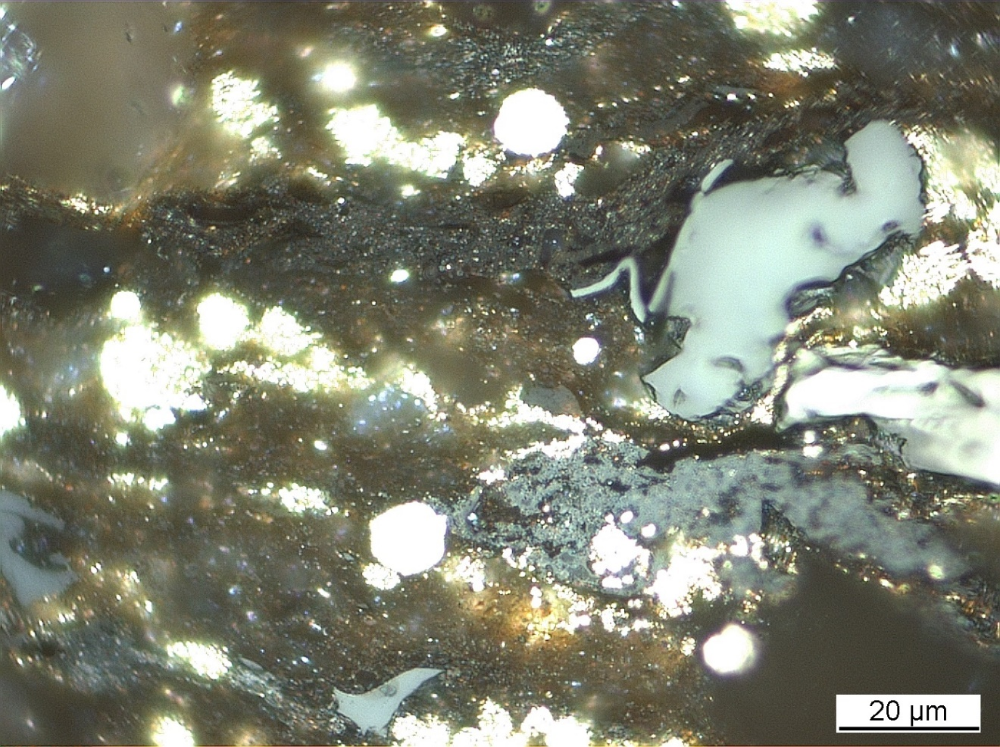
Commission II: Identification of Dispersed Organic Matter WG
2023 Round Robin Exercise:
Bituminite – whole rock sample – dry polishing
B-ite
B-ite
Meeting of ICCP IDOM WG 19.09.2023 – Joint 74th ICCP and 39th TSOP Meeting, Patras, 2023
Notes:
Fibered light sources of a given specification depending on the bulb type, wavelength, output mode and measurement type (Absorbance, Fluorescence, Reflectance, Transmission or Calibration and with options for UV, Visible
Tungsten HalogenHL-2000 – red
Deuterium Tungsten HalogenDH-2000-BAL – blue

Slide 39

Thank you very much for your attention!
Meeting of ICCP IDOM WG 19.09.2023 – Joint 74th ICCP and 39th TSOP Meeting, Patras, 2023

Slide 40
Impressum
Herausgeber:
Bundesanstalt für Geowissenschaften und Rohstoffe
Stilleweg 2
30655 Hannover
Contact:
Dr. Jolanta Kus
Jolanta.Kus@bgr.de
Joint 74th ICCP and 39th TSOP Meeting, Patras, Greece, 2023
ICCP Commission II
Dispersed organic matter in sedimentary rocks WG
Stand: August 2023
Meeting of ICCP IDOM WG 19.09.2023 – Joint 74th ICCP and 39th TSOP Meeting, Patras, 2023

