Slide 1
ICCP Working Group Identification of Thermal Maturity Relevant Organic Matter 2023 Report
Paul C. Hackley - U.S. Geological Survey, Reston, Virginia, USA
Presented for ICCP Commission II, September, 2023

Slide 2
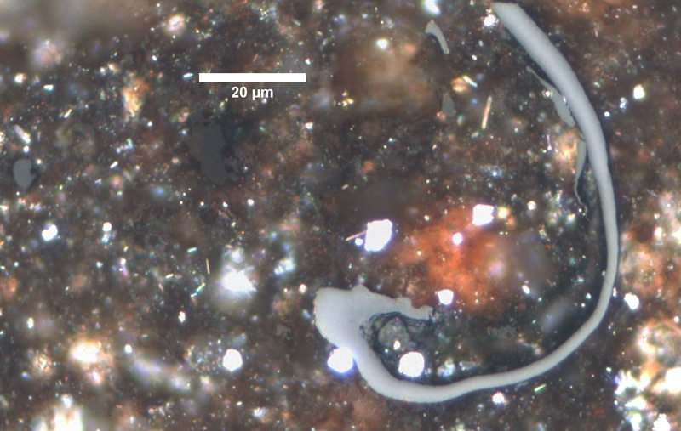
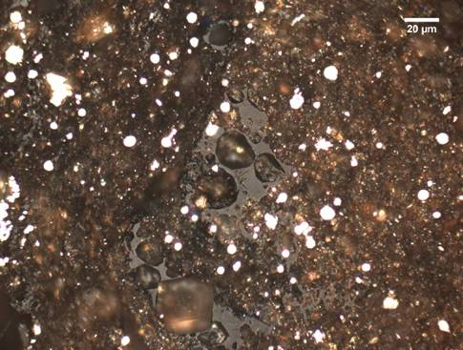
Outline of this presentation
Problem to be solved
History of the working group
Updates since 2022:
ASTM D7708 renewal ballot
Fixes related to renewal ballot
Summary & proposal for new activities
Vitrinite?
Vitrinite?
Presented for ICCP, September, 2023

Slide 3
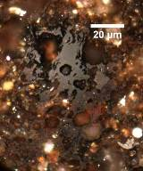
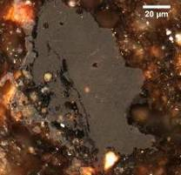
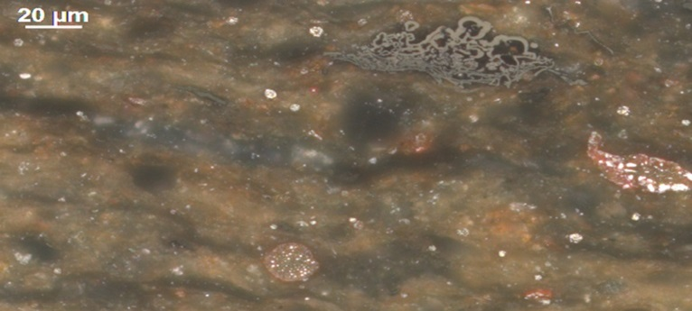
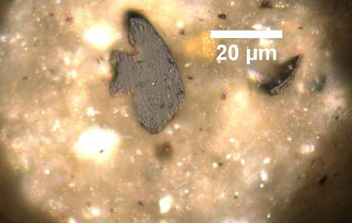
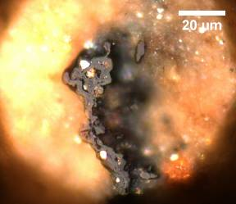
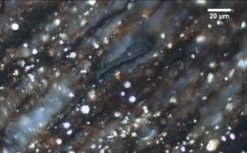
Objective of the working group
Provide guidelines for identification of thermal maturity relevant organic matter population in dispersed organic matter
Vitrinite?
Vitrinite?
Vitrinite?
Vitrinite?
Vitrinite?
Vitrinite?
Presented for ICCP, September, 2023

Slide 4
History of the working group
Proposed by Angeles Borrego 2008 Oviedo
DOMVR survey 2009 Gramado, ICCP News No. 48
ASTM standard D7708 in 2011 ASTM Standards (230 citations)
Oviedo 2008
Gramado 2009
Belgrade 2010
Porto 2011

Slide 5
History of the working group, cont.
ASTM D7708 interlaboratory study (ILS) in 2012-2013
ILS results presented ICCP, Sosnowiec 2013
ILS results presented AAPG, Houston, USA, 2014
ILS results used to update ASTM D7708
ILS results published in J. Marine and Petroleum Geology, 2015 (145 citations)
Porto 2011
Beijing 2012
Sosnowiec 2013
Kolkata 2014
Potsdam 2015

Slide 6
History of the working group cont.
Second interlaboratory study, 2015-2016
Results presented ICCP, Houston 2016
Discussions at ICCP, 2017-2018
Manuscript published, Marine & Pet. Geol., April 2020 (24 citations)
Major renovations (over 100 changes) to ASTM D7708 standard in 2022
Potsdam 2015
Houston 2016
Bucharest 2017
Brisbane 2018
The Hague 2019
Prague 2021
N. Delhi 2022

Slide 7
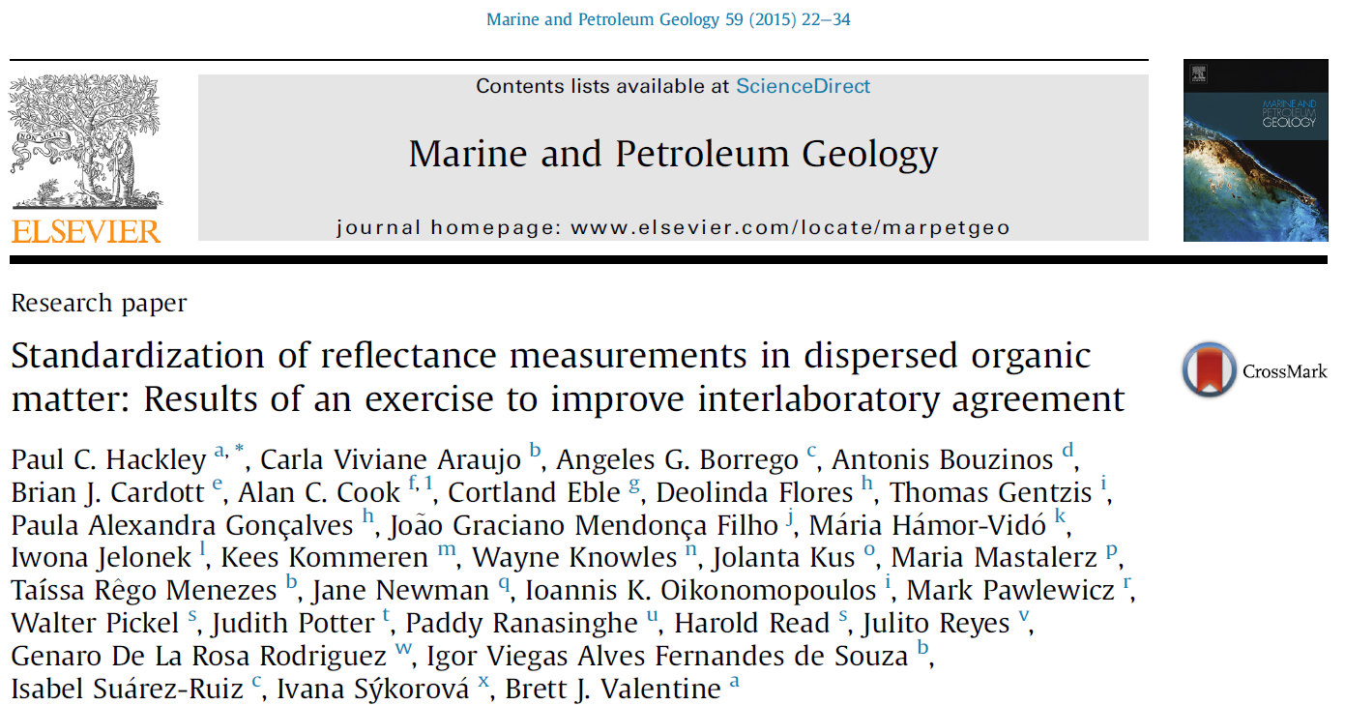
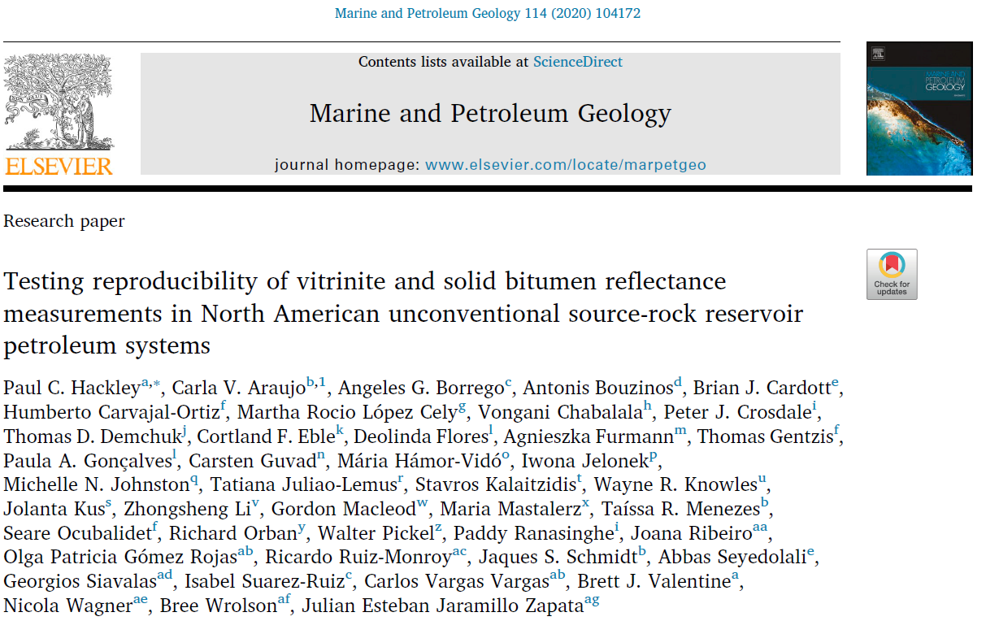
Summary of working group products
Presented for ICCP, September, 2023

Slide 8
Updates since 2022
The webpage was updated with recent activities and files
Negotiations with negative voters from the ASTM D7708 renovation were completed
A non-persuasive finding was balloted on one of the negative voters
Three new ballots were necessary to resolve technical comments/other negative votes received during the major renovation in 2022
Presented for ICCP, September, 2023

Slide 9
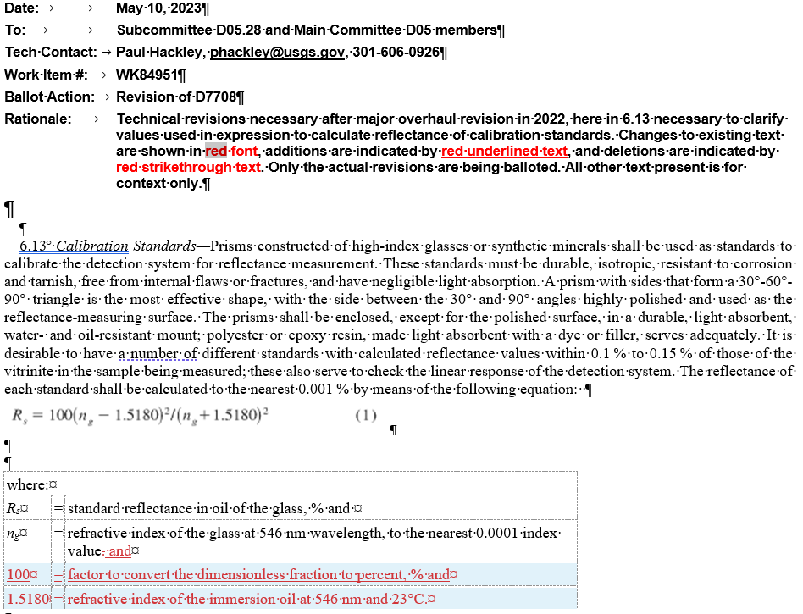
ASTM D7708 ballots in 2023
Example ballot item
Presented for ICCP, September, 2023

Slide 10
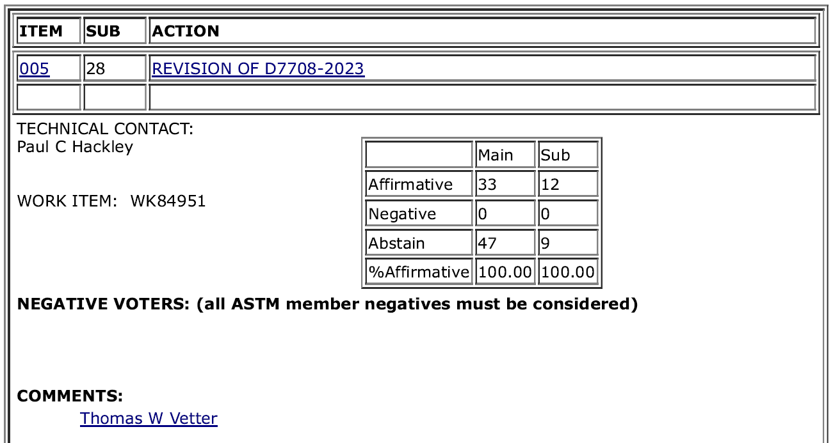
ASTM D7708 ballots in 2023
Example ballot result
Presented for ICCP, September, 2023

Slide 11
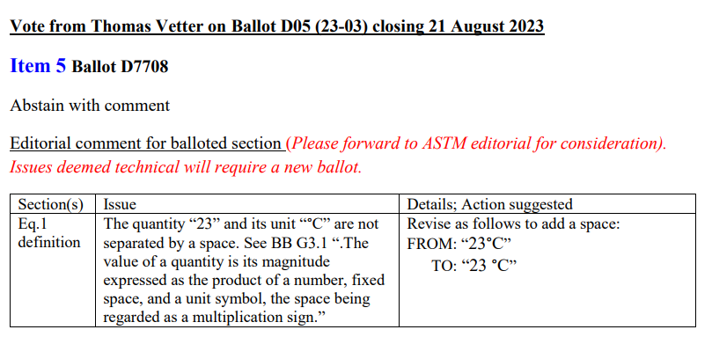
ASTM D7708 ballots in 2023
Example Comment
Presented for ICCP, September, 2023

Slide 12
ASTM D7708 renewal ballot
Non-persuasive finding on negative vote
Voter was against language related to rotating polarizer which they thought could exclude some laboratories from performing the analysis:
Romax measurement should not be limited to “using a fixed microscope stage and a rotating polarizer” since “a rotary stage and fixed polarizer” should also be included for measuring the Romax.
Voter declined to withdraw negative
Presented for ICCP, September, 2023

Slide 13
ASTM D7708 renewal ballot
Rationale for non-persuasive on negative vote:
The rationale for finding the negative not persuasive is that there are currently no laboratories worldwide which make this measurement using a rotating stage, because of its difficulty, and the solution is to use a fixed stage with a rotating polarizer as balloted. Therefore, no laboratories are excluded by the balloted text. If technology should develop in the future to precisely center the rotating stage and objective, and keep the centration, then the updated language to incorporate this future technology for reflectance measurements of dispersed organic matter could be added to the text of the test method so that all laboratories using the future technology are included.
Ballot passed and voter’s negative was found non-persuasive
Presented for ICCP, September, 2023

Slide 14
Proposal for New Activities 2023 onwards
Photograph round robin to identify vitrinite vs solid bitumen
A Hilgers Fossil Student round robin on calibrated images
Continuing maintenance of D7708
Standardization of broad ion beam sample preparation
Difficulties in securing USGS financial support
Valentine & Hackley, 2023
Presented for ICCP, September, 2023

Slide 15
Thanks!
Presented for ICCP, September, 2023

